Slide 1

State of Teachers, Teaching and Teacher Education Report-2023
Review 3 - Editorial Board meeting- 20th October 2023

Slide 2
Agenda
Overall updates
Secondary data: preliminary findings
  UDISE+ data (Comparing with previous report)
  Periodic Labour Force Survey data
  Teacher Eligibility Test main findings
Primary Data: Teacher, Student Teacher
Discussion and feedback of the analysis
Proposed Chapterisation and what to keep with focus on and what to leave out?
Report's release date and possible event (national and regional)

Slide 3
Research questions - A Reminder
The report sets out to examine existing and aspiring teachers (Recent Questions)
Existing teachers
What kinds of teachers are there in the system?
Who are the teachers, what are their characteristics (gender, social, professional)?
Where are they deployed?
What are their employment terms?
Are there adequate teachers?
Do the social and linguistic characteristics of teachers reflect the student/population demography?
Are teachers appropriately qualified for the levels and subjects they teach?
Are teachers teaching subjects and levels for which they are qualified?
Is the profession getting feminised? What are the implications of gender differences in teacher availability and the profession? What are the possible reasons, causes and effects of feminisation?
What are the effects of growth of the private sector on the profession?
What are the effects of state fiscal conditions?
What are the effects of rurality?

Slide 4
Research questions - A Reminder
System
How many and what kinds of teachers are needed in the system?
Does the system have adequate teachers? Where are the shortages? Does the system have excess teachers? Where are the excess teachers? Are these on account of supply, or deployment, or recruitment?
What kinds of teachers are in short supply? What are the reasons for short supply?
Which kinds of schools have inadequate teachers? which regions and which locations have inadequate teachers?
Aspiring teachers
What are the characteristics of teacher aspirants (gender, social, linguistic, qualification?
What do the characteristics tell us about the how aspirational the profession is?
What is the trajectory of becoming a teacher?
Are aspirants for different kinds of requirements/specialisation joining the system? why/why not?

Slide 5
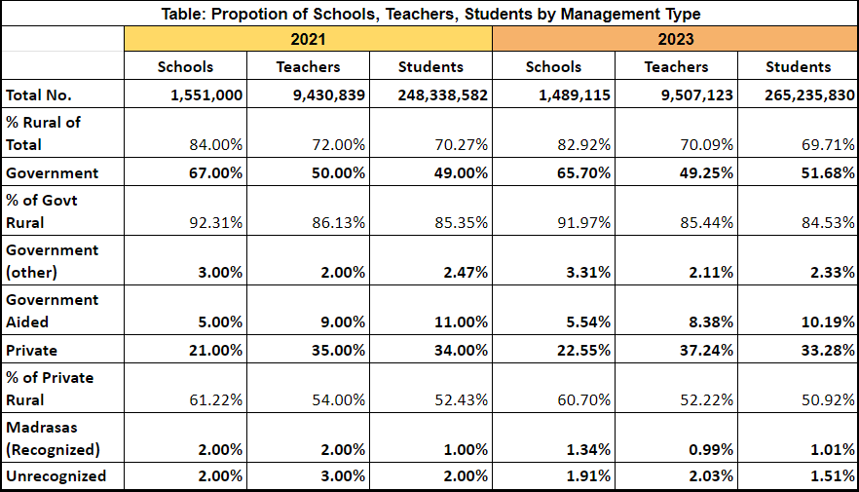
Secondary Data: Preliminary Findings from UDISE+
Key Differences
The data shows that the number of schools have decreased in 2023 and the number of teachers have increased.
We can also note that there is an increase in private schools and private school teachers while we notice there is slight decrease in government schools and government school teachers.

Slide 6
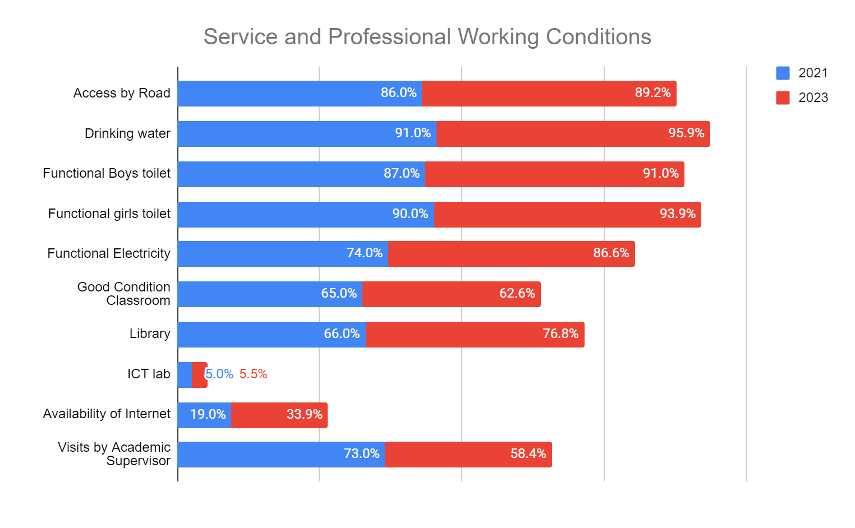
Service and Professional Working Conditions in Schools

Slide 7
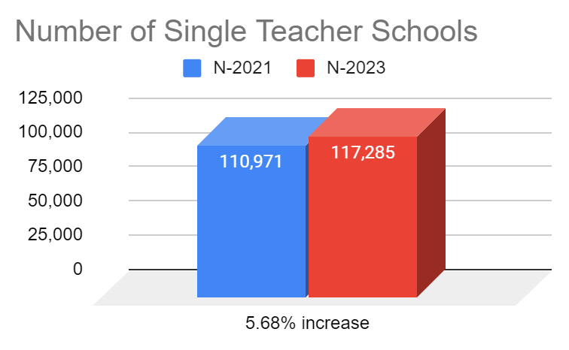
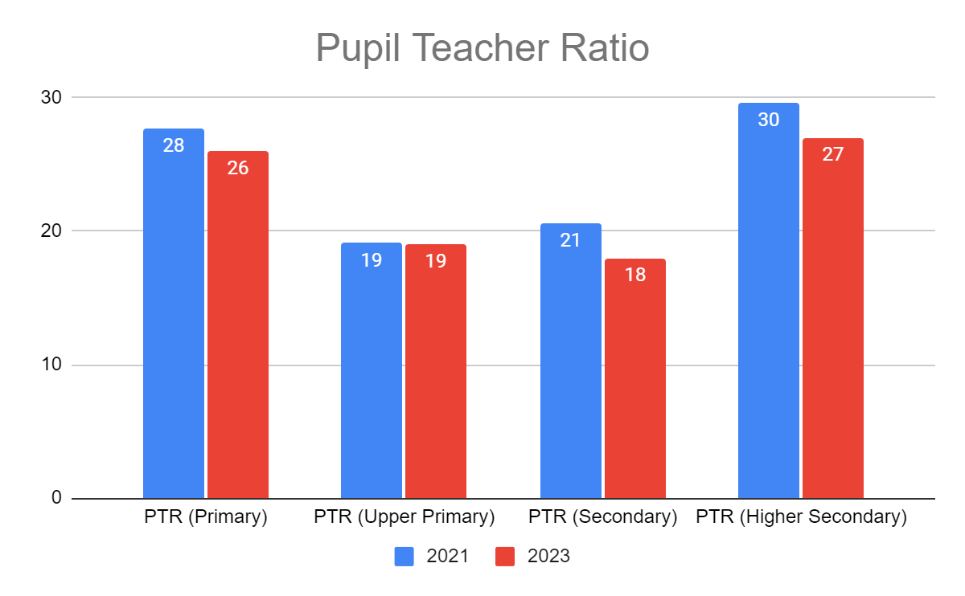
We can note that there is a significant increase in number of single teacher schools from 2018-19 data to 2021-22 data.
Himachal Pradesh (1566 to 3039, ~94%), Punjab (366 to 2523 ~500%), Sikkim (15 to 43 ~186%).
However there was a decrease in the total number of schools and teachers in these states.
The 2021-22 data shows that the gross PTR is 1:28.
There are around 3,52,354 schools having PTR more than 35. 66% of these are government and 20% are private schools.

Slide 8
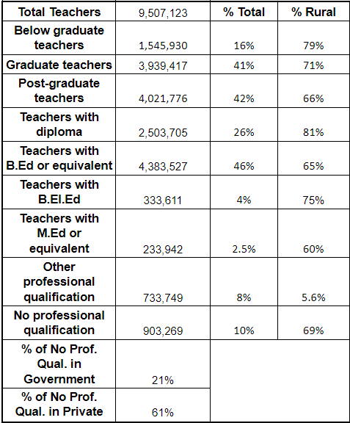
Teacher Professional Qualifications

Slide 9
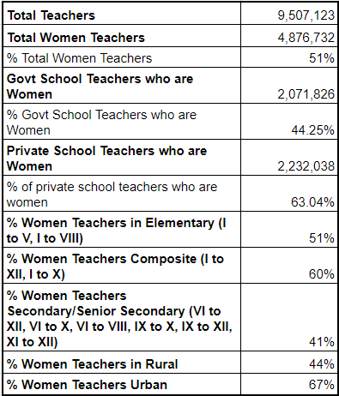
Feminization of Teachers
We notice the overall proportion of women teachers is about 51%.
States like Goa (81%), Chandigarh (81%) Kerala (79%), Puducherry (75%), Punjab (75%) and Tamil Nadu (75%) shows higher feminisation.
States like Tripura (35%), Rajasthan (40%), Jharkhand (40%), Bihar (40%), Assam (41%) shows lower feminization.

Slide 10
Periodic Labour Force Survey: Main Findings
Teacher’s Profile from PLFS 2021-22 Data
Teacher type ((85101+102+211+104+213+222+221+410+420+491+500) | Median age | % women teachers in the respective teacher type | Scheduled Tribes | Scheduled Castes | Other Backward Castes | Others | proportion of workforce in rural locations | Proportion of women among rural teacher workforce | proportion of women among urban teacher workforce
Early Childhood Education | 43 | 91% | 14% | 24% | 35% | 27% | 81% | 82% | 18%
Primary School teacher | 40 | 49% | 13% | 16% | 38% | 33% | 63% | 54% | 46%
General Secondary School | 40 | 43% | 10% | 14% | 39% | 36% | 49% | 36% | 64%
Special education teachers | 33 | 48% | 1% | 44% | 27% | 27% | 56% | 64% | 36%
Vocational education (sec) | 29 | 38% | 1% | 12% | 34% | 54% | 63% | 67% | 33%
Physical Education | 30 | 20% | 1% | 24% | 36% | 38% | 31% | 0% | 100%
Music, Art, Drama | 25 | 68% | 0% | 4% | 16% | 80% | 26% | 32% | 68%
Academic tutoring services | 30 | 53% | 2% | 16% | 28% | 54% | 47% | 42% | 58%
Educational support services | 39 | 38% | 14% | 12% | 39% | 35% | 34% | 22% | 78%
Total 'school' teachers (primary + general secondary) ie B+C | 80 | 46% | 12% | 15% | 39% | 35% | 56% | 45% | 55%
Total teachers (A+B+C+D+E+F+G) | 240 | 51% | 6% | 20% | 32% | 42% | 53% | 48% | 52%
All teachers (85101+102+211+104+213+222+221+410+420+491+500) | 40 | 54% | 11% | 17% | 37% | 35% | 60% | 51% | 59%
Total labour force | 38 | 26% | 11% | 20% | 45% | 24% | 72% | 27% | 22%

Slide 11
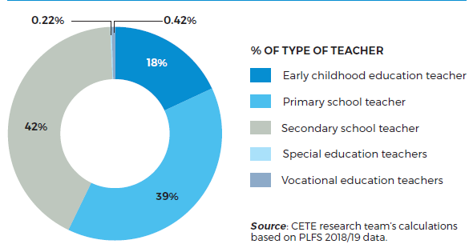
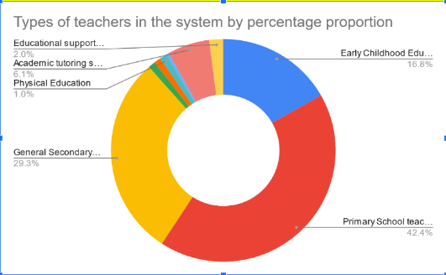
Types of Teacher
Source: CETE research team’s calculations based on PLFS 2021/22 data.

Slide 12
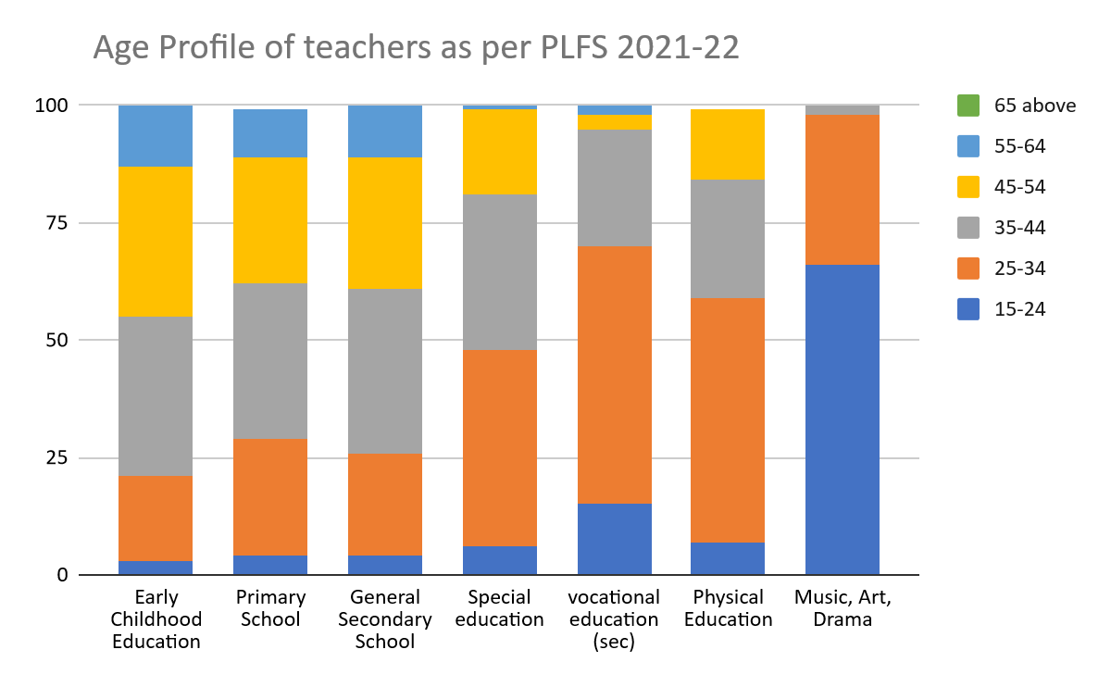
Teacher’s Profile

Slide 13
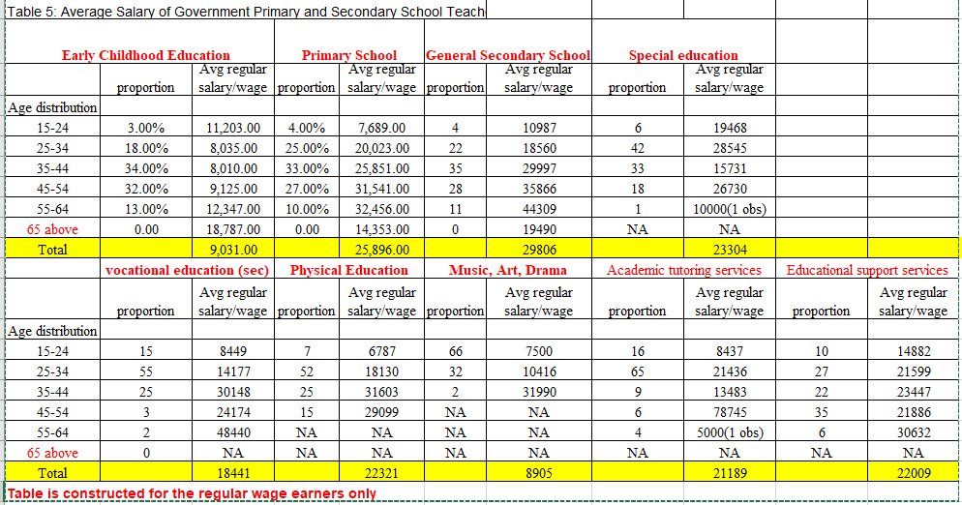

Slide 14
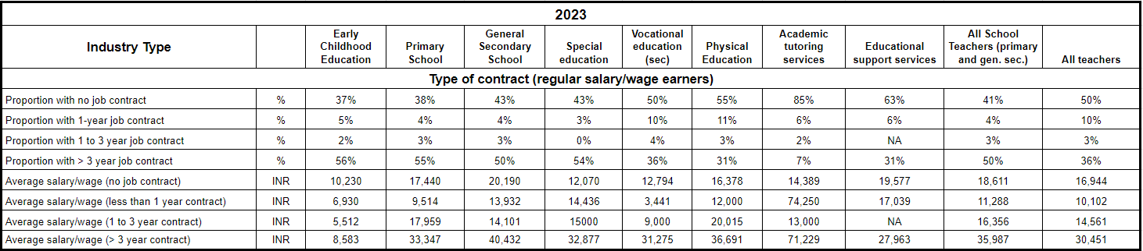
Table 2: Proportions of Teachers Salaries, Social Benefits, Contract Types in Government and Non-government/private Sector Employment

Slide 15
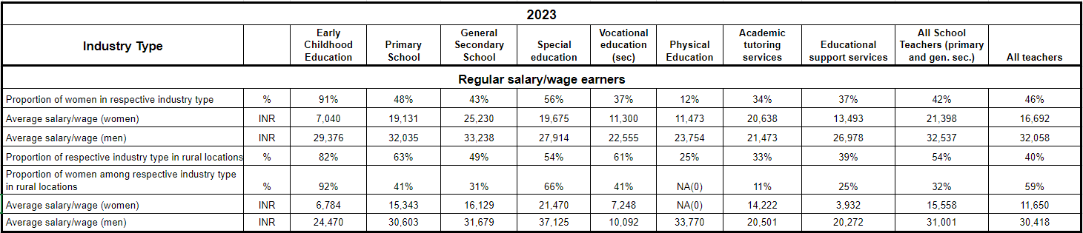
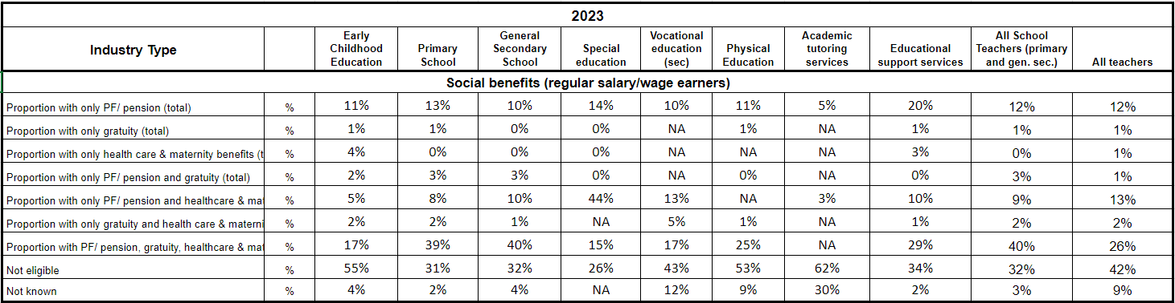

Slide 16
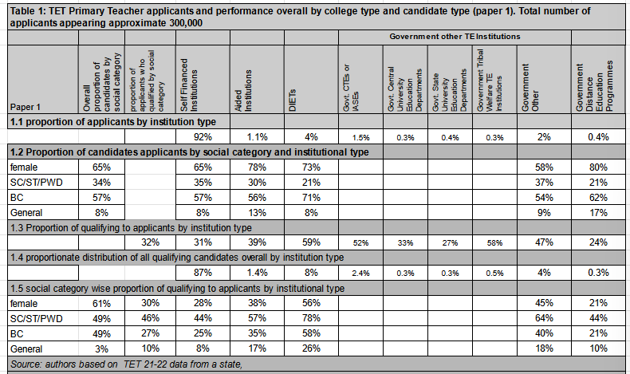
Teacher Eligibility Test main findings-Paper-1

Slide 17
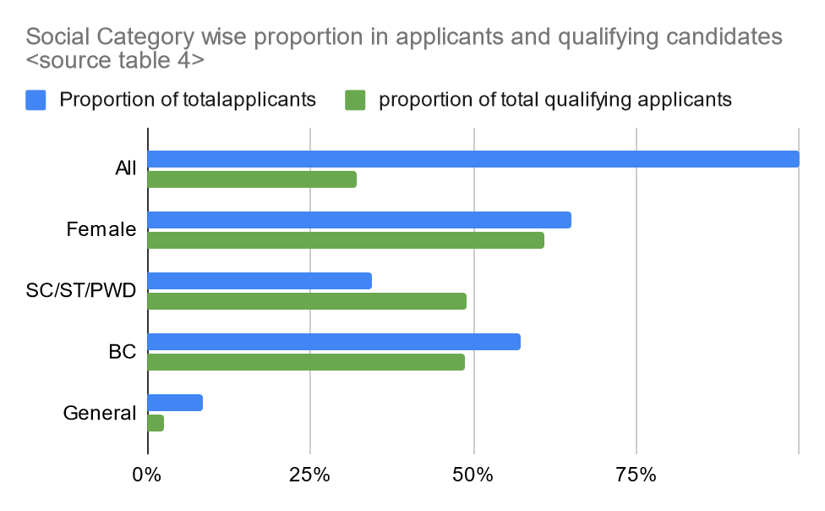
1.1.1 Demographic characteristics of applicants and qualifying candidates- Paper-1
Table 1.1.1
 | women | Social Category |  |  | Overall
 |  | SC/ST | BC | General
State demography (approx.) |  | 24%
TET applicants | 65% | 34% | 57% | 8%
TET proportion of total qualifying candidates social category wise | 61% | 49% | 49% | 3% | 32%

Slide 18
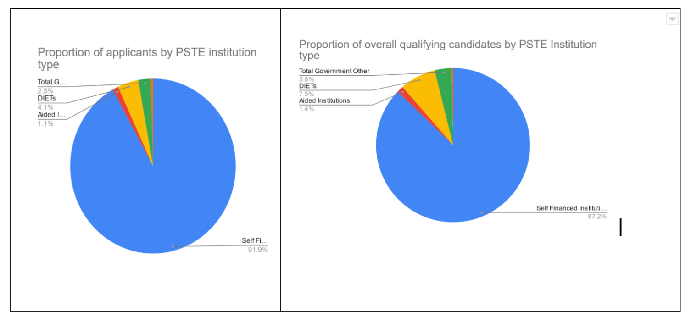
1.1.2 PSTE Institution based analysis of applicants and qualifying candidates- Paper 1

Slide 19
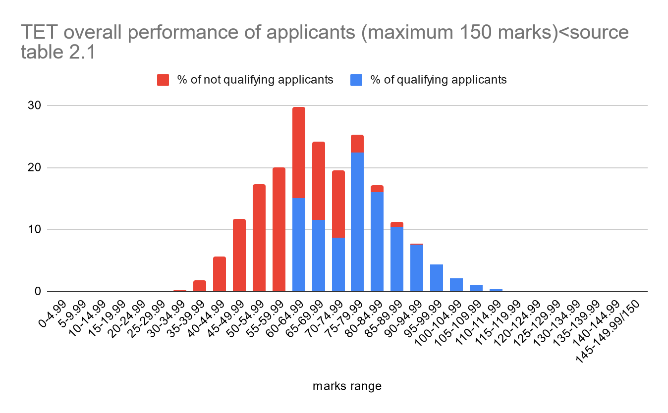
1.1.2 PSTE Institution based analysis of applicants and qualifying candidates- Paper 1
Table 1.1.2
Rank Order |  | overall | female | SC/ST/PWD
1 | DIETs | 59% | 56% | 78%
2 | Government Other | 49% | 45% | 64%
3 | Aided Institutions | 39% | 38% | 57%
 | State overall | 32% | 30% | 46%
4 | Self Financed | 31% | 28% | 44%
5 | University Distance TE programmes | 24% | 21% | 44%

Slide 20
1.2 Quality of candidates based on overall marks obtained in TET- Paper 1
Table 1.2.1
Marks range (max 150) | Pass mark | Marks range in % | % of qualifying candidates in marks range | Notes—which categories and institutions are they mostly from ?
60-74.99 | SC/ST/PWD: 40% | 40% -49.99% | 35.4 | SC/ST/PWD mean: 71 (9)
75-89.99 | BC: 50% | 50%-59.99% | 48.9 | Overall mean 78 (52%) BC mean 84 (8)
90-104.99 | General: 60% | 60%-69.99% | 14.2 | General mean 97 (6)
105-119.99 |  | 70%-79.99% | 1.6
 |  |  | 100%
Source: authors based on analysis of TET data as reported in table 2.1
Table 1.2.2
Selected Sections of the Question paper | Max marks | Mean (SD) for qualifying candidates | Mean (SD) for non qualifying candidates
Overall | 150 | 77.97 (11.32) | 58.56 (10.09)
Child Development | 30 | 13.37 (3.22) | 10 (2.76)
Regional Language | 30 | 17.74 (3.87) | 12.76 (4.17)
English | 30 | 11.69 (3.68) | 9.38 (3.16)
Mathematics content knowledge | 24 | 11.05 (4.68) | 7.45 (3.12)

Slide 21
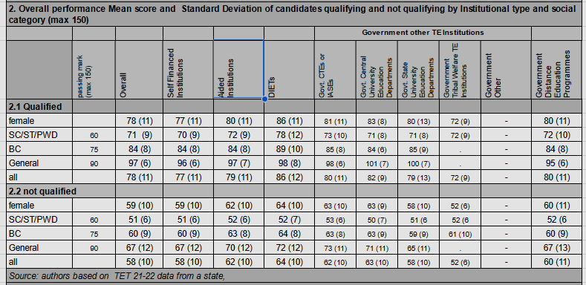

Slide 22
Table 2 comparison of the performance of qualifying candidates institution type wise.
Table 1.2.3
Rank Order |  | overall | female | SC/ST/PWD
1 | DIETs | 86 (12) | 86 (11) | 78 (12)
2 | University Distance TE programmes | 80 (11) | 80 (11) | 72 (10)
3 | Aided Institutions | 79 (11) | 80 (11) | 72 (9)
 | State overall | 78 (11) |  | 71 (9)
4 | Self Financed | 77 (11) | 77 (11) | 70 (9)
Government other category has been left out of this as the means have not been calculated for this group of institutions. Individual institution type means are available in the table 2 and range between maximum of 82 (9) for University Departments and 72(9) for Institutions run by Tribal Welfare Society.

Slide 23
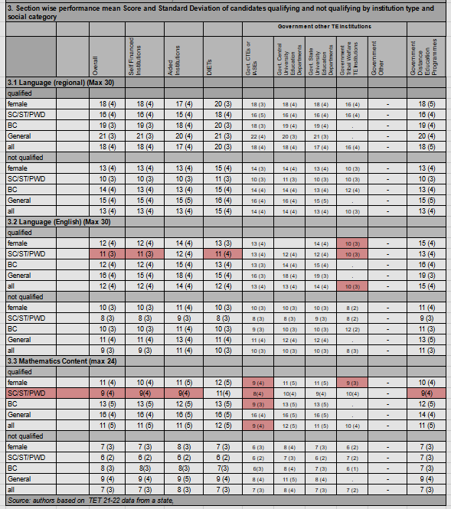

Slide 24
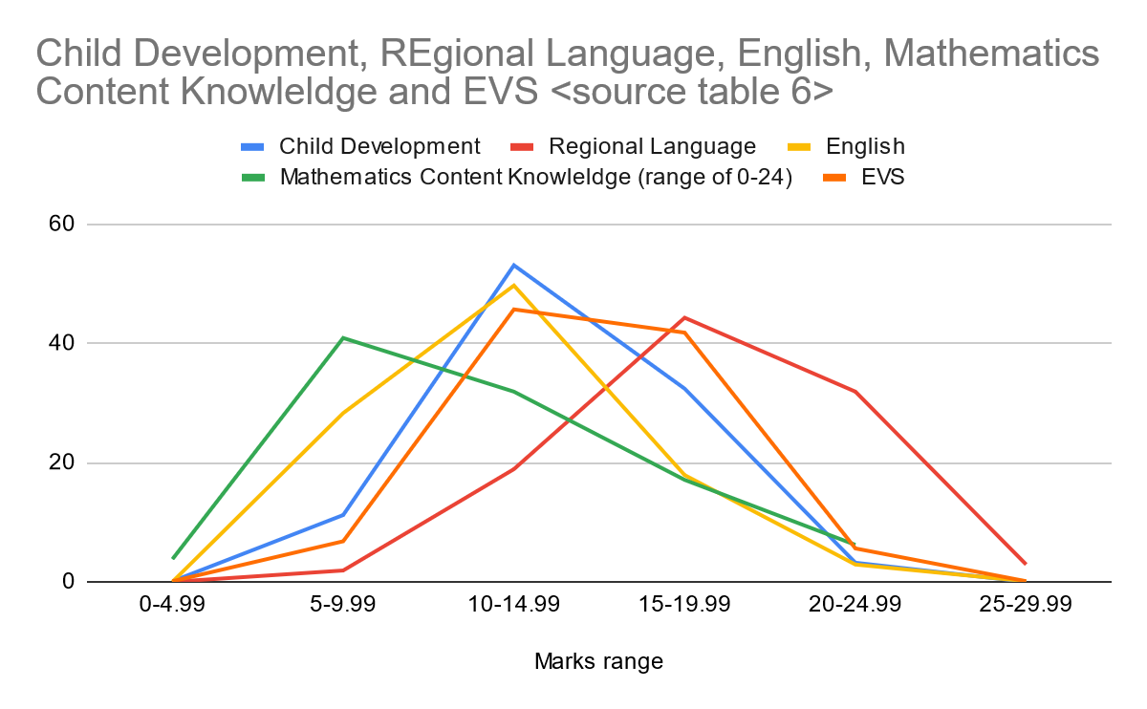

Slide 25
1.2.1 Demographic Characteristics of applicants- Paper 2
Table 1.2.1
 |  | all | women | SC/ST/PWD | BC | General
 | State demography
Science and mathematics | TET applicants |  | 67% | 28% | 60% | 11%
 | TET qualifying candidates | 58% | 61% | 48% | 49% | 2%
Social Sciences | TET applicants |  | 64% | 31% | 59% | 10%
 | TET qualifying candidates | 38% | 61% | 56% | 42% | 1.5%
Table 1.2.2
Rank Order |  | Science and mathematics |  |  | Social sciences
 |  | overall | female | SC/ST/PWD | overall | female | SC/ST/PWD
1 | IASEs CTEs | 78% | 78% | 94% | 57% | 57% | 84%
2 | Aided Institutions | 73% | 71% | 95% | 55% | 53% | 89%
3 | University Distance TE programmes | 69% | 67% | 91% | 52% | 48% | 76%
4 | Government Other | 61% | 58% | 89% | 43% | 43% | 71%
 | State overall | 58% | 54% | 98% | 38% | 36% | 68%
5 | Self Financed | 57% | 54% | 88% | 37% | 35% | 68%

Slide 26
Table 1.2.3 | Science and mathematics |  |  | Social Science
 | all | female | SC/ST/PWD | all | female | SC/ST/PWD
passing marks (max 150) |  |  | 60 |  |  | 60
Govt. CTEs or IASEs | 88 (11) | 88 (11) | 85 (12) | 84 (12) | 84 (12) | 79 (13)
Aided Institutions | 86 (10) | 86 (11) | 83 (12) | 82 (10) | 82 (10) | 78 (11)
Government Distance Education Programmes | 88 (12) | 88 (13) | 84 (13) | 83 (13) | 84 (13) | 78 (14)
Self Financed Institutions | 82 (11) | 82 (11) | 77 (11) | 78 (11) | 79 (11) | 73 (10)
Overall | 82 (11) | 82 (11) | 78 (11) | 78 (11) | 79 (11) | 74 (10)
 | Maximum | TET primary | TET maths and science | TET social sciences
Overall | 150 | 78 (11) | 82 (11) | 78 (11)
Child development | 30
Regional language | 30 | 18 (4) | 21 (4) | 21 (4)
English | 30 | 12 (4) | 13 (4) | 12 (4)
Mathematics content knowledge | 24 | 11 (5) | 12 (5)

Slide 27
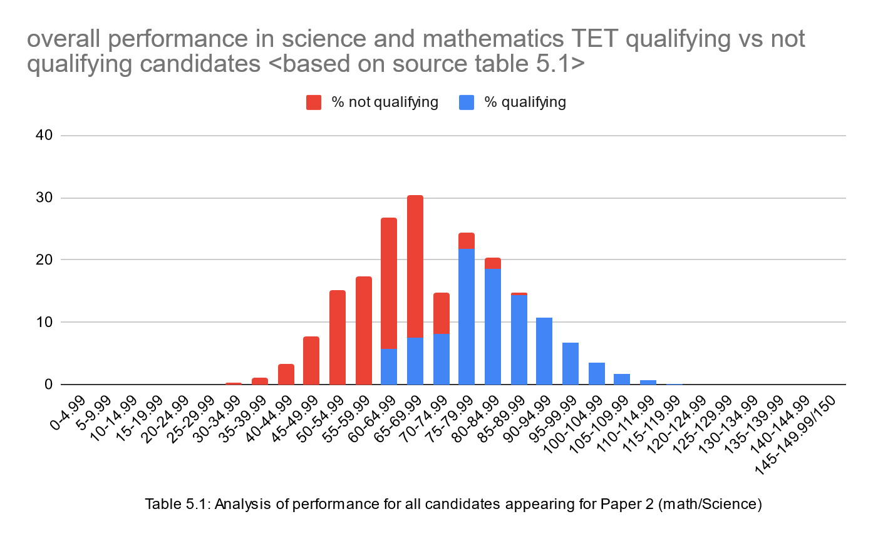
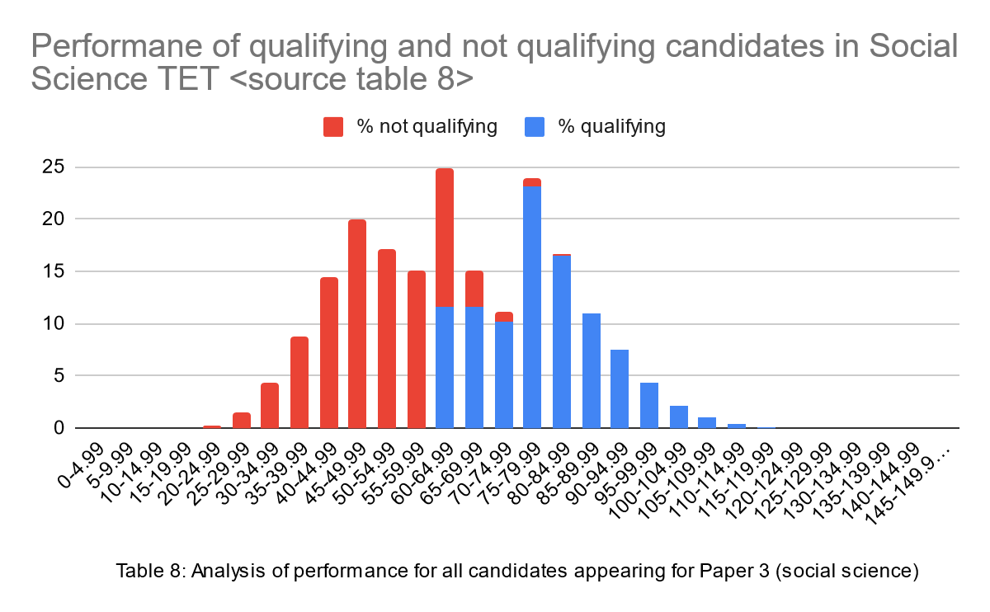

Slide 28
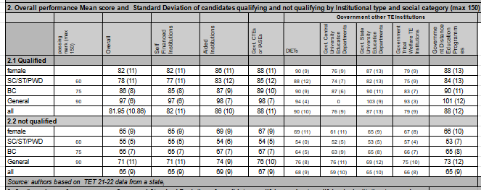

Slide 29
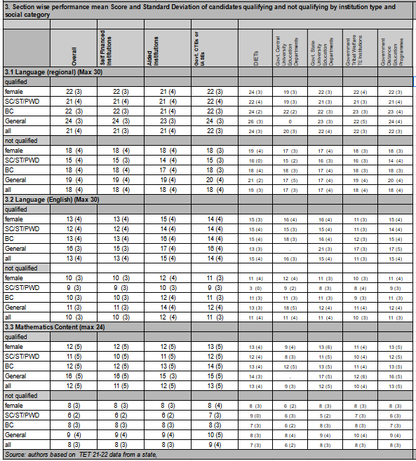

Slide 30
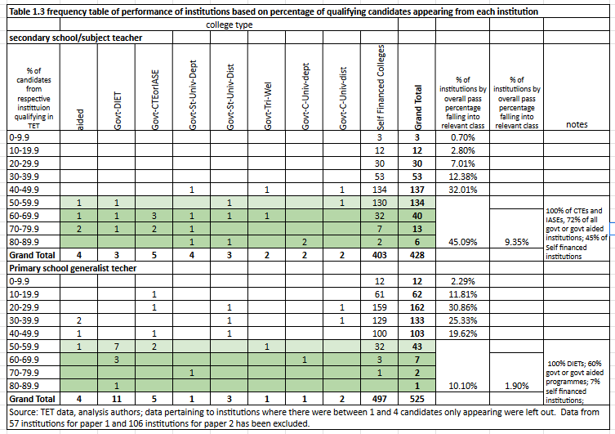

Slide 31
Primary data collection: approach
Primary data:
  Data collected from schools and teacher education institutions from eight States; Assam, Bihar, Chhattisgarh, Karnataka, Maharashtra, Mizoram, Punjab and Telangana

Slide 32
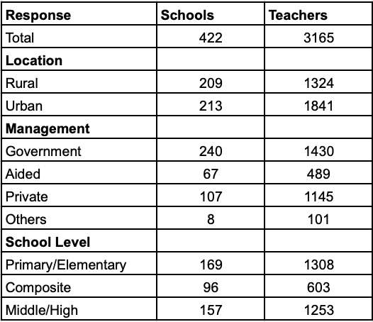
Overview of Schools
422 schools & 3165 teachers participated
83% had ‘pucca’ building conditions
95 per cent of school principals have stated their school premises to be clean.
79.86% had boundary wall
Catchment Area of Students
LEVEL | Within a 1 km radius |  | 2- 3 km |  | More than 3 km |  | Grand Total
Prim/Elem | 106 | 62.72% | 35 | 20.71% | 28 | 16.57% | 169
Composite | 20 | 20.83% | 27 | 28.13% | 49 | 51.04% | 96
Middle/High | 36 | 22.93% | 61 | 38.85% | 60 | 38.22% | 157

Slide 33
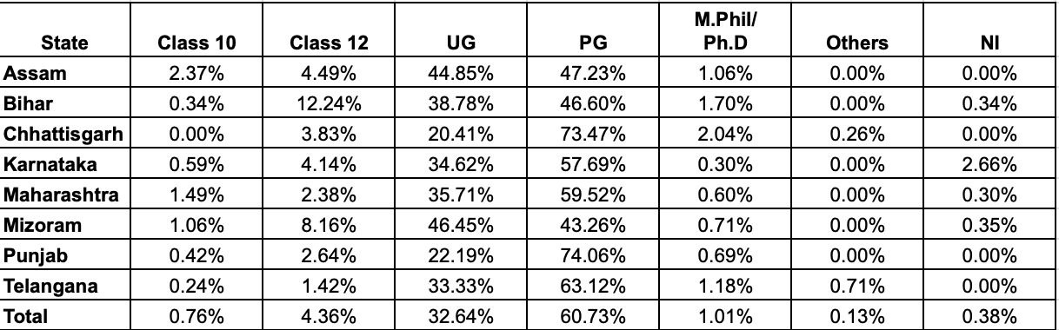
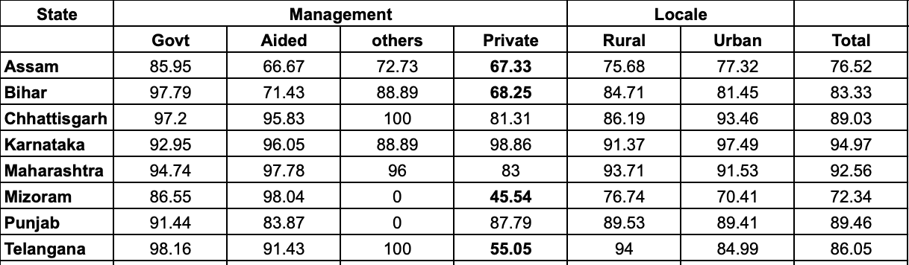
Qualifications
Highest Qualification among Teachers
Professional Training
37% trained in ICT (Maharashtra-71%; Mizoram- 47%)
2% trained in special education (Maharashtra-3%; Assam-3%)
Proportion of Professionally Qualified Teachers

Slide 34
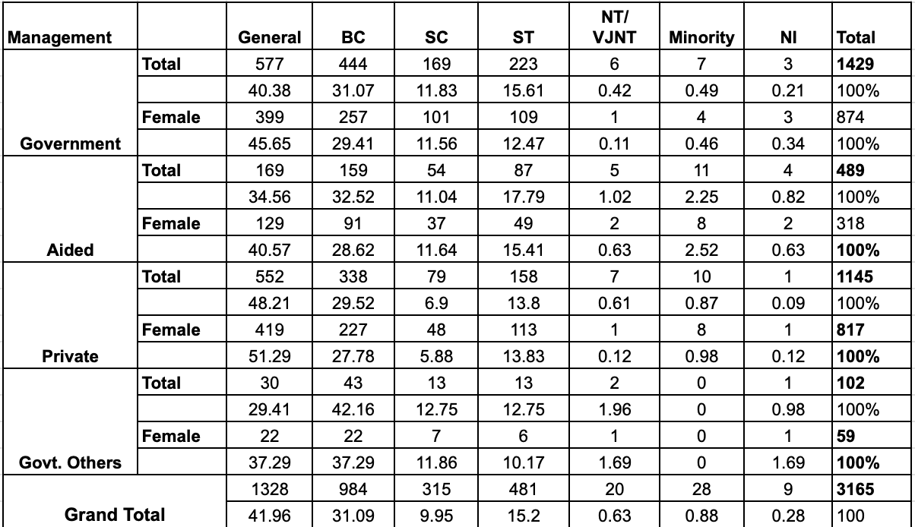
Social Profile
Social Composition of Teachers
State wise- Bihar, Karnataka, Maharashtra and Telangana- Majority is BC, followed by general category
Mizoram - 94% ST

Slide 35
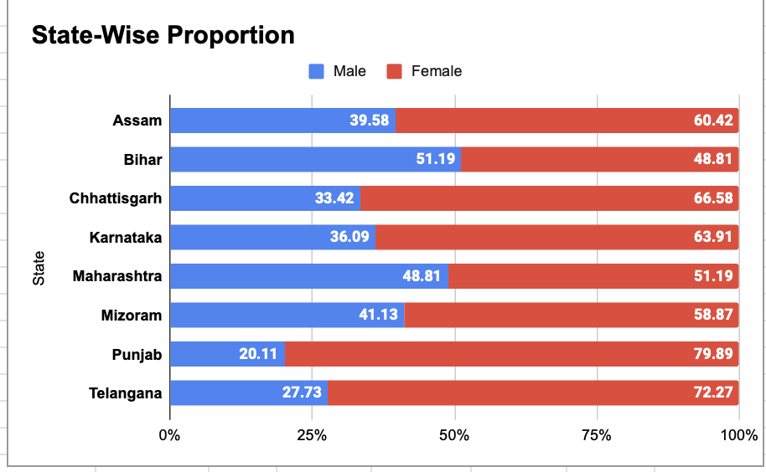
Teachers- Gender Proportion
Context | Female | Male | Other
Rural | 54.91% | 45.02% | 0.08%
Urban | 72.84% | 27.10% | 0.05%
Govt. | 61.12% | 38.74% | 0.14%
Aided | 65.03% | 34.97%
Private | 71.35% | 28.65%
Others | 58.42% | 41.58%
Prim/Elem | 69.82% | 30.18%
Composite | 68.58% | 31.35% | 0.08%
Middle/High | 59.78% | 40.14% | 0.08%

Slide 36
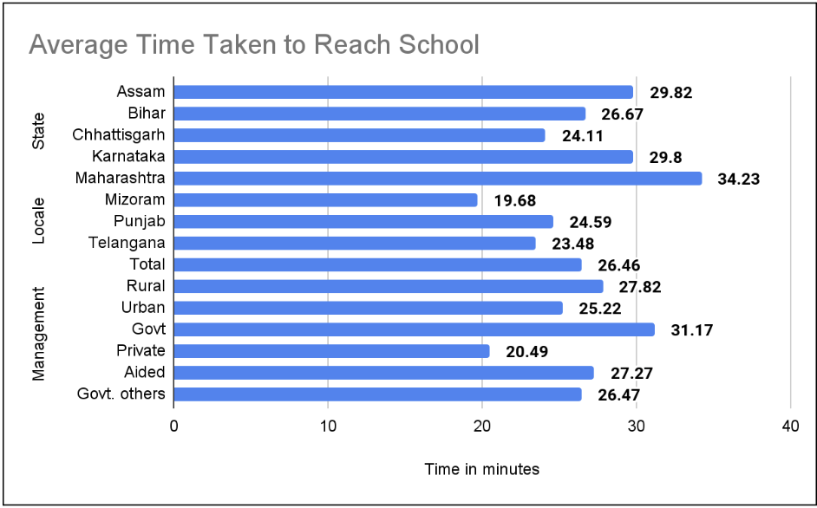
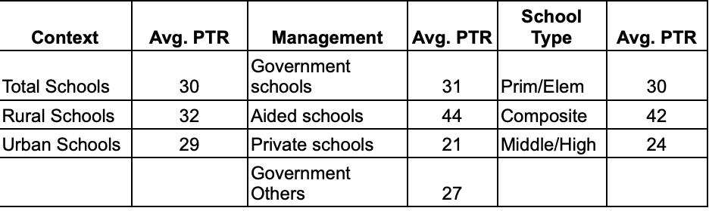
Working Conditions
12 Single teacher schools -12
122 schools have multigrade classes
10 schools had teachers with disabilities
The average time taken by female teachers to reach school is 28 minutes and by male teachers is 24 minutes.
47% teacher timings are same as students, while rest they stay longer - 10 -180 minutes
34% members of networks & 27% - Teacher unions

Slide 37
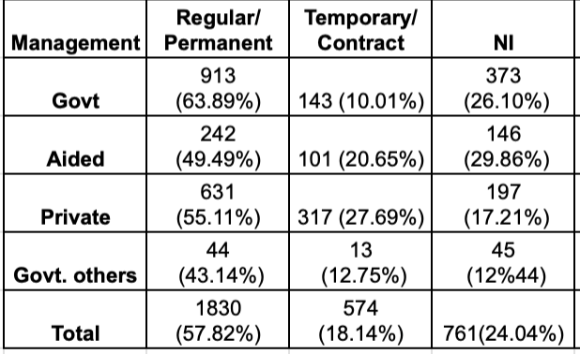
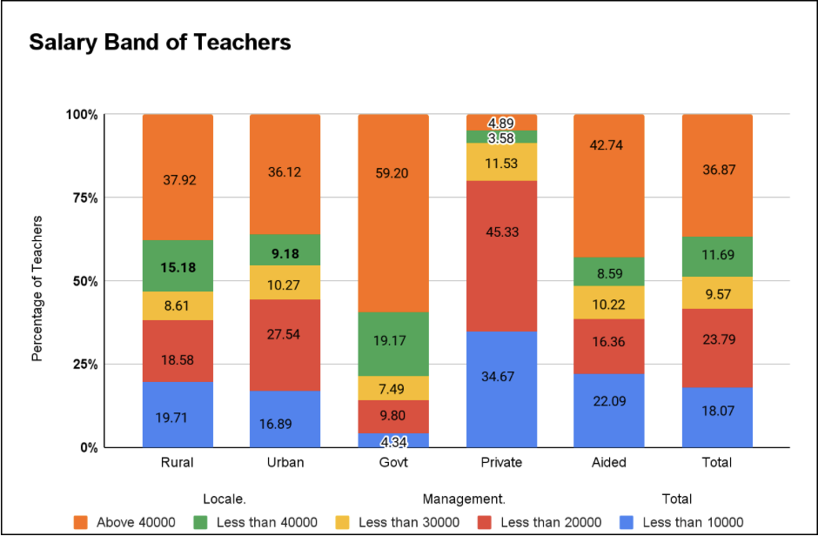
Appointment
Majority are regular/permanent in all categories
Temporary/contract teachers prominent in Private & Aided schools
Salary
Government schools are highly paid followed by Aided school teachers
Private school teachers have a maximum receiving salary less than 10,000/month
21% of teachers did not receive salaries during vacations, particularly private (31%) & Aided (26%)

Slide 38
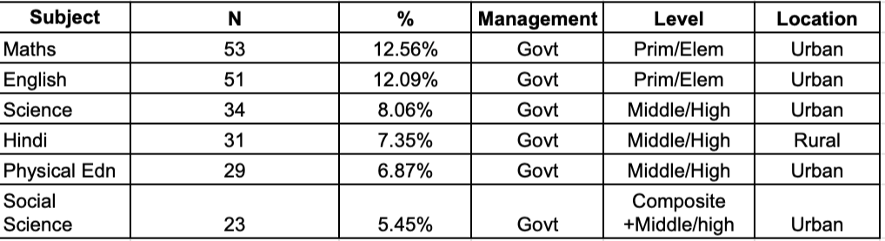
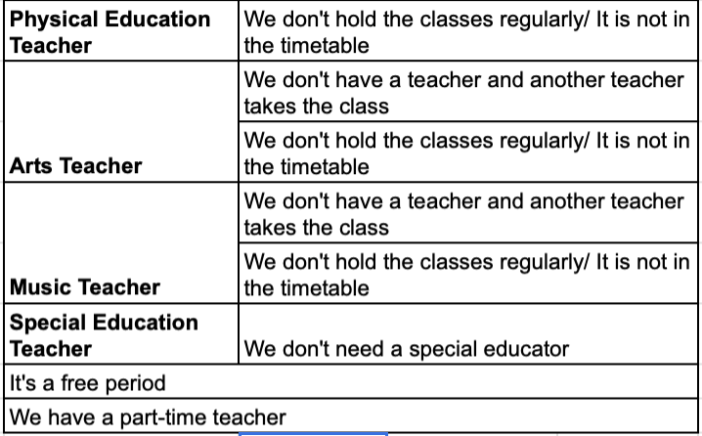
Teacher
Shortage
Subject Wise Shortage (5% above)
261 (61.85%) schools from 422 schools had requirements for teachers
17- 19% of them are teaching subjects they are not qualified to teach.
Shortage- Government, Middle/high and Urban schools
Adapt - Absent in timetable; another teacher takes the class. Few - free period; appoint part-time teacher.
How do Schools meet their requirements?

Slide 39
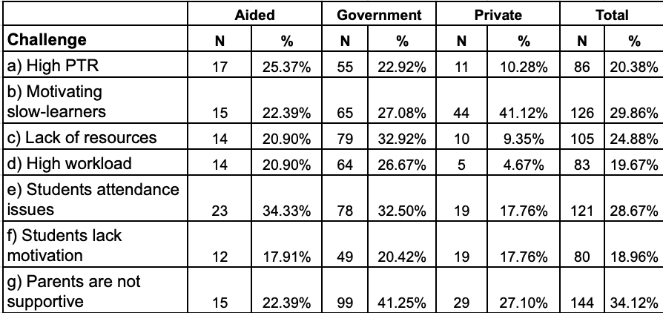
Challenges in Teaching
Head Teacher Perceptions
Motivating slow-learners (Private)
Parents not supportive (Govt, Pvt)
Students attendance (Govt, Aided)
Lack of resources (Govt.)
Teacher Perceptions
68% feel ‘often’ supported by school management/principal
68% feel ‘often’ supported by colleagues
55% feel ‘often’ supported by SMC/parents.

Slide 40
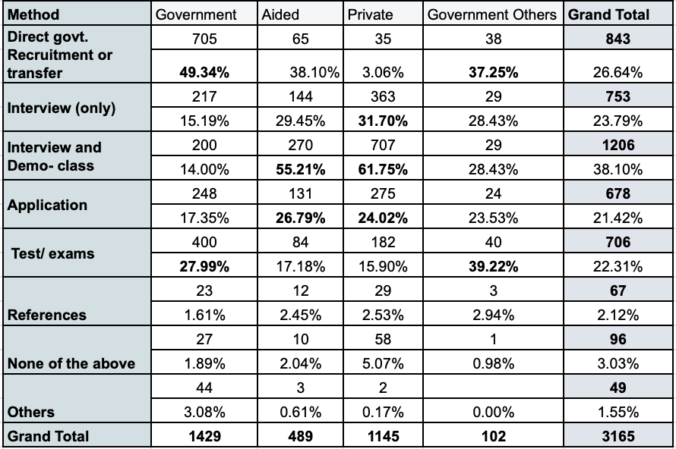
Recruitment
Recruitment Methods Adopted for Teachers
What do head teachers look when they hire teachers?
Qualification (48%)
Knowledge (31%)
Attitude (22%)
Mindset (16%)

Slide 41
Teacher Perceptions
Vision Five years from now
  Working in a government school (38%)
  Promotion/ better pay in school (24%)
Job Aspects not liked by Teachers
  There are a lot of non-teaching responsibilities (31%)
  Salary is not good (29%)
  Work pressure is high (28%)
Reasons for choosing teaching as a career
  Teaching will allow me to contribute to the society (64%)
  Teaching will allow me to work with children and young people (59%)
  Teaching would offer a steady career path (53%)
  Teaching is a secure job (52%)

Slide 42
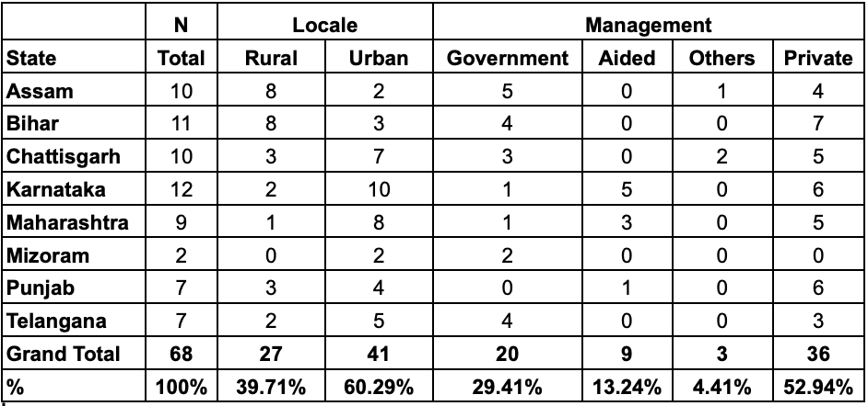
Teacher Education
Distribution of Teacher Education Institutions Across States
68 teacher education institutions
269 teacher educators
1481 Student teachers
Female - 69.01% ; Male - 30.99%
Rural - 36.53%; Urban - 63.47%
B.Ed - 66.58% ; D.Ed/D.El.Ed- 28%
BPEd- 3.11%; Others- less than 1%
Govt - 33% ; Aided - 14% ;
Private - 52%
Age group: 16-20/21-25/26-30 years

Slide 43
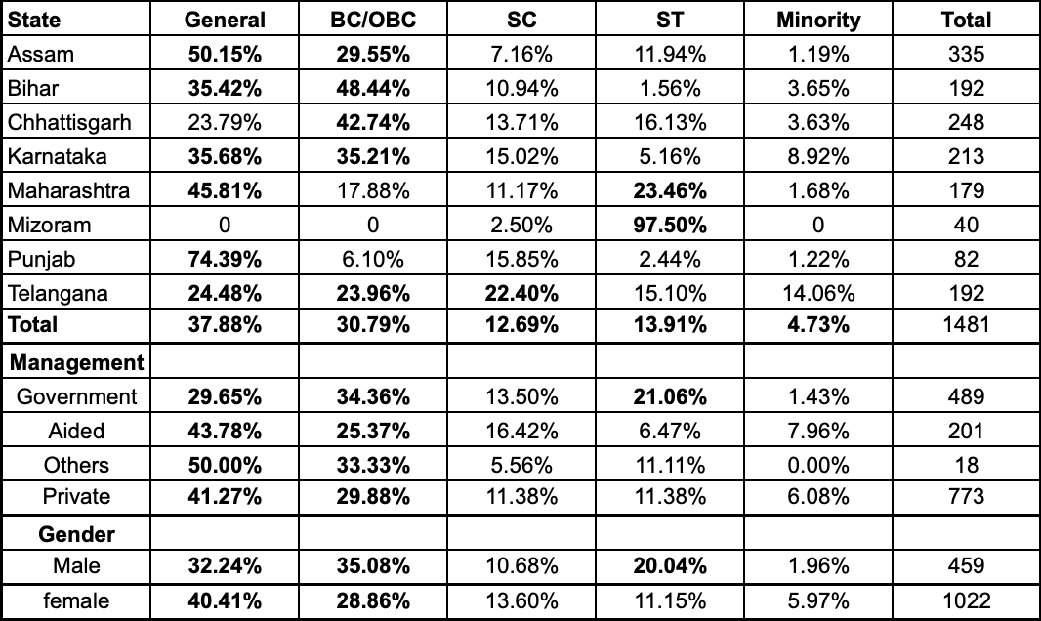
Social Profile
Social Composition of the Student Teachers
Out-of State - 8%
Urban - 10%; Aided - 11%
Married: Female - 26% ; Male - 11%
B.Ed- 26% ; D.El.Ed - 13%
Mothers
Qualification- X or less
Illiterate - 16% ; No Formal Ed- 2%
Occupation - Homemaker-72%; Govt job - 8%; Agri- 7%
Fathers
Qualification - XII or UG
Illiterate - 9% ; No Formal Ed- 1%
Occupation - Govt job - 21%; Agri - 23%; Pvt job - 15%

Slide 44
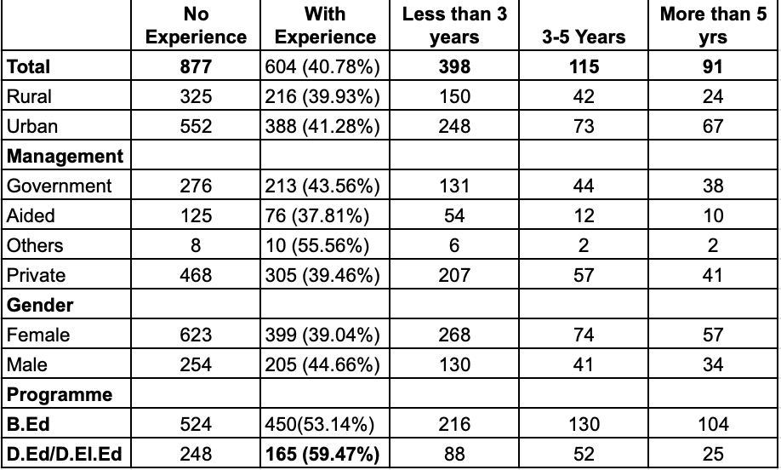
Educational Profile
Total Work Experience among Student Teachers
Highest Educational Qualification
B.Ed - Grad 46%; PG - 52%
D.Ed/D.El.Ed - XII - 32%;
Grad- 47%
Another Prof Degree- 7.36%
Work Experience in School/College
Total - 33%
B.Ed - 32%; D.El.Ed - 34%
Female - 28%; Male -45%
Type of Experience
Tuition/Tutor-41%
Female-39%; Male- 46%
Part/Full time teaching-19%

Slide 45
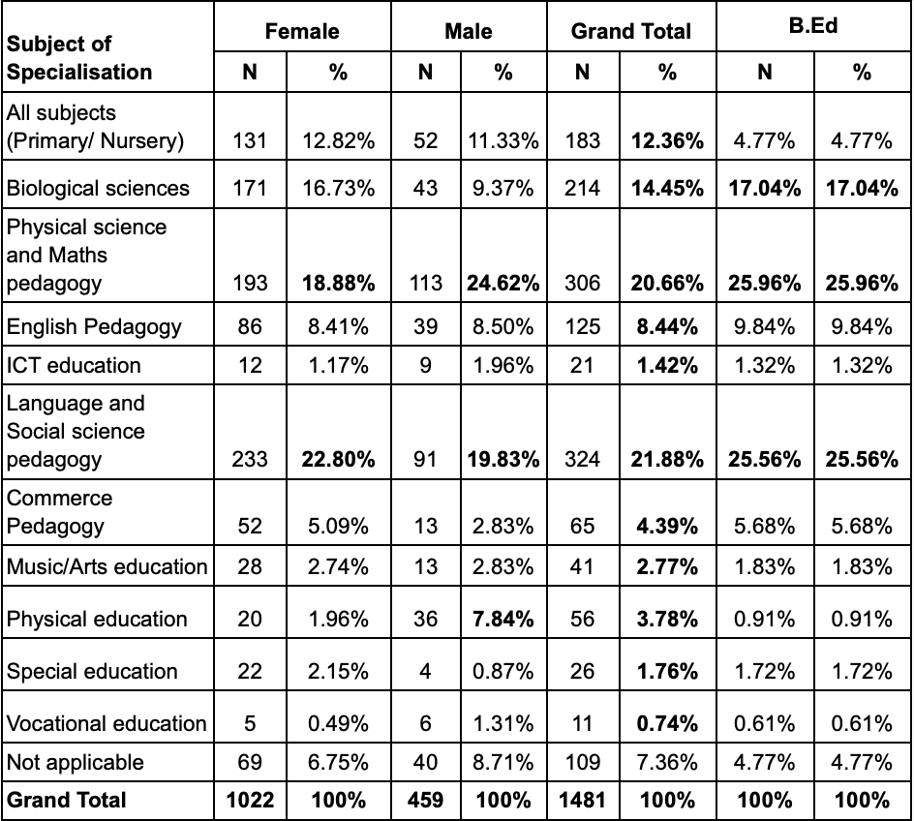
Subject Specialisation
Majority of the B.Ed student teachers chose Physical science with maths pedagogy (26%) and language and social science pedagogy (26%) as their subject of specialisation.
This was followed by Biological sciences (17%) and English (10%) and commerce (6%) subjects

Slide 46
Table 55: Proportion of Student Teachers who Shifted Careers
Shifted Career | No |  | Yes |  | Total
Locale | N | % | N | %
Rural | 419 | 77.45% | 122 | 22.55% | 541
Urban | 685 | 72.87% | 255 | 27.13% | 940
Total | 1104 | 74.54% | 377 | 25.46% | 1481
Government | 357 | 73.01% | 132 | 26.99% | 489
Aided | 152 | 75.62% | 49 | 24.38% | 201
Others | 16 | 88.89% | 2 | 11.11% | 18
Private | 579 | 74.90% | 194 | 25.10% | 773
Male | 310 | 67.54% | 149 | 32.46% | 459
Female | 794 | 77.69% | 228 | 22.31% | 1022
B.Ed | 733 | 74.34% | 253 | 25.66% | 986
D.Ed/D.El.Ed | 304 | 72.90% | 113 | 27.10% | 417
26% of the student teachers shifted their career to teaching. (B.Tech, BBA etc)
Teacher educator perceptions
Students from other degrees (B.Ed, BBA, MBA etc) have started joining (56%)
Students who are shifting their careers have started joining (30%)
Students with work experience have started joining (32%)
Students with passion have started joining (31%)
Teachers Data
2% had other professional degrees (LLB, BBA, D.Pharm, Agriculture, Medical, Forest management, BTech, Engineering, MCA etc.)

Slide 47
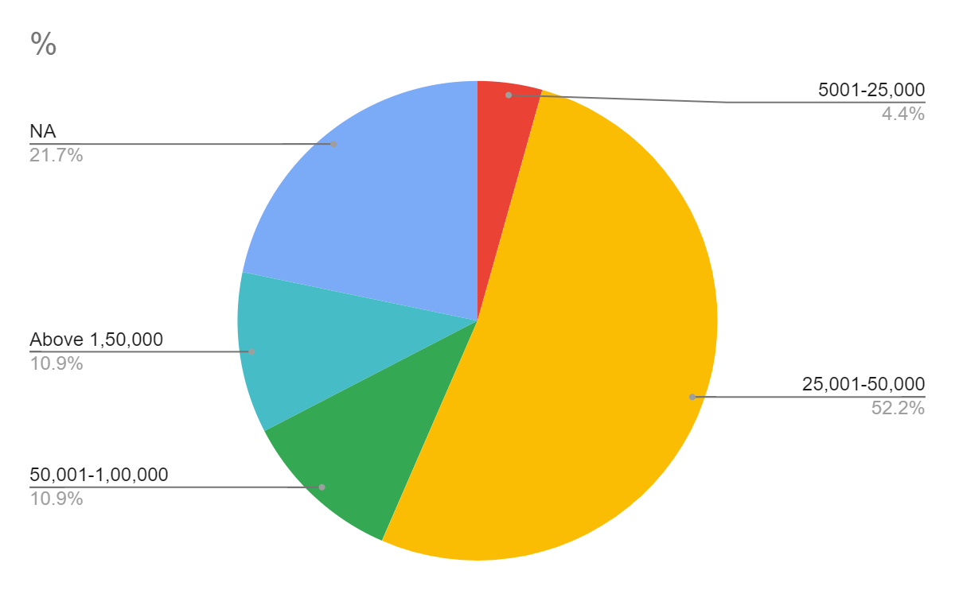
Table 59b: Programme-wise Fees Paid by Student Teachers
Fees Category | B.Ed | % | D.Ed/D.El.Ed | % | B.PEd | %
>= 5000 | 14 | 1.42% | 191 | 45.80% | 0 | 0.00%
5001-25,000 | 267 | 27.08% | 135 | 32.37% | 2 | 4.35%
25,001-50,000 | 252 | 25.56% | 25 | 6.00% | 24 | 52.17%
50,001-1,00,000 | 415 | 42.09% | 29 | 6.95% | 5 | 10.87%
1,00,001-1,50,000 | 4 | 0.41% | 10 | 2.40% | 0 | 0.00%
Above 1,50,000 | 2 | 0.20% |  | 0.00% | 5 | 10.87%
NA | 32 | 3.25% | 27 | 6.47% | 10 | 21.74%
Total | 986 | 100% | 417 | 100% | 46 | 100.00%
On the basis of management, maximum number of the private, aided and B.Ed student teachers paid fees in the fees slab of Rs.50,001 to Rs. 1,00,000 category.
State-wise, the highest fees slab paid by majority of the students teachers is noticed in Assam, Bihar and Karnataka. The fees category here is in the range of Rs. 50,001 to Rs. 1,00,000.
Programme-wise, the fees paid by BPEd student teachers is relatively higher when compared to the B.Ed and D.Ed/D.El.Ed student teachers.

Slide 48
Table 60: Additional Fees Paid by the Student Teachers
Response | Total | Female | Male | Rural | Urban
N | 449 | 312 | 137 | 176 | 273
% | 30.32% | 30.53% | 29.85% | 32.53% | 29.04%
Total | 1481 | 1022 | 459 | 541 | 940
Response | Government | Aided | Others | Private | Total
N | 115 | 68 | 3 | 263 | 449
% | 23.52% | 33.83% | 16.67% | 34.02% | 23.52%
Total | 489 | 201 | 18 | 773 | 1481
Response | B.Ed | D.Ed/D.El.Ed
N | 292 | 150
% | 29.61% | 35.97%
Total | 986 | 417
Additional fees are occasionally taken by institutions under special provisions. From the student teachers responses it is confirmed by 30 per cent of them that additional fees were taken by their teacher education institutions and this proportion is highest in rural, private and aided teacher education institutions.

Slide 49
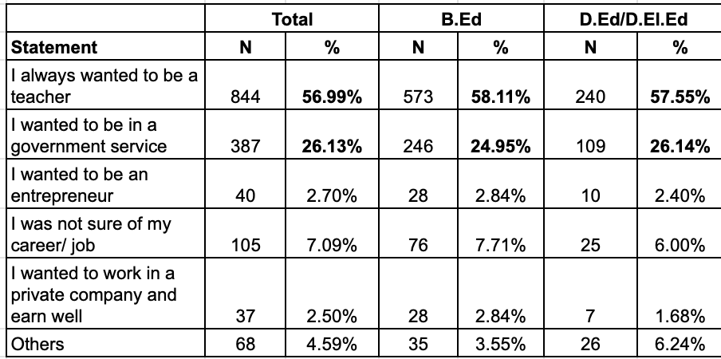
Perceptions
Responses to Aspiration
Motivation to pursue this degree
To get a stable job (41%)
I like teaching children (50%)
Teaching is a well-respected profession (44%)
Employment
Support Expected- Placement, Support in Demo/interview
Salary Expected - Above 40,000/month
Towards Teaching/Teachers
‘Pay’ received the lowest rating &
‘Status’ - by D.Ed/D.El.Ed student teachers
Five years from now Majority wished to work in a Government school

Slide 50
…Perceptions
Reasons for Choosing Teaching as A Career
Teaching would offer a steady career path
Teaching will allow me to work with children and young people
Teaching will allow me to provide a contribution to the society
Reasons for pursuing the selected Degree
To get a stable job
I like teaching children
Teaching is a well-respected profession

Slide 51
Agenda for discussion
Discussion and feedback of the analysis
Proposed Chapterisation and what to keep with focus on and what to leave out?
Report's release date and possible event (national and regional)

Slide 52
Thank You

Slide 53
Research questions - a reminder:
What is the supply of professionally qualified teachers (including the subjects and different levels)?
What and where is the demand for qualified teachers?
How do the supply and demand vary based on various factors such as the size of the state, region (rural/urban), subjects (all school subjects including arts, physical education, special education, computer science, work education), levels (early years, primary and secondary), school management and gender?
How are RTE norms concerning teacher recruitment being fulfilled?
What is the quality of teacher supply?

