Slide 1

State of Teachers, Teaching and Teacher Education Report-2023
Review 2 - Editorial Board meeting- 14th June 2023

Slide 2
Agenda
Overall updates
Primary data: approach and preliminary findings
Secondary data: preliminary findings
UDISE+ data
Periodic Labour Force Survey data
Teacher Eligibility Test data
Insights from literature review
Next steps

Slide 3
Overall updates
Research questions - a reminder:
What is the supply of professionally qualified teachers (including the subjects and different levels)?
What and where is the demand for qualified teachers?
How do the supply and demand vary based on various factors such as the size of the state, region (rural/urban), subjects (all school subjects including arts, physical education, special education, computer science, work education), levels (early years, primary and secondary), school management and gender?
How are RTE norms concerning teacher recruitment being fulfilled?
What is the quality of teacher supply?

Slide 4
Overall updates
Primary data:
Data collected from schools and teacher education institutions in Karnataka, Maharashtra, Telangana, Chhattisgarh, Bihar, Punjab
Data collection ongoing in Assam and Mizoram
Data cleaning and analysis ongoing for Karnataka, Maharashtra, Telangana, Chhattisgarh, Bihar
Secondary data:
Analysis ongoing for data from UDISE+, PLFS, PAB, and Teacher Eligibility Test data
Literature review ongoing

Slide 5
Primary data collection: approach
Two districts in each state for in-depth data collection, and a third district for education officer interviews
One Urban District (state capital) and one ‘aspirational district’
Data collection units and instruments:
Schools: headteacher (tool2) and teacher survey (tool3), teacher-subject mapping (tool4)
Teacher education institutions: interview with principal (tool5), teacher educator and student teacher surveys (tool6)
Interviews with district education officers (tool1)
Key informant interviews

Slide 6
Primary data: preliminary findings
Preliminary findings from headteacher and teacher survey data
School environment and infrastructure including Internet/CCTV
Pupil-Teacher Ratio
Teacher vacancies in schools
Teacher recruitment
How are recruitment needs calculated?
How are teachers recruited?
How are special teachers, such as arts, physical education, music etc. recruited?

Slide 7
Primary data: preliminary findings
Teacher profile
Profile
Qualification including Teacher Eligibility Test
ICT and special education training
Experience
Working conditions of teachers
Employment status (permanent/contract)
Hours
Number of subjects/grades taught at one time
Salary
Benefits
Autonomy and stress
Workload beyond teaching duties
Challenges faced by teachers/headteachers

Slide 8
Primary data: preliminary findings
Teacher motivation, punctuality, job satisfaction, and overall perception of teachers
Teacher awards and credentials
Challenges faced by headteachers and teachers
Status of non-teaching staff including admin and finance
Role of external agencies in providing co-curricular support

Slide 9
Primary data: preliminary findings
Impact of COVID-19
Headteachers
Teachers
Internships for B.Ed students
Communities of practice/communication platforms used by schools
School Management Committees

Slide 10
Secondary data: preliminary findings from UDISE+ data
Profile of teachers
Total teachers: 9,507,123
Rural: 70%, urban: 30%, female: 51%
Caste
General: 41.5%, SC: 12.45%, ST: 7.64%, OBC: 38.36%
Academic qualifications
Graduate: 41.43%, diploma: 26.33%
Professional qualifications:
B.Ed: 46%, B.El.Ed: 3.5%, M.Ed: 2.46%, other: 7.71%
No professional qualifications: 9.5%

Slide 11
Secondary data: preliminary findings from UDISE+ data
Employment status of teachers
Overall:
Regular: 85.45%, male: 50%, female: 50%
Contract: 13.18%, male: 40%, female: 60%
Part-time: 1.36%, male: 45.4%, female: 54.55%
Contract teachers:
Government: 40%, Government (other): 2.92%, Government Aided: 3.79%, Private: 48.14%, Madrasas (recognized): 1.8%, Unrecognized: 3.32%

Slide 12
Secondary data: preliminary findings from UDISE+ data
Schools and Pupil-Teacher Ratio
Total: 1,489,115; rural: 83%, urban: 17%
Elementary: 74.04%, Composite: 9.28%, Secondary: 16.67%
Single teacher schools:
Total: 7.87% i.e.117,285
Government: 55.16%, Government (other): 33.86%, Government Aided: 3.33%, Private: 5.9%
Pupil-Teacher Ratio (school level):
National average: 28
Number of schools with PTR>35: 352,354
Number of schools with PTR<30: 1,000,051

Slide 13
Secondary data: preliminary findings from PLFS data
Demographic characteristics of teachers:
By gender, social group, religion, age-group, place of residence (rural/urban), state
Current status of demographic profile and changes over time
Share of school teachers from various economic status of households (Rich vs poor), various types of households (primary occupation)
Educational and professional qualifications of teachers:
Distribution across qualification, type of school management (Government, Government-aided, Private-unaided, others), level of teaching (Elementary vs secondary), school location, years of service, type of contract (contractual vs permanent), working hours, average income earned by teachers
The above profile separately for female vs male teachers

Slide 14
Secondary data: preliminary findings from PLFS data
Feminisation of teachers:
Has there been a feminisation of school teachers in India? Distribution of teachers vs. rest of the workforce by gender and assessing any change in the pattern over time.
What impacts this gendered segregation of the teaching profession? What are some of the specific characteristics of female teachers (education level, household characteristics, type of employment (permanent vs. contractual, school management types, etc)?

Slide 15
Secondary data: preliminary findings from State TET data
Qualified Marks for Gen- 60% and Above; BC- 50% and Above; SC/ST/PWD-40 % and Above
Gender | Category | Paper-1 (Primary school) |  |  | Paper-2 (TGT, secondary school)
 |  | Appeared | Qualified | Percentage Q. | Appeared | Qualified | Percentage Q.
Female | GENERAL | 21462 | 1888 | 8.80 | 18537 | 2793 | 15.07
 | BC | 123899 | 32302 | 26.07 | 98614 | 38971 | 39.52
 | SC/ST/PWD | 61591 | 28196 | 45.78 | 43549 | 30565 | 70.19
 | Total | 206952 | 62386 | 30.15 | 160700 | 72329 | 45.01
Male | GENERAL | 5487 | 679 | 12.37 | 4988 | 1171 | 23.48
 | BC | 58194 | 17540 | 30.14 | 49600 | 24158 | 48.71
 | SC/ST/PWD | 47805 | 21847 | 45.70 | 35601 | 25239 | 70.89
 | Total | 111486 | 40066 | 35.94 | 90189 | 50568 | 56.07
Total | GENERAL | 26949 | 2567 | 9.53 | 23525 | 3964 | 16.85
 | BC | 182093 | 49842 | 27.37 | 148214 | 63129 | 42.59
 | SC/ST/PWD | 109396 | 50043 | 45.74 | 79150 | 55804 | 70.50
 | Total | 318438 | 102452 | 32.17 | 250889 | 122897 | 48.98

Slide 16
TET Data Analysis
Statistics | Paper-1 (Primary school) |  | Paper-2 (TGT, secondary school)
 | Appeared | Qualified | Appeared | Qualified
N | 318437 | 102452 | 250889 | 122897
Mean | 64.49 | 77.97 | 70.96 | 80.29
Median | 63 | 78 | 70 | 80
Std. Deviation | 13.953 | 11.328 | 14.014 | 11.235
Range | 129 | 73 | 127 | 71
Minimum (Out of 150) | 4 | 60 | 4 | 60
Maximum (Out of 150) | 133 | 133 | 131 | 131

Slide 17
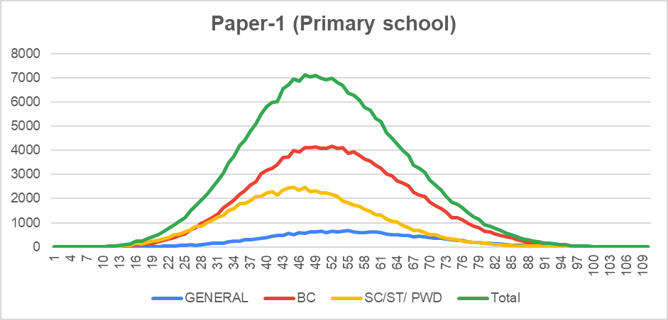
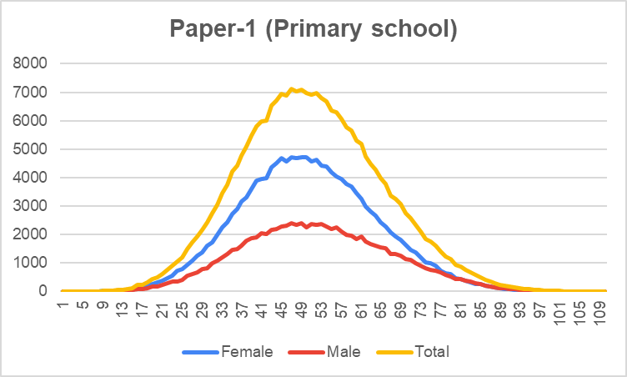
TET Data Analysis

Slide 18
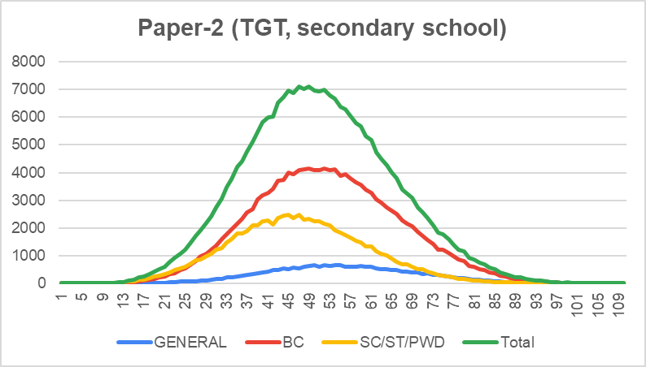
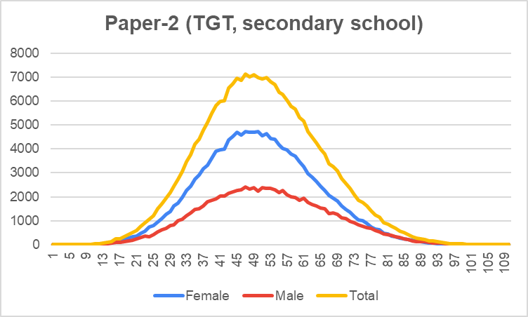
TET Data Analysis

Slide 19
TET Data Analysis
Laguage | Paper-1 (Primary school) |  |  | Paper-2 (TGT, secondary school)
 | Appeared | Qualified | Percentage Q. | Appeared | Qualified | Percentage Q.
BENGALI | 7 | 3 | 0.00 | 0 | 0 | 0
GUJARATI | 2 | 0 | 0.00 | 0 | 0 | 0
HINDI | 8282 | 3106 | 3.00 | 18488 | 4026 | 3.3
KANNADA | 292 | 71 | 0.10 | 193 | 71 | 0.1
MARATHI | 228 | 52 | 0.10 | 119 | 28 | 0
TAMIL | 23 | 5 | 0.00 | 18 | 3 | 0
REGIONAL LANGUAGE | 296397 | 95715 | 93.40 | 222242 | 117037 | 95.2
URDU | 13207 | 3500 | 3.40 | 9752 | 1705 | 1.4
SANSKRIT | 0 | 0 | 0.00 | 77 | 27 | 0
Total | 318438 | 102452 | 100.00 | 250889 | 122897 | 100

Slide 20
TET Data Analysis
Paper-1 (Primary school)
Education Qualifications | Appeared | Qualified | Percentage Q.
Graduation with at least 45% marks AND pass in B.Ed./Special Education or pursuing final year of B.Ed/Special Education | 187455 | 56061 | 54.70
Intermediate / Senior Secondary with at least 45% marks AND pass in 2 - year Diploma in Elementary Education / 4-year B.El.Ed. / 2 - year Diploma in Education (Special Education) or pursuing final year D.El.Ed / D.Ed. | 92260 | 38900 | 38.00
Intermediate / Senior Secondary with at least 40% marks AND pass in 2 - year Diploma in Elementary Education / 4-year B.El.Ed. / 2 - year Diploma in Education (Special Education) or pursuing final year D.El.Ed / D.Ed. | 12320 | 4947 | 4.80
Graduation with at least 50% marks AND pass in B.Ed. / Special Education or pursuing final year B.Ed / Bachelor of Education (Special Education) | 19600 | 1516 | 1.50
Intermediate / Senior Secondary with at least 50% marks AND pass in 2 - year Diploma in Elementary Education / 4-year B.El.Ed. / 2 - year Diploma in Education (Special Education) or pursuing final year D.El.Ed / D.Ed. | 5764 | 890 | 0.90
Intermediate / Senior Secondary with at least 45% marks AND pass in 2 - year Diploma in Elementary Education / 4-year B.El.Ed. / 2 - year Diploma in Education (Special Education) or pursuing final year D.El.Ed / D.Ed. | 1037 | 137 | 0.10
Total | 318438 | 102452 | 100.00

Slide 21
TET Data Analysis
Paper-2 (TGT, secondary school)
Education Qualifications | Appeared | Qualified | Percentage Q.
B.A./B.Sc./B.Com., with at least 45% marks. AND pass B.Ed / B.Ed-Special Education or pursuing final year of B.Ed. / Special Education | 165503 | 89171 | 72.60
B.A./B.Sc./B.Com., with at least 40% marks. AND pass in B.Ed/ B.Ed -Special Education or pursuing final year B.Ed./Special Education | 33875 | 18510 | 15.10
Graduation with language concerned as one of the optional subjects OR Bachelor of oriental language OR Graduation in literature OR Post Graduation in language concerned AND Language Pandit Training Certificate/B.Ed with language concerned as one of the Methodologies, in respect of Language Teachers. | 21900 | 6739 | 5.50
B.E/B.Tech with at least 45% marks and Pass in B.Ed. or B.Ed. Special Education or pursuing final year of B.Ed. /Special Education | 7719 | 4377 | 3.60
B.A./B.Sc./B.Com., with at least 50% marks. AND pass in B.Ed / B.Ed-Special Education or pursuing final year B.Ed. / Special Education. | 14379 | 2518 | 2.00
B.A./B.Sc./B.Com., with at least 50% marks. AND pass in B.Ed/ B.Ed -Special Education or pursuing final year B.Ed./ Special Education. | 5572 | 1018 | 0.80
4-year B.A.Ed/B.Sc.Ed., with at least 45% marks. | 700 | 306 | 0.20
4-year B.A.Ed/B.Sc.Ed., with at least 50% marks. | 95 | 13 | 0.00
B.E/B.Tech with atleast 50% marks and Pass in B.Ed. or B.Ed. Special Education or pursuing final year B.Ed. /Special Education. | 1145 | 245 | 0.20
Total | 250889 | 122897 | 100.00

Slide 22
TET Data Analysis
Paper-1 (Primary school)
Professional Qualification | Appeared | Qualified | Percentage Q.
B.Ed | 205167 | 57236 | 55.90
B.Ed -Special Education | 1888 | 341 | 0.30
B.El.Ed. | 6790 | 1348 | 1.30
D.Ed/D.El.Ed | 102649 | 43134 | 42.10
Diploma in Education (Special Education). | 1942 | 392 | 0.40
Total | 318438 | 102452 | 100.00
Paper-2 (TGT, secondary school)
Education Qualification | Appeared | Qualified | Percentage Q.
4-year B.A.Ed/B.Sc.Ed., | 795 | 319 | 0.30
B.Ed | 232550 | 117967 | 96.00
B.Ed -Special Education | 2142 | 784 | 0.60
LPT | 15401 | 3827 | 3.10
Total | 250889 | 122897 | 100.00

Slide 23
TET Data Analysis: Works going on
Profile of Appeared and Qualified Candidates:
Age
Rural-Urban Background
Type of Institute where they have done their professional degrees (Private, Govt, Aided)
Section and Sub-Section wise results:
Paper-1: Child Development and Pedagogy, Language 1 and 2, Mathematics and Environment Studies
Paper-2: Child Development and Pedagogy, Language 1 and 2, Mathematics and Science, Social Studies, Environment Studies
Question Paper Analysis:
Using Revised Bloom's Taxonomy, Lee Shulman and NCFTE Document approach

Slide 24
Trends in teacher recruitment and retention - Summary of literature review
•Qualifying exams to select teachers can be observed worldwide. (European Union/ Commission, 2013; Alam 2015; Asian Development Bank, 2017; Jha et al., 2016; Ramachandran, Béteille, Linden, Dey & Chatterjee, 2017)
•In South Asia, the entry of para and contractual teachers was a low-cost solution ensuring increased availability of teachers within a short span.(Gonzalez Palau, 2012; Lhaden 2016; UNESCO 2014; Aturupane & Shojo, 2012; Jha, Minni, & Ahmed, 2021)
•Political patronage is relied on extensively regarding initial placement and transfers to favourable locations and better performing schools. (BD News 24, 2017; Jha, Minni, & Ahmed, 2021; Mahmood, 2014; Ramachandran, Béteille, Linden, Dey & Chatterjee, 2017)
•Technology has been deployed to make teacher recruitment transparent. Karnataka has introduced a policy backed by law to use a technology-enabled proof for initial deployment and later transfers that filters the needs of schools (based on PTR and subject specific vacancies) and teacher preferences (home district, years of service, medical needs). This is reported to have minimised patronage and graft. But schools cannot express their needs based on subject vacancies. (Jha et al, 2016)
•Data and systems to ascertain teacher-pupil ratio and subject-teacher vacancies across individual schools do not exist in South Asia. Weak statistical practices and mismatches between different sources are common despite adoption of information management systems. (Jha, Minni & Ahmed, 2021)
•The Australian Teacher Workforce Database provides a good example of evidence base that will inform the future of the teaching profession. (AITSL, 2020)

Slide 25
Trends in the conception of teacher and teaching quality
•Training, skills, qualification (Licensing and certification), experience, job attractiveness, choice of teaching, performance, talent, professional development, competency and standards are some of the terms associated with the quality of teachers and teaching in the global literature (UNESCO, 2022; Kumar and Wiseman, 2021; OECD, 2015).
•There have been attempts to link posit teaching quality in terms of students’ scores in scholastic assessments (Zakharov et al., 2015; OECD, 2013). But researchers point out there are too many unknowns to directly link teaching quality with students’ performance and it is best understood through professional development in terms of advances in knowledge, practice and dispositions (Cochran-Smith & Zeichner, 2009; Robinson, 2008). Santiago (2002) proposes the addition of teaching environment as a determinant of quality in teaching.
•Policies on teacher education in the Global North engages with the notion of quality in three ways to ensure the quality of teaching:
-the nature of preparedness of the teacher
-the standards or teaching competencies which are valued and
-data on teaching workforce
https://www.aitsl.edu.au/research/australian-teacher-workforce-data)

Slide 26
References
•Australian Institute for Teaching and School Leadership (AITSL). https://www.aitsl.edu.au/teach/teacher-education
•Australian Council of Deans of Education. https://acde.edu.au/teacher-education/
•Cochran-Smith, M., & Zeichner, K. M. (Eds.). (2009). Studying teacher education: The report of the AERA panel on research and teacher education. NY: Routledge.
•Darling-Hammond, L., & Bransford, J. (Eds.). (2005). Preparing Teachers for a Changing World: What Teachers Should Learn and Be Able to Do. Jossey-Bass.
•Darling-Hammond, L., Hammerness, K., Grossman, P., Rust, F., & Shulman, L. (2005). The Design of Teacher Education Programs.
•Department of Education, Skills and Employment. https://www.dese.gov.au/initial-teacher-education
•Department for Education - https://www.gov.uk/government/organisations/department-for-education
•EI/UNESCO. 2019. “Global Framework of Professional Teaching Standards.”
•European Agency for Special Needs and Inclusive Education. (2020). Teacher Education for Inclusion: European Policy and Practice. Publications Office of the European Union.
•European Agency for Special Needs and Inclusive Education. (2020). Teacher Education for Inclusion: European Policy and Practice. Publications Office of the European Union
•European Agency for Special Needs and Inclusive Education. https://www.european-agency.org/
•European Commission/EACEA/Eurydice. (2018). Initial Teacher Education in Europe: Policies and Structures. Publications Office of the European Union.
•Ingersoll, R. M., & Strong, M. (2011). The Impact of Induction and Mentoring Programs for Beginning Teachers: A Critical Review of the Research. Review of Educational Research, 81(2), 201-233.
•National Council for Accreditation of Teacher Education (NCATE). (2010). Transforming Teacher Education through Clinical Practice: A National Strategy to Prepare Effective Teachers.
•Sarangapani, P., Ramanathan, A., Kumar, R., Thirumalai, B., & Ramchand, M. (2021). State of the Education Report for India 2021: No Teacher No Class. UNESCO.
•Santiago, P. (2002). Teacher Demand and Supply: Improving Teaching Quality and Addressing Teacher Shortages (OECD Education Working Papers No. 1; OECD Education Working Papers, Vol. 1). OECD. https://doi.org/10.1787/232506301033
•Sucre, F., & Fiszbein, A. (2015). Setting The Stage For Improved Learning: The State of Teacher Policies in El Salvador, Guatemala, Honduras and The Dominican Republic (PREAL’s Teacher Policy Report Card) [Regional Report]. Inter-American Dialogue.
•Symeonidis, V. (2015). The Status of Teachers and the Teaching Profession. Education International.
•Teacher Education Accreditation Council (2009). Quality Principles for Teacher Education Programs.
•Teacher Registration Authorities in Australia https://www.aitsl.edu.au/regulatory-authorities
•Thompson, G. (2021). The Global Report on the Status of Teachers 2021. Education International.
•UNESCO. (2005). Teachers for Tomorrow's Schools: Analysis of the World Education Indicators 2005. US Department of Education (2001). No Child Left Behind Act.
•US Department of Education (2010). A Blueprint for Reform.
•

Slide 27
Next steps
Nov 22 – Feb 23
Mar – June 23
July – Sept 23
Sept - Oct 23
Finalise concept note
Preliminary mapping of data sources: secondary and primary
Editorial Board Meeting - 1
Primary data collection preparation
Primary data collection
Secondary data analysis
Editorial Board Meeting - 2
Data processing, analysis and interpretation
Report writing
Sharing early findings and recommendations
Editorial Board meeting – 3
Final report launched on Sept 5

Slide 28
Thank You

