Slide 1
India Education Outcomes Fund: a case study
Dr. Archana Mehendale
Centre for Education Innovation and Action Research,
Tata Institute of Social Sciences, Mumbai

Slide 2
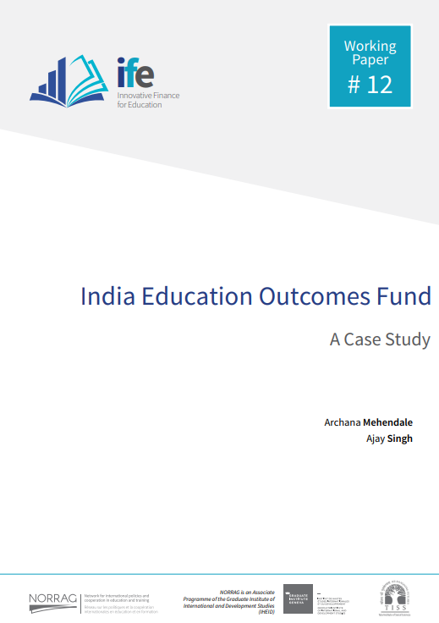
Mehendale, A. and Singh, A. (2020). India Education Outcomes Fund: A Case Study. Innovative Finance for Education Working Paper #12. Geneva: NORRAG.

Slide 3
Background
Growing interest in innovative financing mechanisms (SDG17) for achieving inclusive and equitable quality education and lifelong learning (SDG4)
Need for material development and capacity building on Innovative Financing for Education (IFE)
The development of teaching case studies on IFE is carried out by an inter-university collaboration: NORRAG (anchor), University of Fribourg, Zurich University of Teacher Education, Beijing Normal University, Tata Institute of Social Sciences, Bertha Centre for Social Innovation and Entrepreneurship of University of Cape Town and Universidad Nacional de General Sarmiento.
Supported by Consortium of Education and Research (COFER) which is funded by the “Swissuniversities Development and Cooperation Network” (SUDAC) in Switzerland.

Slide 4
Methodology
Teaching case study focusing on the process of developing the ecosystem, a ‘work-in-progress case study’
Secondary material consulted – IEOF prospectus, market analysis reports, articles and reports
In-depth interviews with key informants using customized interview guides
Interviews were recorded, transcribed, approved and then used to conduct thematic analysis
Draft discussed with peers in the consortium and revised based on feedback received
Duration: October 2019 to April 2020

Slide 5
Context
Under-allocation of Funds
Less than 4% of GDP (Actual)
Mobilization of Domestic Resources
Expanding Private Spending on Education
Annual private spend is USD 56 billion out of USD 133 billion annual market of education (Kaizen, n.d.).
6% of GDP (Target)
Education Cess
Corporate Social Responsibility
Funding Gap for Achieving SDGs
Size of the gap: USD 740 billion (2015-2030) (Bhamra, Shanker & Niazi, 2015)
Attractive Market for Impact Investing
Financial reports about stable financial markets, rule of law, recession proof sector, low working capital requirement, unmet social needs - Pandit & Tamhane (2017); Kaizen (n.d.)
Focus on Learning Crisis
Pay for results that are achieved
Incentivize innovation that can improve learning

Slide 6
To harness capital to address social challenges where outcomes are poor, where the system is acknowledged to be failing and where the costs of failure are high
Social Finance India
Nonprofit established in 2018 with financial support of Tata Trusts
India Education Outcomes Fund Prospectus 2019

Slide 7
Social Finance India
India Education Outcomes Fund (IEOF)
First Outcome Fund of its kind that aims to catalyze outcome-focused funding and work with funders, service providers and governments at scale

Slide 8
Theory of Change

Slide 9
To create transformational impact in Indian education through funding USD 1 billion of outcomes-focused activity
Vision
India Education Outcomes Fund Prospectus 2019

Slide 10
Problem Statement
Public education budget is not enough to meet SDG4
Government funds are restricted and input-based
CSOs are insecure about funding
Need for flexibility to innovate and scale
Need for greater accountability

Slide 11
Outcomes
Through a unique pay-for-success model, IEOF aims to focus on the following outcomes:
Catalyze funding across a variety of sources to scale proven impact aligned with national priorities
Outcome funder money will go further, through paying only for outcomes actually achieved
Bring private sector rigor and tools to manage social investments
Build an ecosystem of accountable service providers, investors, and funders able to work at scale
India Education Outcomes Fund Prospectus 2019

Slide 12
Thrust Areas
Early Childhood Education
Foundational Learning Skills
Secondary Learning
School to Workforce transition
Inclusive education (learning and intellectual disabilities)

Slide 13
Approach and Design

Slide 14
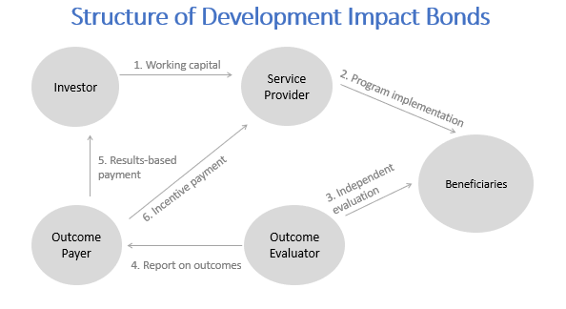
Development Impact Bond
When the Outcome Payer is the Government, this structure is called
“Social Impact Bond”
Adapted from Ziswiler, M., & Terway, A. (2019). Tackling the global education crisis: the UBS Optimus Foundation’s use of social finance. In N. Y. Ridge, and A. Terway (Eds.), Philanthropy in Education (pp. 54-69). Edward Elgar Publishing. CC License.

Slide 15
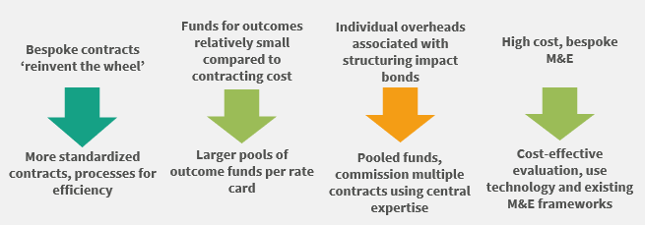
Impact Bonds V1.0 versus Impact Bonds at Scale

Slide 16
Process of Creating an Ecosystem
Supply of high-quality interventions
Securing investment and pricing outcomes
Financial mechanisms
Monitoring, evaluation and capacity building

Slide 17
Perspectives of Engaging Key Actors
Government
Service Providers
Risk Investors
Outcome Payers
CSR

Slide 18
Challenges, Concerns and Lessons

Slide 19
IEOF is work-in-progress
Organization-related
Unique blend of human resources required
No template of work available/Innovative
Require grit and tighter controls over bail-outs
Instrument-related
Only certain interventions can be ‘DIB-able’
Balance between supporting experimentation and proven initiatives
Nonconventional funding not tapped yet
Regulatory restrictions
Cost effectiveness of an intermediary structure

Slide 20
Acknowledgements
Satyajit Salian, Tata Trusts
Social Finance India representatives – Ashutosh Tyagi, Shantanu Ghosh and Rohit Bhatia
Respondents from Central Square Foundation, Educational Initiatives, IndusInd Bank, Kaizen Private Equity, Language Learning Foundation, Nishith Desai Associates
Arushi Terway, Marina Avelar, Marina Dreux Frotte, Gita Steiner-Khamsi (NORRAG) and Nicholas Burnett
Videos - Shiva Thorat, Sayan Bhattacharyaji, Laurent Le Diagon, and Francois de Raemy
Production of the publication - Anouk Pasquier Di Dio and Alexandru Cretu
Administrative support from TISS - Munaf Merchant and Padma M. Sarangapani

Slide 21
Thank you

