Slide 1
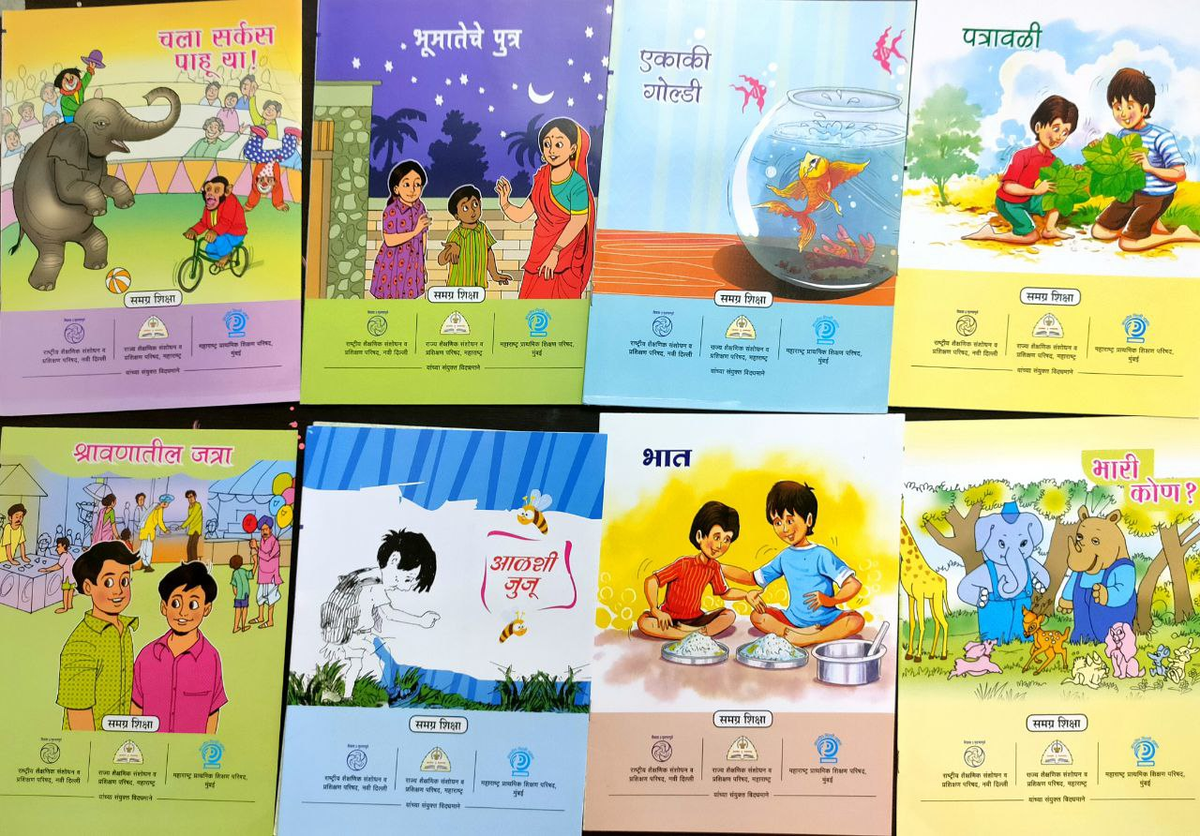
UNICEF-TISS Maharashtra School Library Study 2022 ( Anusha , Sheetal and Ravi )

Slide 2
Overview of the Study
Shala Granthalaya chi Ghosti (The Story of School Libraries in Maharashtra) is a study that responds to UNICEF’s Call for Proposals to assess the status of school libraries in government elementary schools in Maharashtra.
We understand from the call the need to :
use secondary research to establish the importance of libraries as physical spaces to improve literacies ranging from foundational to critical to cultural,
present an analysis of various policies and frameworks related to libraries, especially in the context of Maharashtra,
conduct a survey to understand
the nuances of the libraries that exist in government elementary schools in Maharashtra with respect to availability, quality, access and use of library resources,
teacher preparedness in identifying, selecting and facilitating use of resources,
stakeholders perceptions regarding use of libraries.
gather first hand information with regards to availability of, access to and use of resources in the library,
identify gaps between policy and practice and similarities and differences in stakeholder perceptions.
identify and document best practices adopted by government school libraries.

Slide 3
Objective of the Study
The overall objective of the study is to recommend to the state, practices and policy-level changes for ensuring effective use of libraries to promote literacy and reading in the government schools in Maharashtra.
In particular, the study will aim to-
Compile the various policies and provisions on libraries issued by GoI and in the state chronologically;
Assess the status of libraries vis-à-vis the above policies and provisions at the school level;
Understand the status of libraries from the perspective of number of books available, the types of books, their quality and appropriateness for all children, the functioning of the libraries, and usage among students;
Study the type of trainings given to teachers to promote the use of libraries for students in school;
Identify the gaps in current policies/ implementation and expectations from children and schools;
Document good practices and innovations in the context of libraries and library use in the state.

Slide 4
Methodology and Study Scope
A mixed study methodology will be used that includes secondary data analysis, in-depth literature review, desk review of relevant and credible data sets, interviews with key stakeholders, FGDs and field visits as follows:
Desk research: this will include compilation and analysis of available research studies by universities/ reputed NGOs/ other agencies on the status of libraries in the last five years. Data from reliable data sets such as the UDISE, and reports published by the state on the utilization of library funds will also be considered.
Field Survey: data collection for the study will use both qualitative and quantitative methodologies of data collection, including focus group discussions, interviews, and field surveys with relevant stakeholders.
To the extent possible, we will ensure diversity in respondents in terms of age, gender, and social groups and geographies..
Analysis and recommendations: subsequently, data compilation and analysis will be conducted to provide a final report, including best practices and recommendations. Inputs provided by UNICEF will be incorporated in the report before finalisation.
Target Group :The primary respondents of the study will be district officials (DIET and EO office), block and cluster officials, school HMs, teachers, children, and other relevant stakeholders working in the schools (including community representatives).

Slide 5
Geographical Coverage
The study will be conducted in selected government (education department) elementary (grades 1-8) schools that have received books in the last 5 years and/ or funds for infrastructure to set-up school libraries. The same will include different types of schools based on their enrollment size of the 36 districts in the state.
The first phase of data collection will use rapid survey tools and cover all 36 districts of Maharashtra. The survey form would require facilitation at the SCERT and DEOs level to be sent out as formal orders. This process needs to be supported by UNICEF.
The second phase of data collection will include field visits. The field visits will cover 10-12 districts. This selection would be based on purposive sampling to representatively cover rural, urban and, tribal sites guided by suggestions solicited from the stakeholders, the trends indicated by the rapid survey and the suggestions by UNICEF. The primary respondents will be school HM, teachers, students and those working in the schools in the library space, including community leaders, NGO members and such. The tools used would be interviews and focus group discussions primarily. There will also be observation of a session of students using library resources. In each district, attempts will be made to visit 02 representative schools.

Slide 6
Research Questions and Information Scope
The list below provides the main research questions. Note that these will be finalized by the agency during the inception phase, along with the analysis framework, subject to UNICEF approval.
What are the current policies and provisions with regards to libraries in the state in the last 5 years (central and state)? This will include the following-
The basis of fund allocation and the different grants for setting up of libraries in the school;
Selection criteria of books to be procured for schools (types of books defined);
Process of procurement;
Roles and responsibilities of different state bodies/ departments within Education with regards to libraries;
Policies around the capacity building of teachers with regards to the use of libraries;
Guidelines for the effective use of libraries, including the library set-up/ practices of maintaining books in the libraries.

Slide 7
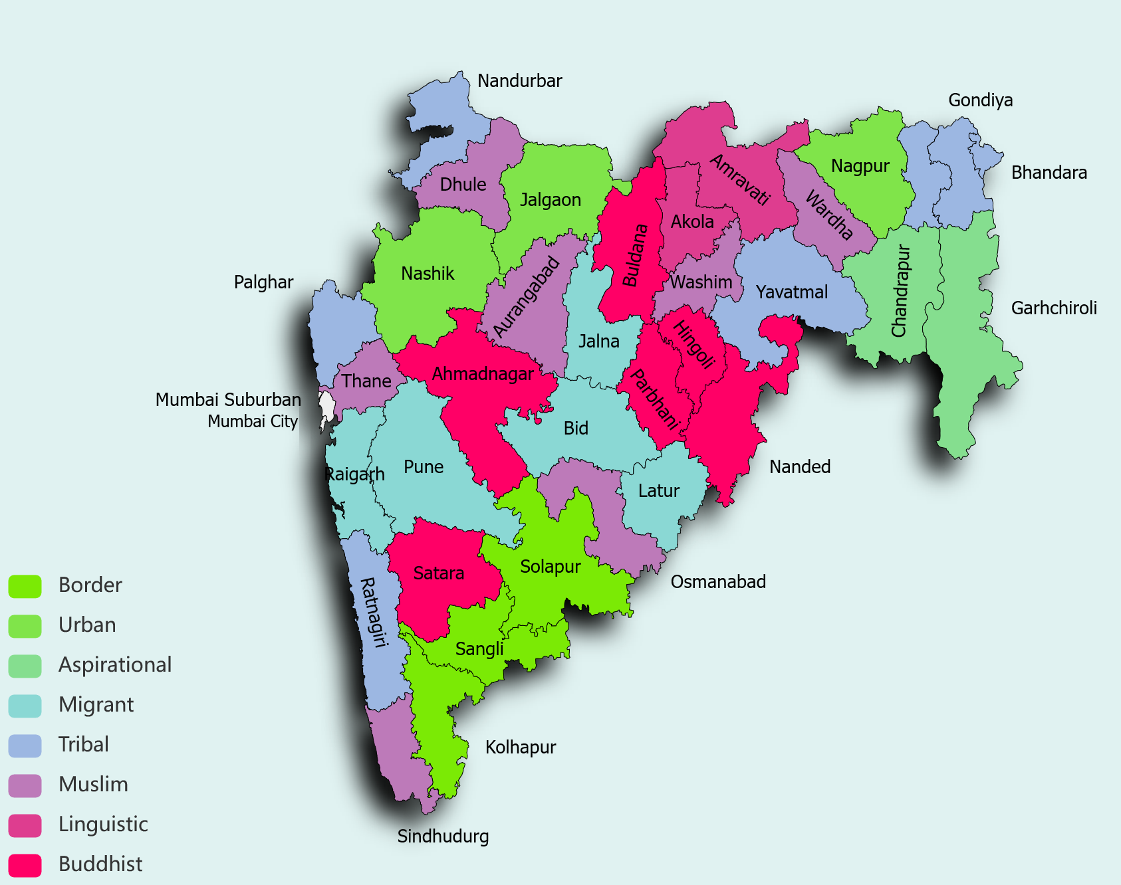
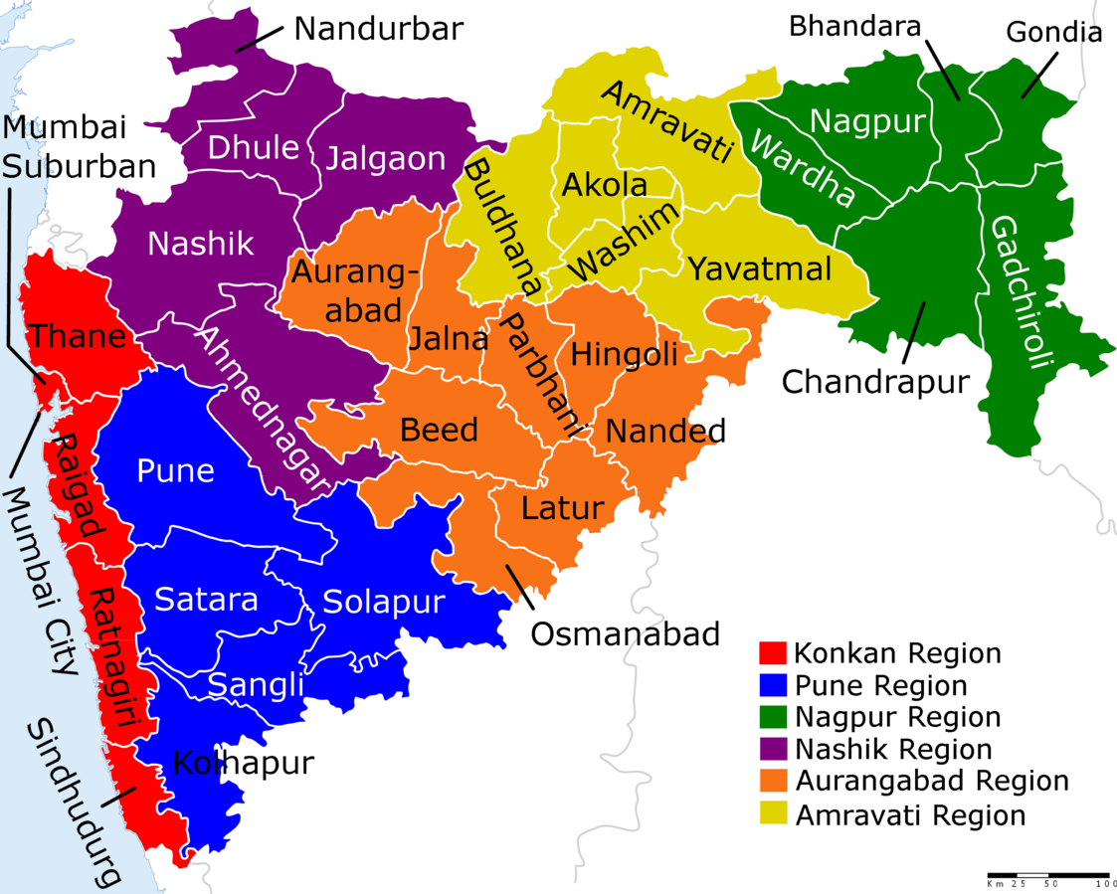
Recommendation for the Selection of Districts
=

Slide 8
The selection of the districts for field visits will be based on four major criteria:
Regional Representation
Geographical aspects (sharing borders with other states, water scarcity, etc.)
Demographics - (Tribal, Religious minorities, etc), the economic landscape (rural/urban/migrant, BPL, etc), and linguistic representation and disability
Aspirational districts

Slide 9
Region | Districts | Criteria
Western Maharashtra | Satara Sangali Solapur Kolhapur Pune | Buddhist Population | Rural | History | Border | Conflict Border | Conflict | Disability Urban-Rural | Border | Conflict | Linguistic Urban | Migrant | Disability
Marathwada | Aurangabad Latur Beed Nanded Hingoli Jalna Osmanabad Parbhani | Urban-Rural | Muslim | Linguistic | Disability Rural | Muslim | Migrant population Rural | Migrant | Buddhist population Buddhist population Tribal Muslim Rural Aspirational | Muslim Buddhist
Konkan | Ratnagiri Sindhudurg Thane Raigad Palghar Mumbai City Mum -Suburban | Tribal | Sex Ratio 1122 | Disability Muslim population | Sex Ratio 1036 Urban-Rural | Muslim | Tribal | Migrant | Disability Migrant Tribal Urban | Migrant | Linguistic | Clubbed with Mumbai-City | Disability
Vidharbha | Gadchiroli Chandrapur Gondiya Nagpur Yavatmal | Border | Naxalism | Rural | Aspirational | Tribal Tribal | Rural Urban-Rural | High density of schools Rural

Slide 10
North Maharashtra | Nandurbar Nashik Jalgaon Dhule Ahmednagar | Tribal | Aspirational District | Disability Urban | Buddhist Populations Muslim Population Buddhist Population Buddhist | Conflict | High Dropout
Vardha | Buldhana Washim Akola Amravati Bhandara Wardha | Buddhist Population Muslim Population Linguistic Urban-Rural | Linguistic Tribal Muslim | Disability

Slide 11
Activity | Deliverables | Deliverable will include | Timeline (since signing of contract)
Inception and desk review | Inception report – max 15 pages, plus annexes | The inception report will include: introduction, context and purpose detailed literature review study protocol method for developing a sampling frame to study methodology including data collection methods, tools (protocols for KIIs and FGDs) identification of key informants and specific settings, sampling, analysis framework, limitations survey instruments final translated data collection tools, ready for field work procedures for data collection and management data collection training guide that will be used by the interviewers/enumerators process followed for finalizing the ethical considerations anticipating the risks involved in the data collection from adolescents work-plan detailing schedule, team members roles responsibilities and logistics | Month 2 This has been shared in stages since the timelines getting shifted.

Slide 12
Activity | Deliverables | Deliverable will include | Timeline (since signing of contract)
Inception and desk review | Inception report – max 15 pages, plus annexes | The inception report will include: introduction, context and purpose detailed literature review study protocol method for developing a sampling frame to study methodology including data collection methods, tools (protocols for KIIs and FGDs) identification of key informants and specific settings, sampling, analysis framework, limitations survey instruments final translated data collection tools, ready for field work procedures for data collection and management data collection training guide that will be used by the interviewers/enumerators process followed for finalizing the ethical considerations anticipating the risks involved in the data collection from adolescents work-plan detailing schedule, team members roles responsibilities and logistics | Month 2 This has been shared in stages since the timelines getting shifted.

Slide 13
Data Collection | Brief weekly updates of progress | progress update as per agreed upon template | Weekly
Data Collection (Rapid Survey and Key Informant Interviews at State Level) | Interim findings presentation – max 20 slides | survey administered to all 36 districts government elementary schools head teachers, teachers and community leaders through DEOs. | Month 3-3.5 Could not be done -- But findings from interviews were shared.
Data Collection (Field Visit and Interviews) | Interim findings presentation – max 20 slides | summary of the progress and implementation summary of findings summary of challenges, issues, limitations summary of secondary data analysis (if any) recommendations for mid-course changes (if any) | Month 4-4.5
Analysis and reporting | Draft and Final report (after incorporating feedback) – max 40 pages, plus annexes | synthesize the findings from qualitative enquiry along with relevant executive summary quantitative analysis Data analysis draft report policy brief state profiles interview/FGD transcripts/recordings key findings and recommendations as well as action points for strengthening the school connectivity | Month 5-6 Is being drafted even as analysis and data collection is ongoing 15 March

Slide 14
Analysis and reporting | Final presentation – max 15 slides | Presentation based on final report | Month 7 15 March
Analysis and reporting | Policy Brief- 4 pages max | The policy brief will help state/ policymakers in understanding the current status of libraries and informing revisions to further strengthen policies and use of school libraries for children in the state. | Month 7 Will be done by 15 March
Translation of final collaterals | Policy Brief Final Presentation Final Report | In Marathi | Month 8 Will expedite this to finish by 31 March

Slide 15
Week 1
15-18 Sep 2022 | Onboarding Staff for Project Literature Review TISS-UNICEF: Meeting 01 Reach out to Constitute Advisory Group District Profile Immediate To-Dos | TISS | Done
Week 2
19-20-Sep 2022 | First Cut of Survey Tool | TISS | Done
21-23 Sep 2022 | Literature Review Begin work on Inception Report Finalize Advisory Group and send documents for review to Group by Friday, 23-Sep-2022 | TISS | Done
19-Sep-2023 to 24-Sep-2022 21-Sep-2022 to 24-Sep-2022 | Advisory Group Nominees from State District Profile to be reviewed and discussed with TISS State Survey Tool to be reviewed and discussed with TISS State | UNICEF | Done Advisory Group Meeting held on Tuesday, 27 Sep 2022 at 2:00 PM Tools were discussed with state in meeting

Slide 16
Week 3
27-Sep-2022 | Advisory Group Meeting at 2:00 PM Explain the project . Share overall timelines Get feedback on Survey tool Get feedback on District Selection Get feedback on overall methodology | TISS and UNICEF | Done State (SCERT) called in by UNICEFf
26-30 Sep 2022 | Survey Tool Finalization District Selection Finalization Literature Review On-going Outline of Inception Report - Outline | TISS | Done
Week 4
3-8 Oct 2022 | Survey Tool Translation Developing Protocols of Administration Region Wise timetabling of Online Interactions Literature Review Ongoing | TISS | Done - Round 2
7-8 Oct 2022 | State Circulars to be released for this study and the tool to be pushed by State | UNICEF | This took time due to Exams and Diwali Vacation.

Slide 17
Week 5
10-15 Oct 2022 | Mapping Survey Tool Progress Conducting Regional Online Meets Generating Interim Reports of Meetings and Survey Field Visit Tools (Interview, FGDs, Observation, etc) Inception Report Draft 1 Finalization - Raising request for Tranche for Field Visit Activities (prep) | TISS | Survey Tool was not released on Field.
Week 6
18 Oct 2022 | 2nd Advisory Meeting Interim Findings Field Visit Tools | TISS and UNICEF | 2nd Advisory needs to be shifted to just the final one due to data paucity
17-21 Oct 2022 | Finalization of Field Visit Tools Updating Survey Findings Setting up District Visits Selection of Interns | TISS | Done (other than in red)

Slide 18
Week 7 and 8 (School Diwali Break - Probable)
24 Oct - 5 Nov 2022 | Translation of tools Finalising Protocols Training Interns Interim Finding of Survey results Fixing up Meetings and School Selection Interviews with SCERT Interviews with key NGO players | TISS | TISS Liaise directly with Samagra
Weeks 9 - 11/12
7/14 - 26 Nov / 2 Dec 2022 (Depending on School Schedule) | Field Visits Stand-up Calls with Interns to track progress and identify key observations (if any) Weekly reports of interim findings (if any stark findings) and progress of field visits to be shared with UNICEF | TISS | Field Visits Delayed to 30 Nov Interns Orientations and such were held.
Week 12
28 Nov - 2 Dec 2022 | Trend Mapping Identifying gaps in data and identifying remedial measures (if needed) | TISS | This occurred as school visits happened
2 Dec 2022 (Friday) OR 6 Sep 2022 (Tuesday) | 3rd Advisory Meeting Sharing of findings from Survey and Field Visits (Initial Trends) Discussion on Analysis aspects Measures to cover gaps, if any What to provide in first dissemination event | TISS | Field Visits were ongoing at this time. Survey tool had not yet hit the field.

Slide 19
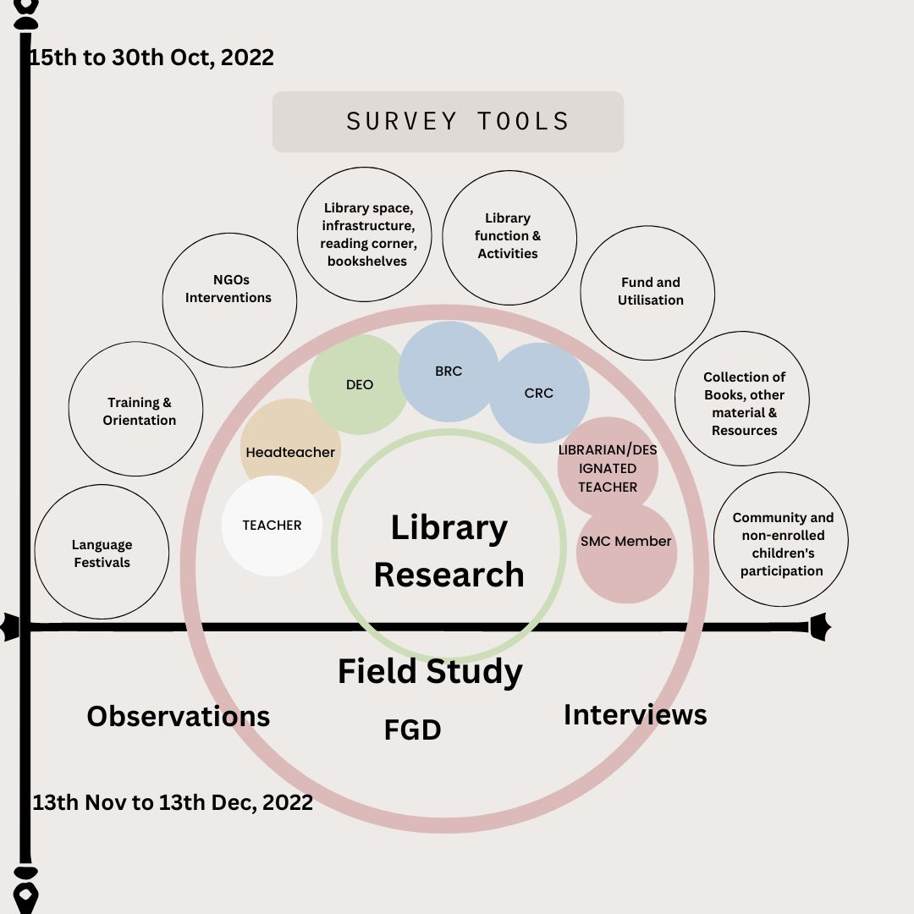

Slide 20
Activities Done
Visited SCERT office in Pune on 1st November 2022
Conducted pilot study of Nashik district on 9th and 10th November 2022. During pilot study FGD with CRC/BRC and DIET faculty
Conducted an orientation program with research interns for data collocation on 25 Nov 2022
Visit 15 Districts School for qualitative data collection with help of Research interns (Date of Data collection November 30 to December 22, 2022
During data collection Conducted FGDs with BRC/CRC, SMC members and conducted personal interviews with DIET faculty, Teacher and HM
Draft key observations of relevant stakeholders after the school visit

Slide 21
Process to approach the Samgara
Prepared survey tool in English as well as Marathi on 25 October 2022. After finalizing the survey tools , we approaches Samgara for the pilot study.
We had sent a letter to Samgra on 11th October 2022 for the Nashik Pilot study
Another permission letter had been written to Samgra on 12th November 2022 for visiting ZP school in 15-district.
Third letter written to Samagra on 13 January 2023 for online google survey form

Slide 22
Key Observation
We visited 15 districts of Maharashtra and conducted FGDs with CRC/BRC with the help of DIET faculty and BEO in Maharashtra. Personal interviews were also conducted with teachers and HMs. These are the most significant observations of the study which help to analyze the education policy.
Self-motivation among teachers is seen as the biggest driver in schools with functional libraries. They are taking the initiative to run the school library.
Funding for the school library has not been available for the last several years. Therefore, most of the teachers are not aware of the special provisions of the school library fund.
One of the schools visited had a special educator who emphasized the lack of books for the CWSN students. The lack of books that caters to disabilities ( Such as Braille or Audiobooks, tactile books, etc. ) further dis -a privilege the disabled as the library is not inclusive of them.

Slide 23
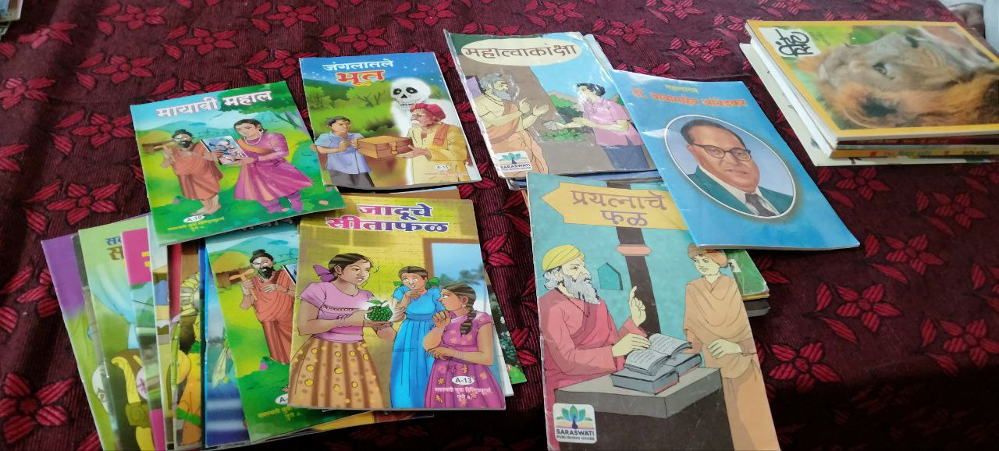
Books Collections
=

Slide 24
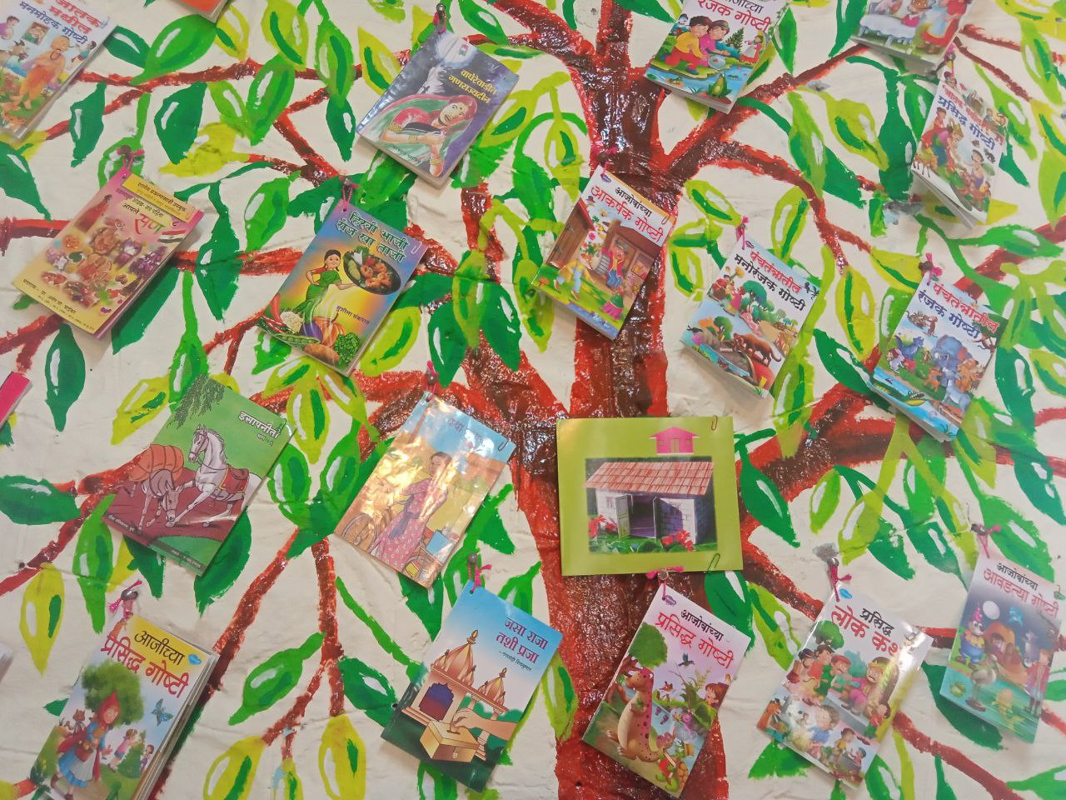
Books Arrangement
=

Slide 25
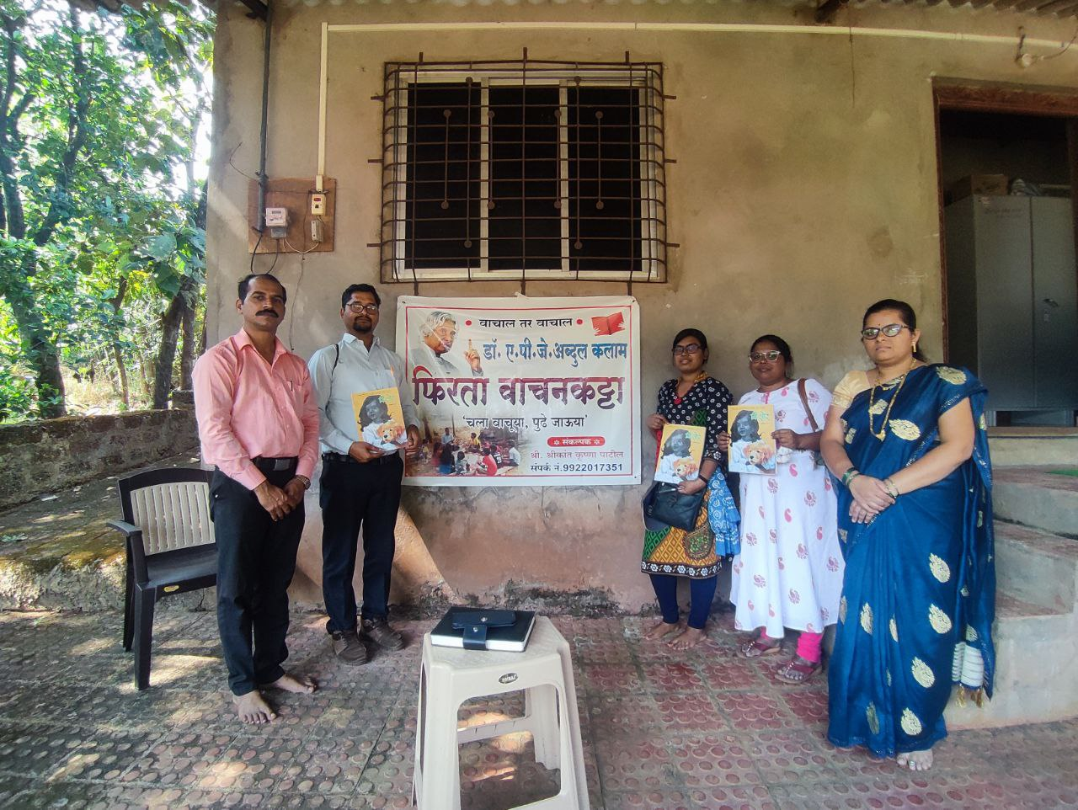
Best Practices of School Libraries
=

Slide 26
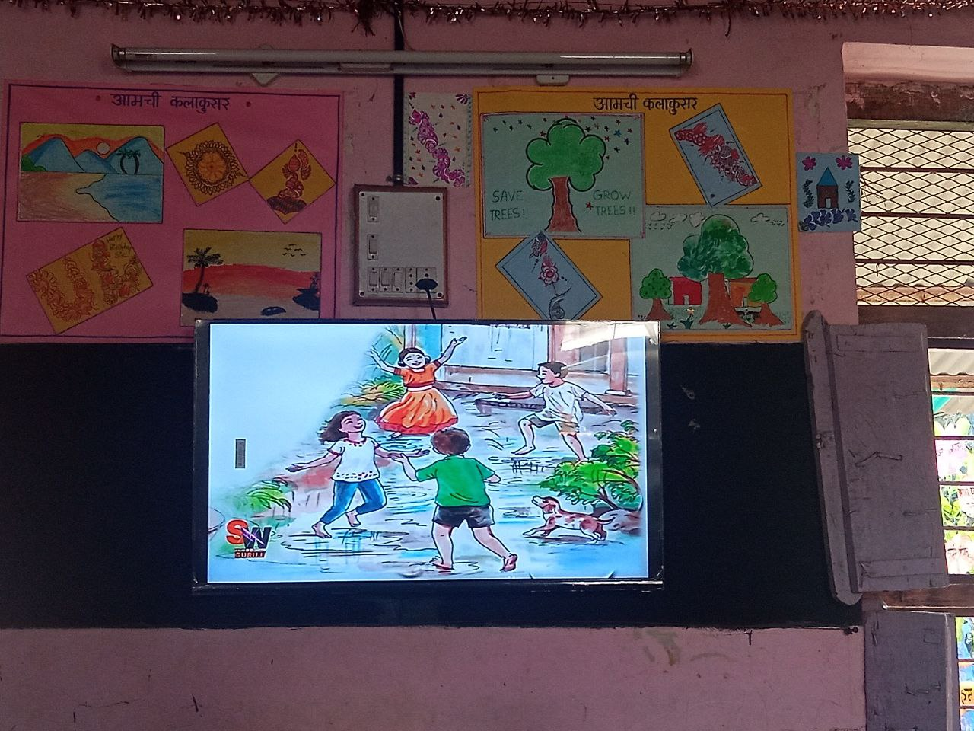
Digital Library
=

Slide 27
Qualitative Data collection and Analysis
Created WhatsApp message and shared google link to DEO/BEO BRC/CRC SMC member ,Teachers and HM with help of Samagra. TISS monitoring the online data as well as connecting with district wise stakeholder for the technical error and help the stakeholder to fill up the online survey tools
Send daily updated message to Samagara Jagtap madam to follow google form
So far online data collected through Google link across the districts
Plan to visit Palghar school on tentative date is 22 Feb and 23 Feb 2023 for group case study of children.
A visit to 'Village Boo/ Pustankacha Gaon' NGO in Satara District is planned on 24 and 25 February 2023 to study and understand community library and people participation which is impactful learning for ZP School children

Slide 28
Preliminary Findings
Qualitative Data were collected through FGDs and in-depth interviews with HMs, Teachers and CRC/BRC and these specific findings emerged.
Books distributions: Teachers and HMs and CRC/BRC said that they have not received specific funds for school library in the last five years. Teachers are self motivated. They are taking the initiative and playing the role of a librarian. They also uses personal money to run the school library. Books are not provided as per the requirement of the school when sourced by gram panchayat, etc.
Languages and Inclusivity: Multilingual and local language (dialects) books are not available for children
Training and Awareness : All teachers were asking for the library training. According to them, school library management training will help them in running the library. Some feel that DIET faculty are willing to conduct half day workshop for teachers on library. According to DIET Faculty appropriate library management training material should be developed. Awareness is important for school library funding and policy and provision.
Documentation and Monitoring : Number of books in school library pertaining the to FLN years that data is not available . 100 days reading campaigning not really working school for long time: No dedicated library period for children.

Slide 29
Challenges
Due to school exams , Diwali vacation and election duties . The teachers was busy with these duty. Hence could not meet the data collocation deadline .
Time is a major constraint for online data filling. Teachers and HMs were busy with school sports activities. Therefore they could not fill the data on time. So it is difficult to reach the target of 15000 data
BRC/CRC teachers were busy with NIPUN Bharat Research and could not fill the online form
DIET faculty plans teacher training for BRC/CRC and teachers. Therefore online region wise as well as district wise meetings could not be held.

Slide 30
 | Name of District | DEO/ BEO | BRC/ CRC | HMs | Teachers | SMC Members | Total Entry | % Entry
1 | Pune | 0 | 0 | 8 | 9 | 0 | 17 | 0.6
2 | Nanded | 0 | 2 | 25 | 16 | 0 | 44 | 0.6
3 | Washim | 1 | 8 | 39 | 15 | 0 | 62 | 0.7
4 | Dhule | 1 | 1 | 4 | 2 | 0 | 8 | 0.3
5 | Gondia | 0 | 5 | 29 | 22 | 0 | 56 | 0.61
6 | Sangli | 0 | 8 | 42 | 26 | 0 | 76 | 0.97
7 | Palghar | 0 | 3 | 9 | 21 | 0 | 33 | 0.4

Slide 31
Recommended next plan of action
During online data collection there are few recommendation from the Samagra and the Education Extension officer :
According to Samagra Jagtap, Madam DIET faculty is the stakeholder of this research. She suggested to develop the separate survey tools for the DIET Faculty.
We got call from the Educational Extension Officer. According to them they are the stakeholders who are handing the fund and distribution the books for school . They want to be part of this research. Therefore separated survey tools are required for the district extension officer.
Qualitative data analysis will be conducted under the following themes a)awareness reading school library fund b)Receipt of funds c) Appropriation of Funds and Utilisation d) Suggestion and Recommendation form stakeholder
District wise updating Google form data data on daily basis. Deadline of the online data collection is 20 Feb 2023.

Slide 32

=

