Slide 1

Inclusive Schools
Day 4
Sustaining Inclusivity
Notes:
Facilitator’s objective of the day:
To ensure that the PDM’s have understood the following at the end of the four-day training program:
That inclusion is a principle and a response to diversity.
Diversity is a natural phenomenon which is treated as a resource
Prerequisite knowledge and skill for facilitators
Prereading(recommended)
Expected learning outcomes from participants

Slide 2
Day | Sub-topic | Concepts | Pedagogy | Time
Day 4 | Sub Competencies mapped:
 | Vision building: Sustaining inclusivity and role of Professional Development Members in promoting inclusive schools | Concept 5: Equality of access- difference between integration and inclusion | Welcome and Community building activity | 30 min
 |  |  | Review of day 1, 2 and 3 | 30 min
 |  |  | Sustaining inclusive schools Imagining an ideal inclusive school model | 45 min
 |  |  | Short Break | 10 min
 |  |  | Brief presentation on equality | 5min
 |  |  | Role of professional development members | 30min
 |  |  | Lunch | 60min
 |  |  | Presentation of two non-Afghan inclusive education check list. | 60min
 |  |  | Free reading activity | 30min
 |  |  | Short Break | 10 min
 |  |  | Structured reflection for the day | 45min
 |  |  | Recap of the training past 4 days and way forward | 10min
 |  |  | GDAS Competency Self-Assessment | 20min
Notes:
Facilitator: to share the plan for fourth day.

Slide 3
Teamwork game
Source: https://crescendowork.com/guide-start-diversity-inclusion-strategy/2019/2/26/group-diversity-inclusion-activities-teams
Notes:
Facilitator: Paper and Basket game:
Objective:
The Paper and Basket game/ Teamwork game is a micro way to show how systemic issues affect individuals and how inclusive principles of collaboration help achieve target and enable more people win.
Materials: Basket/a Bucket, scrunched –up paper balls (as many as the participants are.)
Suggestion: This activity is best with 5-10 people. (If there are more keep a larger basket. And group them into two teams if there are 30 people. One group play while the others watch and provide constructive feedback after the game and provide ideas on how to help)
Instruction to participants:
We are all stakeholders in education and have common goals. We PDMs are part of a larger team doing tasks at varying levels of difficulty to achieve same goal. Play
Part 1: Aim: to throw the balls and get all paper balls in the basket
Start with a basket in the middle of the room or against a wall
Let the participants stand in a line about 10 feet away from the basket.
Give everyone a sheet of old newspaper
Tell them to scrunch it -up into a paper ball
Later spread people out randomly, regardless of physicality or potential skillset. This is done by playing some instrumental music. While the music is on, the participants walk around the basket in various directions without touching anyone. As soon as the music stops, they must stand still where-ever they area and in which ever direction they are.
Note: Let a few be very close to the basket and some far away (keep everyone within 10 feet of the basket but at all different angles)
After they position themselves, explain that getting all the paper balls in the basket is the goal of the game. It’s not an individual game, but a team sport. The only problem - no one is allowed to help anyone else.
Everyone has one shot to throw the paper ball in the basket without moving from their spot
Count how many balls get in the basket, noting who succeeded and who didn’t
Part 2: Aim: to throw the balls and get all paper balls in the basket
After the activity, ask people to continue to stand where they are. Get them to talk about the following.
how did you feel throwing the ball and with the result?
Note what they say. The probable responses could be ,
some people felt fine
some people felt they needed more tries
Some wanted to be closer to the basket.
Some wanted to be farther away from the basket
Remind people - the goal is to get all the balls in the basket. This is a team of individual contributors working towards common goals.
Then tell, you will get two minutes to talk to your team and if anyone who failed the first time need help with ideas, tips, and tricks to get your ball in the basket are free to seek support orally from other team-mates. The condition is you continue to stand wherever you are in the same orientation and position,
Keep everyone in the same positions but let them try again after talking through their issues and getting ideas from their team. This time also count the number of balls inside and outside the basket
Part 3: Aim: to throw the balls and get all paper balls in the basket
Ask again how people felt - did talking help?
Find out how many failed both times ? Give them a third chance and ask if the wish to move closer to the basket. If they accept, move them no more than half-way closer from where they were (e.g. if they were 10 steps away, move them to 5 steps away from the basket).
Let everyone try again. And count the number of balls in the basket.
It is likely that most of the balls can be put inside the basket.
Now explain:
Part 1 of this activity shows how privilege works. Some people simply don’t have the same resources as others, and that affects their workplace performance.
Part 2 shows how a team of individual contributors can still support and help each other. There’s a common team goal, so everyone succeeds when everyone is more able to complete their task.
Part 3 shows how inclusive actions help the team do more. When someone needed an accommodation, they were (hopefully) more successful. Note that this didn’t take away from anyone else’s ability to be successful - and the team overall got more done with simple tweaks for individuals who needed them. Accommodation is one of the inclusive principles without compromising on expectations.

Slide 4
Vision building: Sustaining inclusivity and role of Professional Development Members in promoting inclusive schools
Concept 5:
Equality of access- differentiating integration from inclusion
Notes:
Review of day 1, 2, 3 combining the knowledge to elicit the meaning of equality of access
Objective:
To assess whether the participants have fair understanding of the existence of barriers to education-physical, social and economical barriers. They have understood the meaning of exclusion due to stereotyping and discrimination. Lastly they have understood the principles of UDL. Use the following check list and ask orally if they have any queries / comments about the pointers in the check list.
Believe that diversity is a natural phenomenon, inclusion is a response to diversity.
Aware that most of the barriers to inclusion at both intra and international situations are due to exclusion and biases.
Be convinced that the barriers can be mitigated or minimized in an incremental manner by simultaneously using both top down and bottom-up approaches.
Knowledge of Universal Design for Learning (UDL) to promote inclusion.
Be able to communicate the aspirations of MOE and the strategies of UDL to enthuse and each other and the other stakeholders in such a way that they in turn gradually overtime become competent enough to contribute to the implementation at the grassroot levels.
Conduct activities and presentation to achieve the learning objectives.
Skills of generating mind-maps/ concept maps for planning their activities and also facilitate the same in schools
Can they now develop/use a checklist to identify and record the diversity acting as barrier to inclusion at the school level, develop the competency to facilitate TLC for skill transfer at the intra and interschool levels, facilitate schools towards sourcing and collecting resources for creating UDL classrooms, and develop the expertise of reporting the ground level situation to PDMs in higher offices.
Know the need for accessing resources for cross learning and skill transfer across the schools and provinces .
Providing constructive feedback and guidance to the teachers or community members - a quality essential at all levels between the facilitator and the learner.

Slide 5
Sustaining inclusive schools Imagining an ideal inclusive school model
Objective:
Getting participants to engage in reflecting on inclusive practice, ability to sense the barriers, skills to facilitate and document innovative practices, knack of distinguishing integration from inclusion; formal school from inclusive school, conventional pedagogy from inclusive pedagogy using UDL frameworks,
Notes:
Facilitator:
make five teams. Let the participants call out team 1, 2, 3,4 and 5.
Materials: chart paper, colours, paints, craft paper etc
Activity: 30 + 15 minutes
Each team can sit where ever they want and come up with a model which is an ideal inclusive school with no barriers at all or all barriers are fixed .
in the end each group share the model of their dream school for 3 minutes each.

Slide 6
Equality of educational opportunity
“Equality in education means despite individual differences among the learners, every individual should get equal and suitable opportunity to cultivate her talent and receive education according to her needs and abilities.”
Notes:
Brief presentation on equality of educational opportunity(5 min)
When the participants return, ask the participants to think whether they had thought of equality of educational opportunity in their model schools.
Ask what is equality?
Elicit responses and note it on the chart paper or blackboard. Lastly you give your definition.
“Equality in education means despite individual differences among the learners, every individual should get equal and suitable opportunity to cultivate her talent and receive education according to her needs and abilities.”
Then ask: Do they want to make changes to their model, just in case if anything is left out which could prevent equality of educational opportunity. Once the response from participants is complete, tell them that next you move on to discuss the role of PDMs in inclusive schooling

Slide 7
Role of professional development members
Regular observation and feedback of classroom teaching and school management
Being pragmatic with expectations rather than relying on rhetoric since inclusion requires political will, administration support, teacher skills and availability of appropriate teacher kits
Notes:
Facilitator led presentation of the slide. Getting consensus from the participants
Facilitator should ask the participants to share the following and also note it in their personal diaries.
How do they plan to observe a classroom and provide feed back?
What is the role of PPDMs in regular observation? How is it different from what DDMS would do?
What do they understand by being pragmatic?
What is their expectation from school heads to support teachers ?

Slide 8
Sample observation checklist
https://www.heartland.edu/documents/heip/faculty/QualityInclusivePracticesChecklist.pdf
Index 2002 complete_05 (eenet.org.uk)
Notes:
Facilitator
The following two links are samples of consolidated checklist which shall be used for giving the participants an idea on how different countries monitor inclusivity in their contexts. Files in resources folder:
Quality Inclusive Practices Checklist for day 4, and
Index 2002 complete_05 for Day 4
It is recommended that eventually the PDM will develop indigenous checklist to monitor inclusivity.
Requirement:
If the participants are comfortable in using softcopies, the links may be accessed during training program. Or else sections of this document will need to be printed and used for training purpose
Reference 1: https://www.heartland.edu/documents/heip/faculty/QualityInclusivePracticesChecklist.pdf
Reference 2: Index 2002 complete_05 (eenet.org.uk)

Slide 9
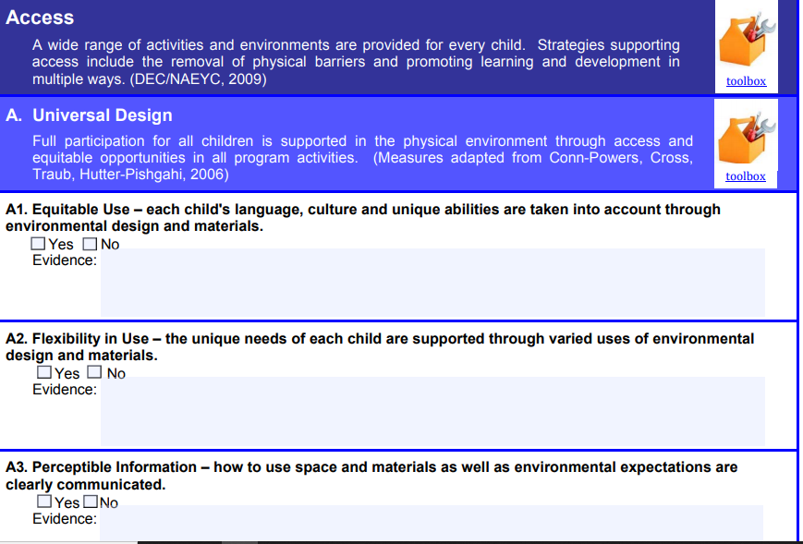
Sample from :https://www.heartland.edu/documents/heip/faculty/QualityInclusivePracticesChecklist.pdf
Notes:
To the facilitator: The format is used for discussion during last day of the training:
It is recommended that eventually the PDM will develop indigenous checklist to monitor inclusivity.
Requirement:
If the participants are comfortable in using soft copies, the links may be accessed during training program. Or else sections of this document will need to be printed and used for training purpose

Slide 10
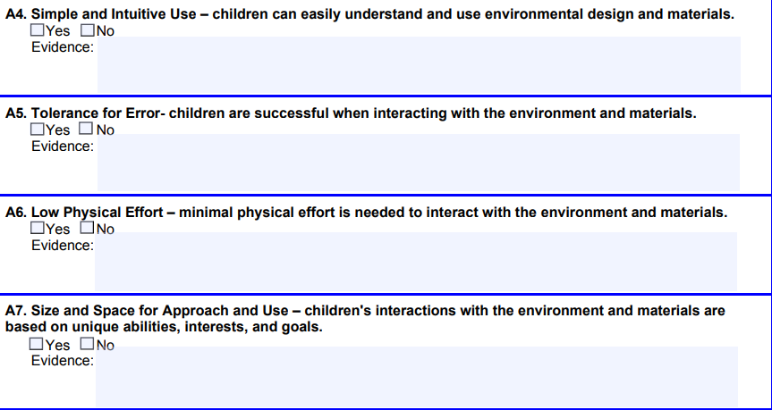
Sample from :https://www.heartland.edu/documents/heip/faculty/QualityInclusivePracticesChecklist.pdf

Slide 11
Structured Reflection session
How | Why/What/Which/When | So What
Positive emotion | What went well for you? Feedback for the facilitator’s presentation
involvement | Which activity gave you insights? Which activity kept you engaged? Which aspect were difficult/easy?
Peer relationships | What was your experience in communicating? With facilitator/coparticipants
Understanding | What were your expectations for the day? What do you want to share or get clarification from the facilitator? What more are you expecting from tomorrow?
Achievement/ Accomplisment | Why are you satisfied/not satisfied? What is your take away?
Notes:
To Facilitator:
Every day ends with structured reflection of the day.
Objective:
This is to simulate the TLCs facilitated by trainers. For this all participants are required to sit in a circle along with the facilitator.
Materials: (If needed the ppt slide can be displayed)
Participants must have their pens, interactive diaries and their personal notes.
In the interactive diaries they need write to the facilitator as a feed back, seek clarification, share their points of view.
In the end the facilitator will collect their diaries and respond in writing to each one of them and return it the next day morning.
In the personal diaries the participants make notes from the discussion they carry out on the topic,
It is recommended that the Facilitator makes note of intangible feedback from participants various feelings such as happiness, disappointment etc. and use them as examples to draw their attention towards implications of barriers.
The following are some of the questions which can be kept on as a slide to facilitate the structured reflection session:

Slide 12
Core Competency | Highly Proficient I have 100% of all these | Mildly Proficient I have more than 80% of these | Low Proficient I have between 80% and 50% of these | Not Proficient I have less than 50% of these
Education expertise: The knowledge, ability and a sound understanding of Education Policy Development, School Management , Develop Self and Others, Decision Making
Knowledge of education system, policies, rules, and norms: Knowledge and understanding of Afghanistan education law and procedures, Knowledge of National Education Strategic Plan, Sound understanding of MOE education policies, SOPs, guidelines and forms
Working effectively with others Honesty and Integrity, Teamwork, effective oral communication, Active listening, building community relationship, Negotiation and conflict management, Adaptability, Empathy, Flexibility , Influencing
Problem solving and decision making. The ability to use analysis, wisdom, experience, logic, creative and critical thinking to take effective, considered, and timely decisions by gathering and evaluating relevant information from within or outside the organization and making appropriate judgements to establish shared ownership and effective action.
Knowledge of teaching methodology Honesty and commitment to the profession, Impartiality and fairness, Positive and conducive learning environment setting, Multiple teaching methods and instructional strategies to engage students in learning process effectively, Effective communication with students and parents
Knowledge of pedagogy Knowledge of Pedagogical Approaches, Knowledge of learning and teaching processes, Knowledge of learning theories, Knowledge of digital pedagogy, Child Psychology. The knowledge of Pedagogical Content Knowledge (PCK) and General Pedagogical Knowledge (GPK), Digital pedagogy, classroom management and content-related skills.
:
Notes:
To facilitators:
1: This form which the participants are familiar (filled the first day) is distributed. Ask the participants to write their full names and then fill the form.
2: Then they need to self-evaluate their competencies and return the forms to the facilitator.
3: Suggestion: The participant’s first and last day forms can be entered in a spread sheet, so that the participants may periodically return to this form to assess themselves and work on further developing their competencies.

Slide 13
Conclusion
How you are?(playing role model):
Adaptability, Empathy, Flexibility, Honesty and Integrity
How you do? (Demonstration in action):
Teamwork, Effective oral communication, Active listening, Influencing
Why?(for what/ to achieve):
Building community relationship, Negotiation and conflict management

