Slide 1

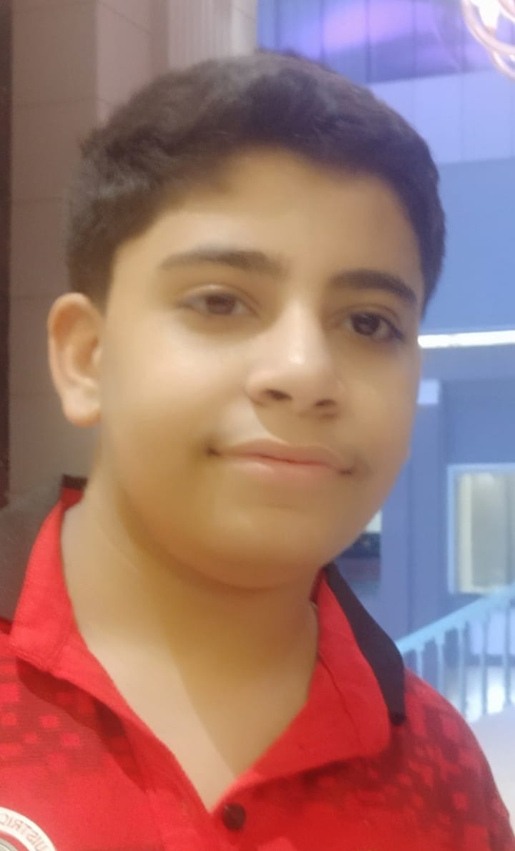
Transmedia Storytelling Module
JAIRAJ DUA ,
SOSE, BLUEBELL,
ROLL NO.18

Slide 2

Topic of the story : The Impact of Covid-19 on our family.. A true story

Slide 3

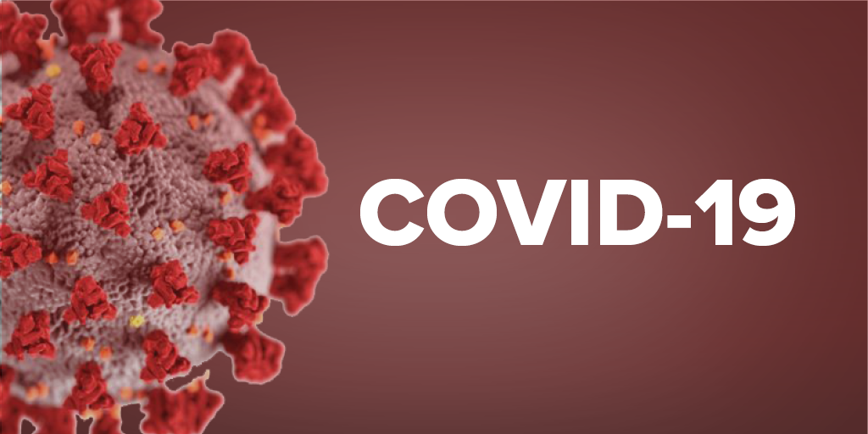

Slide 4
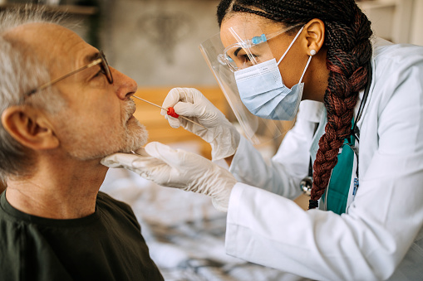

Slide 5
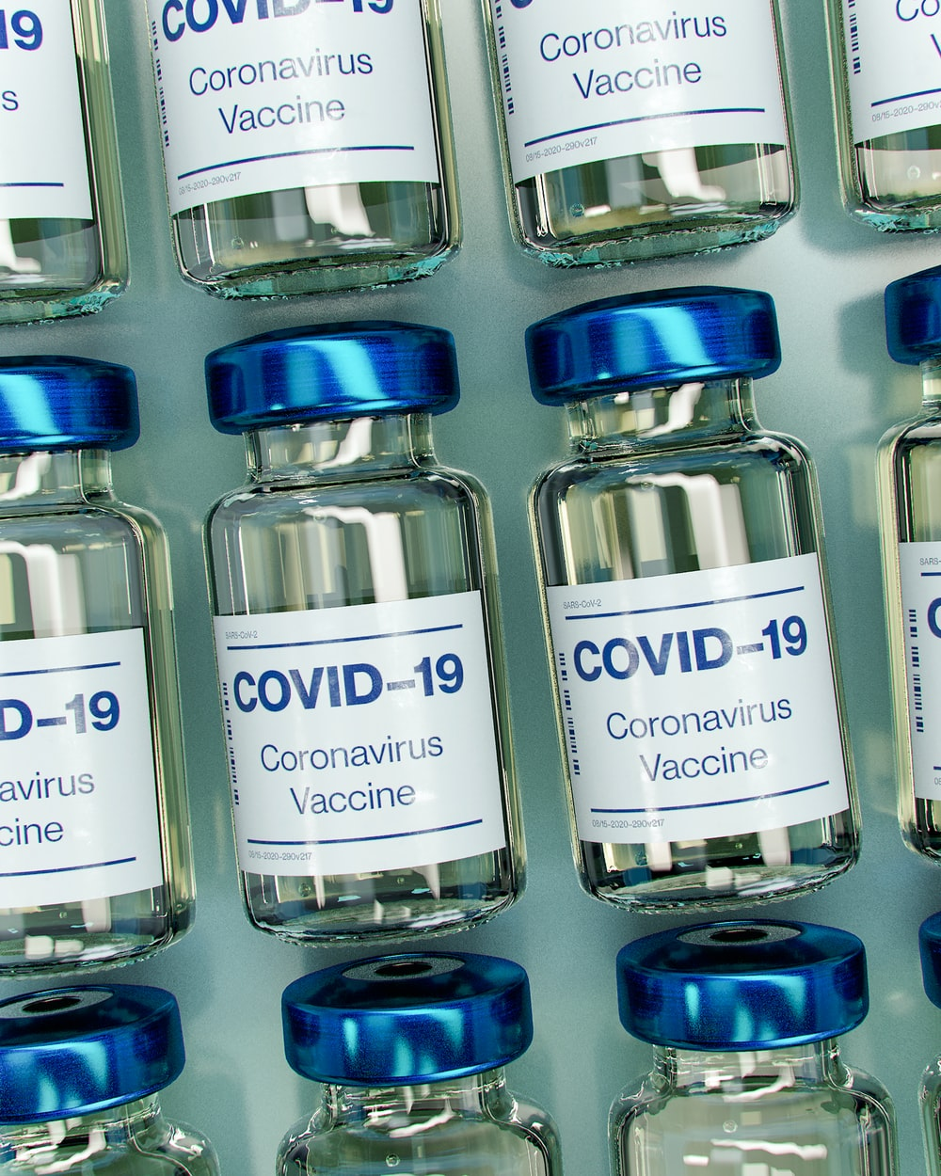
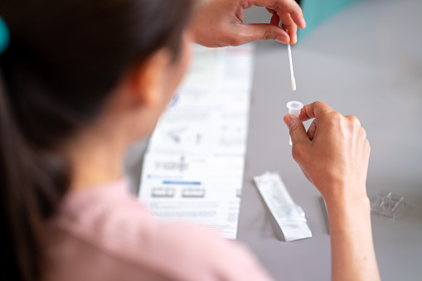

Slide 6
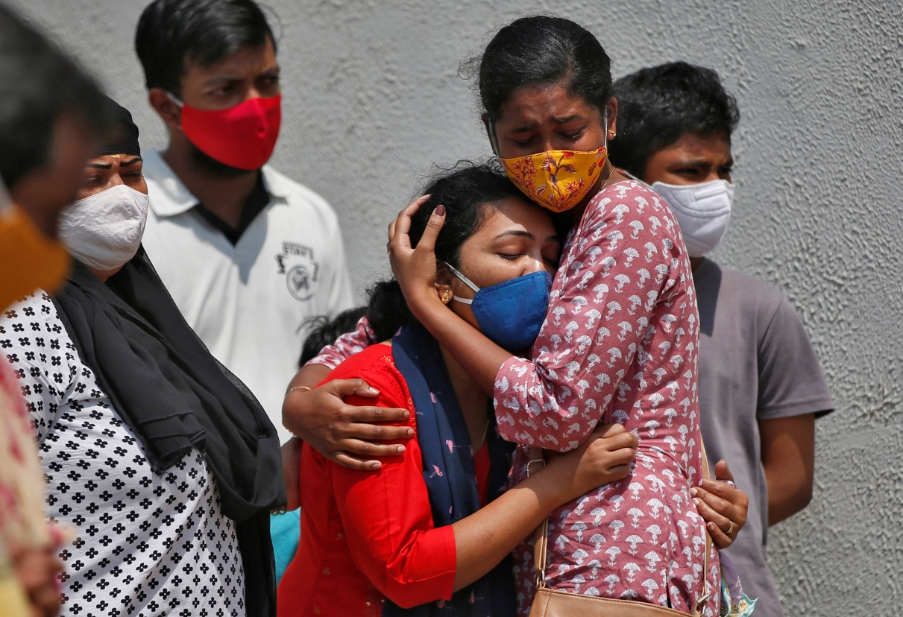
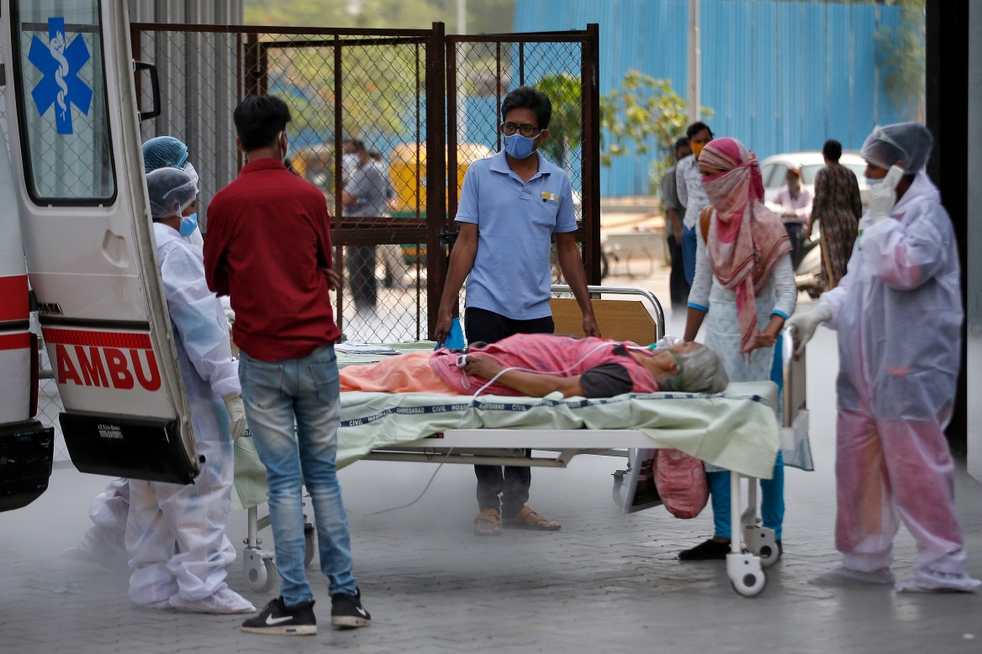

Slide 7
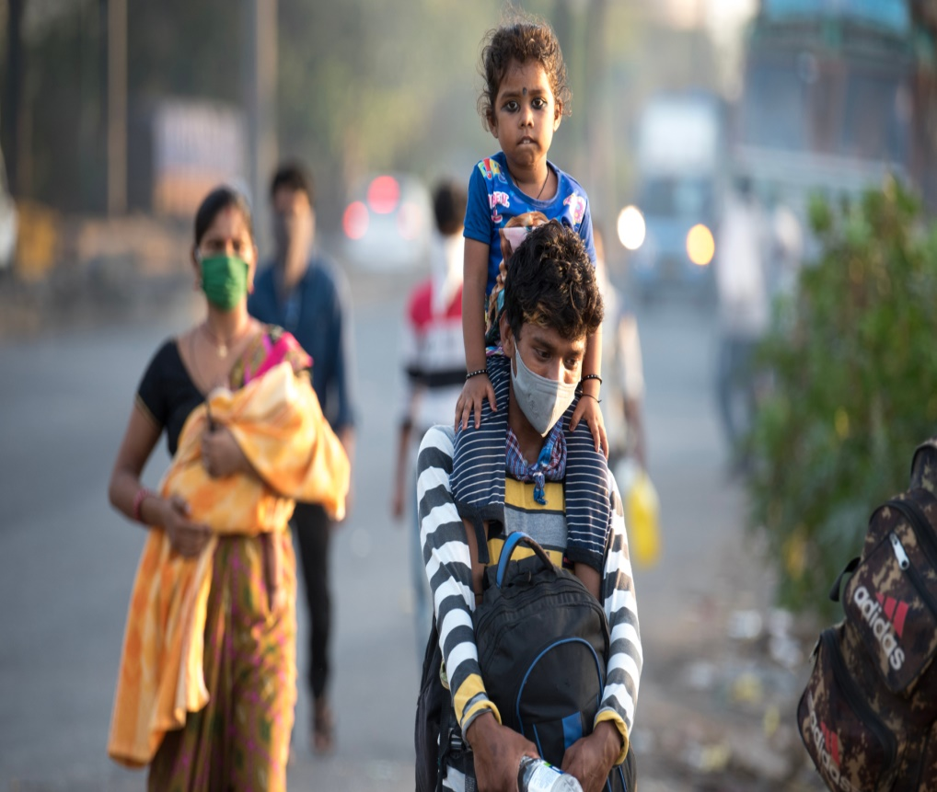
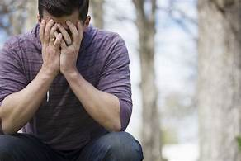

Slide 8
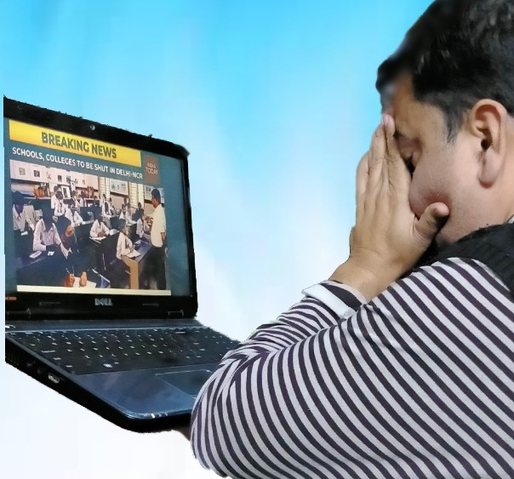
It is said that when a person is sitting with his hands on his head, he is in a big dilemma.
I've seen my dad sitting like this many times.

Slide 9
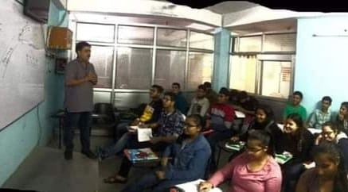
One day I saw my father staring at the ceiling with tearful eyes . My mother tried to console him but in her heart she also was scared .
My dad is a private teacher and he runs a private coaching centre with some friends.

Slide 10
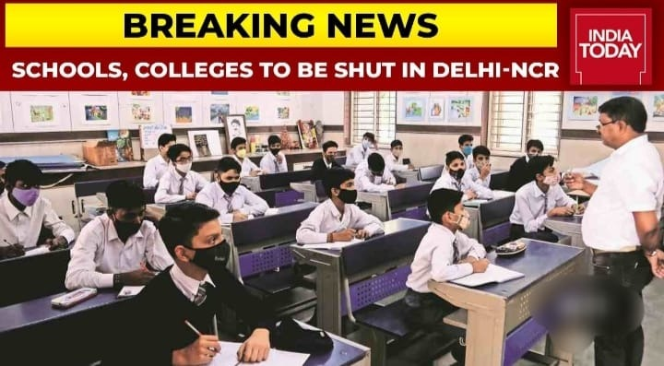
I wanted to know the reason for his concern.
He said that We have lost many of our close ones during this pandemic.
During this pandemic, the government decided to close down all schools and colleges.

Slide 11

There has been a change in the way we teach.
Earlier where we used to teach children in offline mode, now we had to create an online platform for them.
It was a new experiment for all of us.

Slide 12
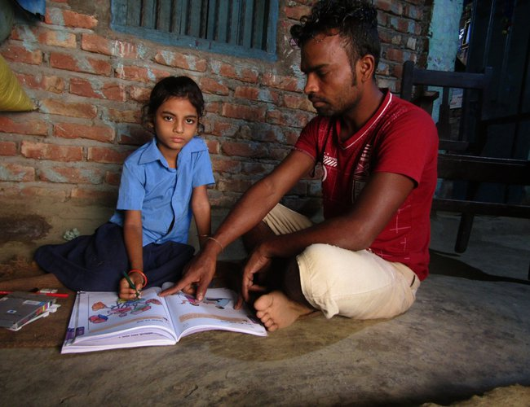
He was mainly concerned for children who belonged to poor families. Those who didn't have smartphones , internet connection and laptops to take their online classes.
Some of the children stopped tuition classes because their parents have lost their jobs in this pandemic.

Slide 13
Which has also had an adverse impact on our income. We have no other source of income except tuition fees. We have to pay Loan’s EMI , rent, your and yours sister’s school fees , household expenses, etc. Now we have no other option to use our past savings.
But on the other hand, there is no reduction in the expenses of our house.
When parents were asked to deposit their children's tuition fees, they often avoided saying that there is an epidemic right now and not in the stage that we could deposit our children's tuition’s fees . There were also some parents who were very rich in themselves.

Slide 14
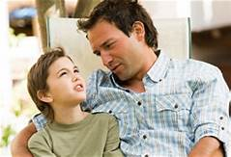
I asked dad why did you teach those kids when they were reluctant to pay the fees.
He replied that "If I do that too, there will be no difference between them and me.
He always says, Education is the most powerful weapon by which we can change the world.
The journey which started from March 24, 2020 to the present has been very difficult for us.

Slide 15
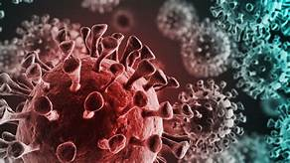
I hope this epidemic ends soon.

Slide 16
Being a sensitive child I could understand the entire situation but could not help him out .I studied in private school which had a big fee. I saw forms for SoSE and I decided to appear in the examination . I got admission here and now I am happy to study in this school of international standard. This was a little support to my father from my side. I shall definitely be successful in my life and make my parents proud of me

Slide 17
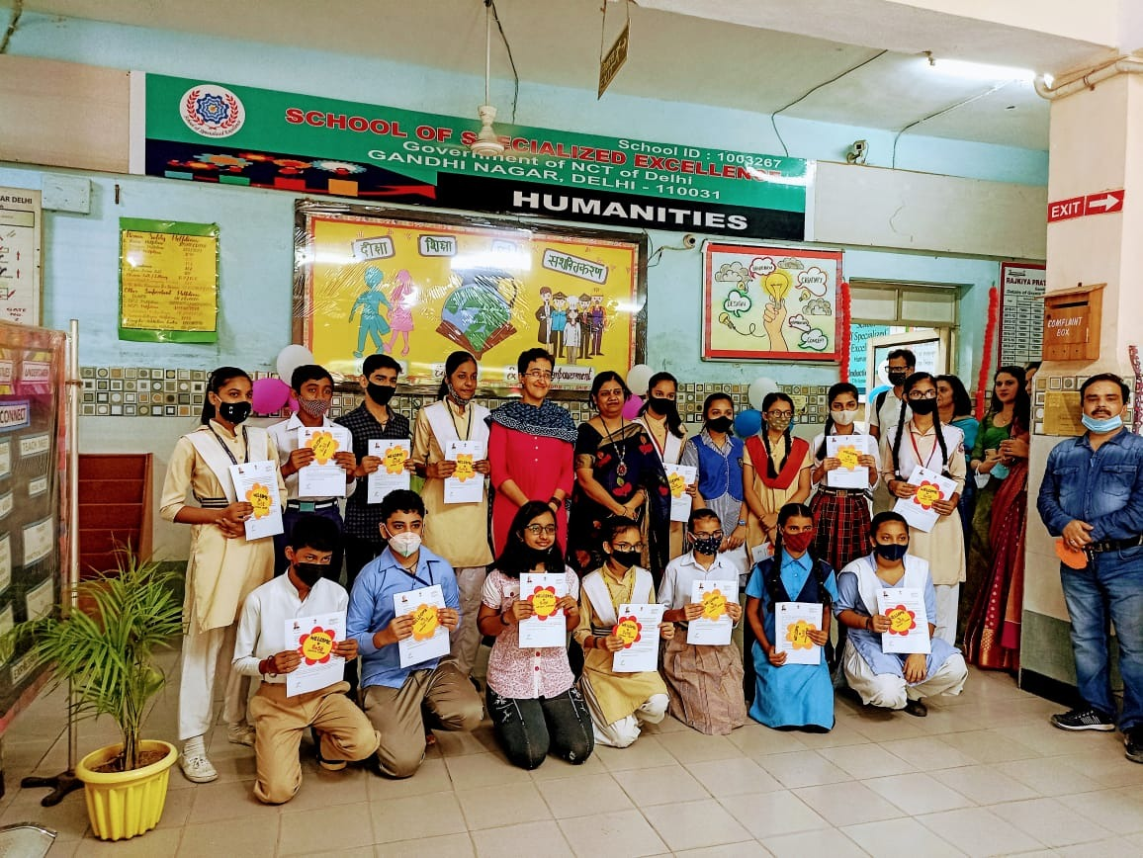

Slide 18


