Slide 1
State of the
State of Education Report for India: Teachers and teaching
2nd meeting of the board
21 May 2021
1.Work of the last 3 months (since inception report ie Feb18.2021)
2. What will the report likely look like
3. How we plan to get there (what we are going to do in June and July

Slide 2

Preparing a report in the times of a pandemic

Slide 3
Plan and status
feb | Commencement of activities. Putting team together. Inception report. Bibliography and literature review begins. Data sets are identified | Completed as planned
mar | Literature review and data analysis TET exam is examined and analysed | Literature: identified and almost complete using zotero. Review in progress Data access: UDISE, NSS. partial access to CTET. more on this
apr | Schemes and policies are studied. Key informant interviews are conducted. Small survey is designed to be conducted. | Schemes and policies identified and partially completed. State selection for small survey of TE is planned. Survey is piloted. Key informant interview not conducted.
may | Emerging trends are presented to Board Small survey conducted Case studies are identified and built | Survey is in progress. Emerging trends for some parameters. Have not yet identified themes or cases

Slide 4
Data:
1 | UDISE | Profile of teachers, working conditions, teacher deployment (state, management, rural/urban→ PTRs, school size, availability of head teachers, incidences of supervision and monitoring) gender, age, caste, qualifications (academic and professional), availability of subject teachers. Trends vis a vis teachers in private employment, type of contracts, teacher qualification. Teacher vacancies. Projection of current teacher requirement based on pupil strength and RtE norms for PTR; projection of subject teacher requirement.
2 | NSS | Socio-economic profiling of those who report employment as teachers.
3 | CTET | To project teacher supply for primary school and subject teaching (based on paper2)--who applies, who qualifies. To understand ‘quality’ of teacher supply--who passes. Caste and gender profile of who qualifies. Strengths and weaknesses in performance (based on performance in different parts of the paper). What are the institutions from which successful students come? How well do their 12 class, UG and BEd/DElEd grades correlate with TET performance? Item categorisation: content, PCK, etc carried out. Analysis to tell us within the paper, which are the items where they perform well and which ones do they not perform.

Slide 5
Data continued
4. | State TETs | Approach for more ‘drilling down’ for state level information restricted to a selection of 5 states in the country: Karnataka, Maharashtra, Madhya Pradesh, Delhi, Assam (Himachal, Odisha, Gujrat--considered), Gained access to Karnataka-TET. In process for other states.
5. | NCTE data base on TE programmes in the country | To understand teacher supply. No response to repeated requests to date.
6. | Shala Siddhi CENTA | State reports Not yet requested

Slide 6
plan
 | Themes in literature and primary data | Policies, schemes, state action/efforts | Case studies
Chapter 3: the teaching profession | Literature, ‘statisfaction’ Data on private employment limited | Do/what-kind-of incentives work? For whom and when? What has been tried? Is there better monitoring and accountability in pvtly managed schools? What is the role of Teacher Unions . recruitment and transfers, use of technology
Chapter 4: Teacher professional development and teacher supply | Literature: who comes to be a teacher (does the profession attract ‘talent’/why whynot? Small survey of TE institutions Opportunities for inset: technology. | Institutional development and govt investment (CSSTE scheme) Role and effect of NCTE and regulation, effect of TET, DIKSHA and use of technology
Chapter 5: Quality of teaching | Classroom studies what ‘sticks’ and why Relation to student achievement/NAS results | Monitoring tools, ‘teacher management’ tools, PINDICS, Shala Siddhi NEP: PSSB, use of technology
Chapter 6: Teachers and teaching in COVID times | Recent studies and newspaper reports to some extent also from survey 1

Slide 7
Key informant interviews and small survey
 | bureaucracy/regulators/administrators | employers/schools | Professional development institutions | ‘Influencers’, experts, Think tanks,NGOs, professional bodies(?) | Primary stakeholders: teachers, parents, children (?)
National | MoE NCTE,/ CBSE for TET, RCI | CBSE, ‘Societies’ such a NVS and KVS | NCERT | EkSTEP-DIKSHA
state1: |  | DoE/CPI Private school/private school associations | SCERT Survey 1: TE departments and colleges (govt, uni, aided, private self financing, for different types of programmes |  | Teachers from private schools Teacher unions(?) Children: what do we value most in teachers? parents?
State 2:
State 3:
State 4:
State 5:

Slide 8
Small telephonic survey wrt Teacher Education institutions
Who comes to the programme
What works, what does not
What are the sectoral trends
What is desirable to happen
What is readiness to implement NEP recommendations
What are conditions of TE
What is the impact of COVID
Where do students get employed? What do they earn?
How many pass in TET?

Slide 9
Literature review: 491 research papers (2010-2021); 68 journals
Key policies, schemes and initiatives:
NEP 2020
CSSTE → Samagra Siksha Abhiyan
PMMMNMTT
DIKSHA, SHAGUN, PGI, NAS, TET

Slide 10
classroom processes | blended learning-literacy and numeracy, diagnostic feedback - difference in teacher performance between intrinsic and extrinsic motivators, concept of teacher orientations, science teaching, hybrid learning space, maths teaching,teacher knowledge learning in situ, multigrade-multi level CR,
comparative studies of teacher education | HESSA
CPD: identity formation
CPD: quality
CPD:diagnostic tests, feedback to teachers
CPD:Experimental/Interventions | professional dialogic interactions, modeling of pedagogic strategies , collaborative apprenticeship model
CPD:implementation factors: | beliefs, motivation, support college admin, students response to use technology. T's awareness about S's meeds,
CPD:NCFTE
CPD:types:virtual/open online course | virtual-satellite, open online courses using MOOCS
CPD:types:VTF | Voluntary Teacher Forums,
General state of education:Socio, economic,political issues of teachers | historical accounts, books, book reviews,

Slide 11
Knowledge and Competence: student achievement | unobserved characteristics of teachers (teacher efforts, teacher ability, teacher motivation, teacher's lack of faith in educability of the poor )
Knowledge competence skills: attitude towards learners | labelling, child friendly classroom,
Knowledge competence skills: ICT | inequality,social concerns, interventions in quick succession with little time to revisit the earlier interventions, acceptance of ET
Knowledge competence skills: inclusion | special education, disability, economically poor, first generation learners,
Knowledge competence skills: OER | availability, access
Knowledge competence skills: perceptions about subjects | English, mathematics, evs, social science, visual and performing arts, first language,local languages,
 | science, outcome expectancy beliefs, case study from Hoshangabad
 | Visual arts, pe/games/sports, pupil’s health and sanitization, corporal punishment
Knowledge, competence skills-assessment | Teacher performance assessment
Knowledge, competence skills- disciplining | corporal punishment

Slide 12
Pandemic times: | challenges for teachers
Policy and Programmes: evaluation of CSSTE
Policy and programmes: impact on profession
Policy and programmes: reforms and change management | professionals, accountability, autonomous,
Policy and Programmes: rethinking curriculum | :post covid,NCFTE review
Policy and Programmes: Shala Siddhi | National Programme on School Standards and Evaluation- a programme document
Policy and programmes:collaborations /PPP: | TESS, TFI, APF,Agastya,HSTP,Ekalavya,NGO
Policy and programmes:review of policy | NCF 2005, NEP 2020

Slide 13
Preservice: privileges | for underprivileged, reserved categories,
Preservice: quality | PCK, competency, knowledge of social justice, gaps in learning about curriculum, problems, theory for assimilation vs understanding
preservice: teacher educator | teacher educator's education
Preservice::teaching context | : language, math,science,social, other subjects
Preservice:comparative account
Preservice:courses | 4yr integrated
Preservice:NCTE data/information | response to covid-oer,
Preservice:perceptions | inclusion, science teaching
preservice:regulation | RTE and its impact on teacher labourforce and meeting supply demands
Preservice:types of players | public, private, policy issues

Slide 14
Service condition:job satisfaction, collegiality | stressors
Service condition:response to covid pandemic
Service condition:school governance, supervision, transfer | motivation, responsibilities,
Service conditions: absenteeism
Service conditions: unions
Service conditions: Dispute redressal forums
Service conditions: health | voice related
Service conditions: influence of community
Service conditions: motivation
Service conditions: multiple factors, classroom culture | ethos, infrastructure, classroom organisation,
Service conditions: pvt vs public school
Service conditions: resources | textbooks
Service conditions: social distancing ( in terms of similarity in economic status/class, caste, sub-caste,gender with pupils/ colleagues/community)

Slide 15
Supply and demand of good teachers-contractual teachers
Supply and demand of good teachers-gender | contradicting UNESCO's claim (2006) No correlation between gender and student achievement
Supply and demand of good teachers-private | RtE, inclusion in private schools, social discrimination and inequality
Supply and demand of good teachers-public | deployment, school allocation
Supply and demand of good teachers-regional differences and why | Goa-historical, TET
Supply and demand of good teachers-shortage | shortage, surplus, unemployed trained teachers
Supply and demand of good teachers-tuitions

Slide 16
Teacher career: teacher pay
Teacher careers: Leadership-women
teacher careers: para teachers | competency, quality
teacher careers: teacher contracts in private and public | regular, temporary
teacher careers:accountability:influence of other stakeholders | Politicians, Governemt officials
Teacher careers:Performance pay
Teacher education: Policy and schemes wrt TE
Teacher eligibility and aptitude test | responce to TET by private teachers,
Teacher eligibility and aptitude test | attitude towards tet, B.Ed students
Teacher status: Comparative accounts

Slide 17
Some emerging insights from our small survey
Bindu

Slide 18
Some analysis on CTET
Ruchi

Slide 19


Slide 20
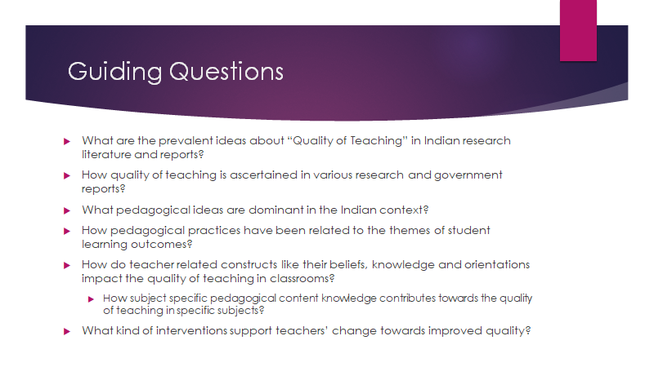

Slide 21
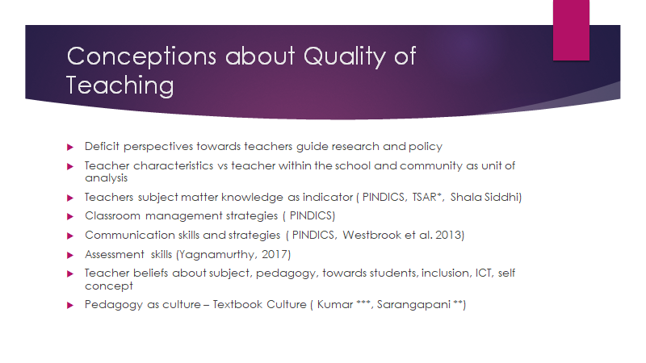

Slide 22


Slide 23
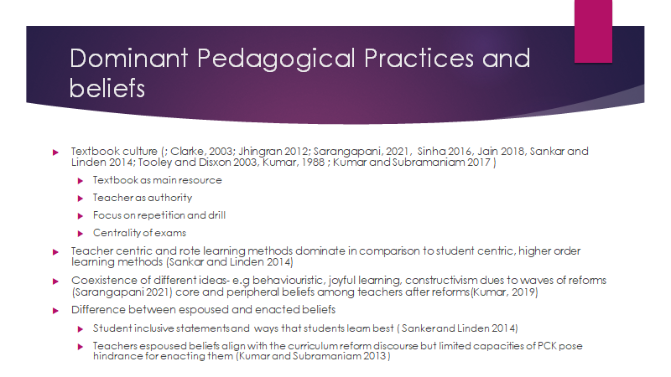

Slide 24


Slide 25
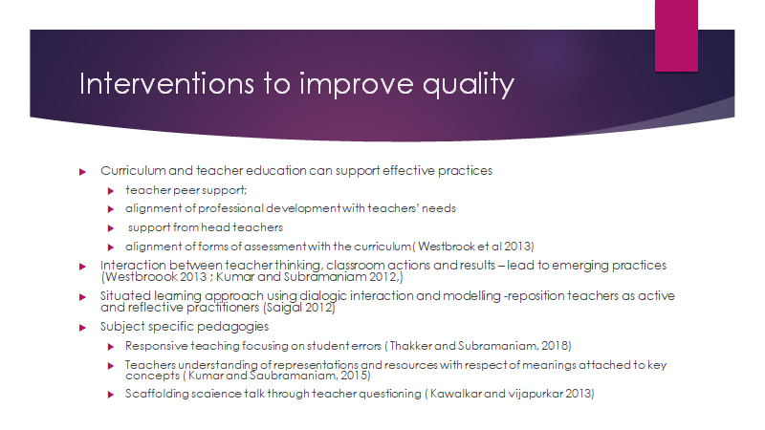

Slide 26


Slide 27
What focus shall we bring to the report?

Slide 28
What are some of the key issues and policy directions for which the report will try to present the status based on evidence as of today and also flag lack of adequate data/research evidence?
NEP 2020,
UNESCO (2015) Teacher Policy Development Guide
and select other indicators wrt SDGs
and key global and national concerns/considerations)

Slide 29
NEP
1. Replacing the 2-year Bed as the dominant mode with a 4-year BA-Bed/BSc-Bed programme providing different pathways to prepare teachers for different stages of school (foundational (including ECCE), primary, middle and secondary) and subject areas (including art and physical education). Strengthen the curriculum of ITE to enhance greater understanding and ability for foundational learning.
2. Improving working conditions of teachers and involving them in school governance, and recognising their autonomy in pedagogical matters, ensuring non teaching work is eliminated, incentivising teachers, and supporting them to work in rural areas with provision of housing etc.
3. Creating a needs and interest based system of continuous professional development for teacher with upto 50 hours of professional development to be provided every year.
4. Creating and instituting professional standards which will govern the profession and be linked to accountability, monitoring, professional development, career pathways within each stage, and vertical mobility within government structures and institutions
5. Improving teachers management, with greater recruitment at school complex level, teacher resource optimisation at school complex level, transfer policy, filling vacancies, ensuring availability of subject teachers,
6. Strengthening quality by improving the teacher eligibility test, which will be required even for private school employment, attracting more rural students with knowledge of local languages into the system with more scholarships for students.
7. Strengthening regulation and oversight of teacher education colleges so that substandard programmes are eliminated and all teacher education begins to take place in multidisciplinary environments and composite institutions. Placing TE within higher education, and integrating TE regulation into HE regulation.

Slide 30
● Extensive use of technology to improve teaching learning and educational planning and management
● A light but tight regulatory framework to ensure integrity, transparency and resource efficiently, encouraging efficiency of the educational system, and innovation and out-of-the-box ideas
● Outstanding research for the sector
● Continuous review of progress based on sustained research and assessment

Slide 31
Unesco-2015 guidelines
Recruitment and retention
2. Teacher education (initial and CPD)
3. Deployment
4. Career structure and paths
5. Employment and working conditions
6. Reward and renumeration
7. Standards
8. Governance
9. Accountability

Slide 32
Other relevant themes
Other issues:
Gender
Global warming and the environemnt
Peace
resilience

Slide 33
From unicef
Though the TOR mentioned that the report will highlight dimension relevant in the context of the Pandemic, COVID-19, it will be important to explore the implications of COVID on the teaching profession and its implications for the future of teaching in India – seeing the role of the teacher beyond the classroom as teaching and learning takes place inside and outside of the classroom. Especially as it relates to teacher education, working conditions, standards, and accountability.
It will be important that the questionnaire reflect the views of respondents – school principals, teachers, students, and parents – from diverse backgrounds (ST, disabled, SC, minorities, migrant, urban poor) and rural/urban/remote divide.

Slide 34
Much needed: your inputs, advice and suggestions
What is desirable
What is doable

Slide 35
