Slide 1

Welcome to the launch of
The Right Teacher for Every Child
State of Teachers, Teaching and Teacher Education Report for India 2023
The event will start at 05:00 pm (IST); 11:30 am (GMT)
Thank you for joining!

Slide 2
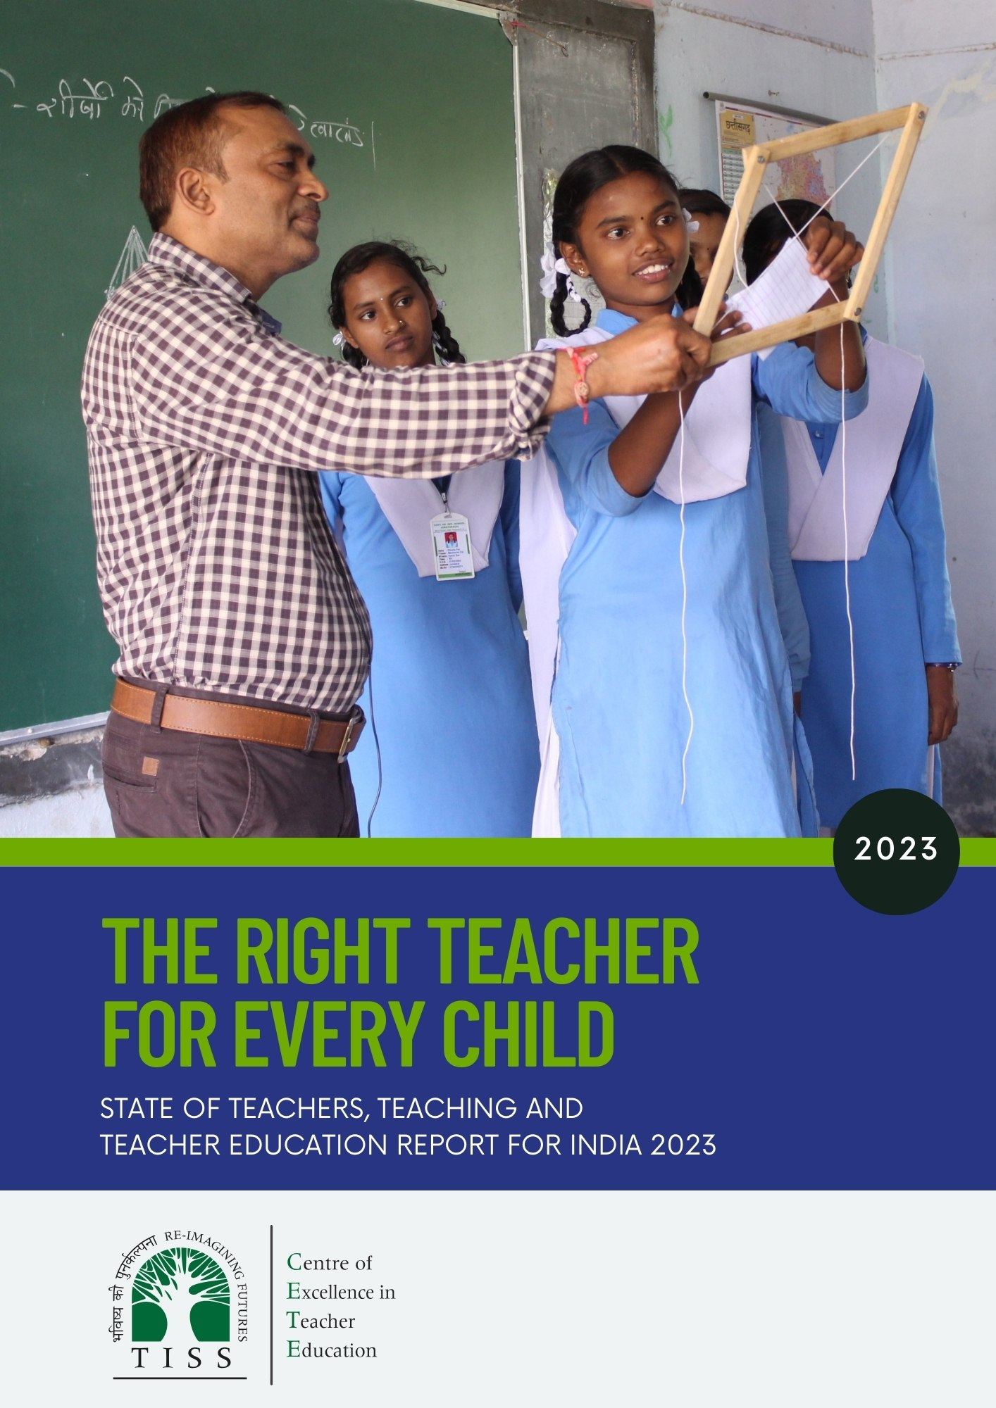
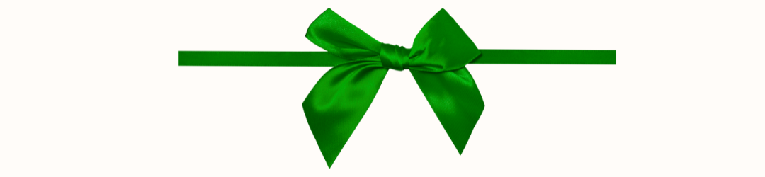

Slide 3
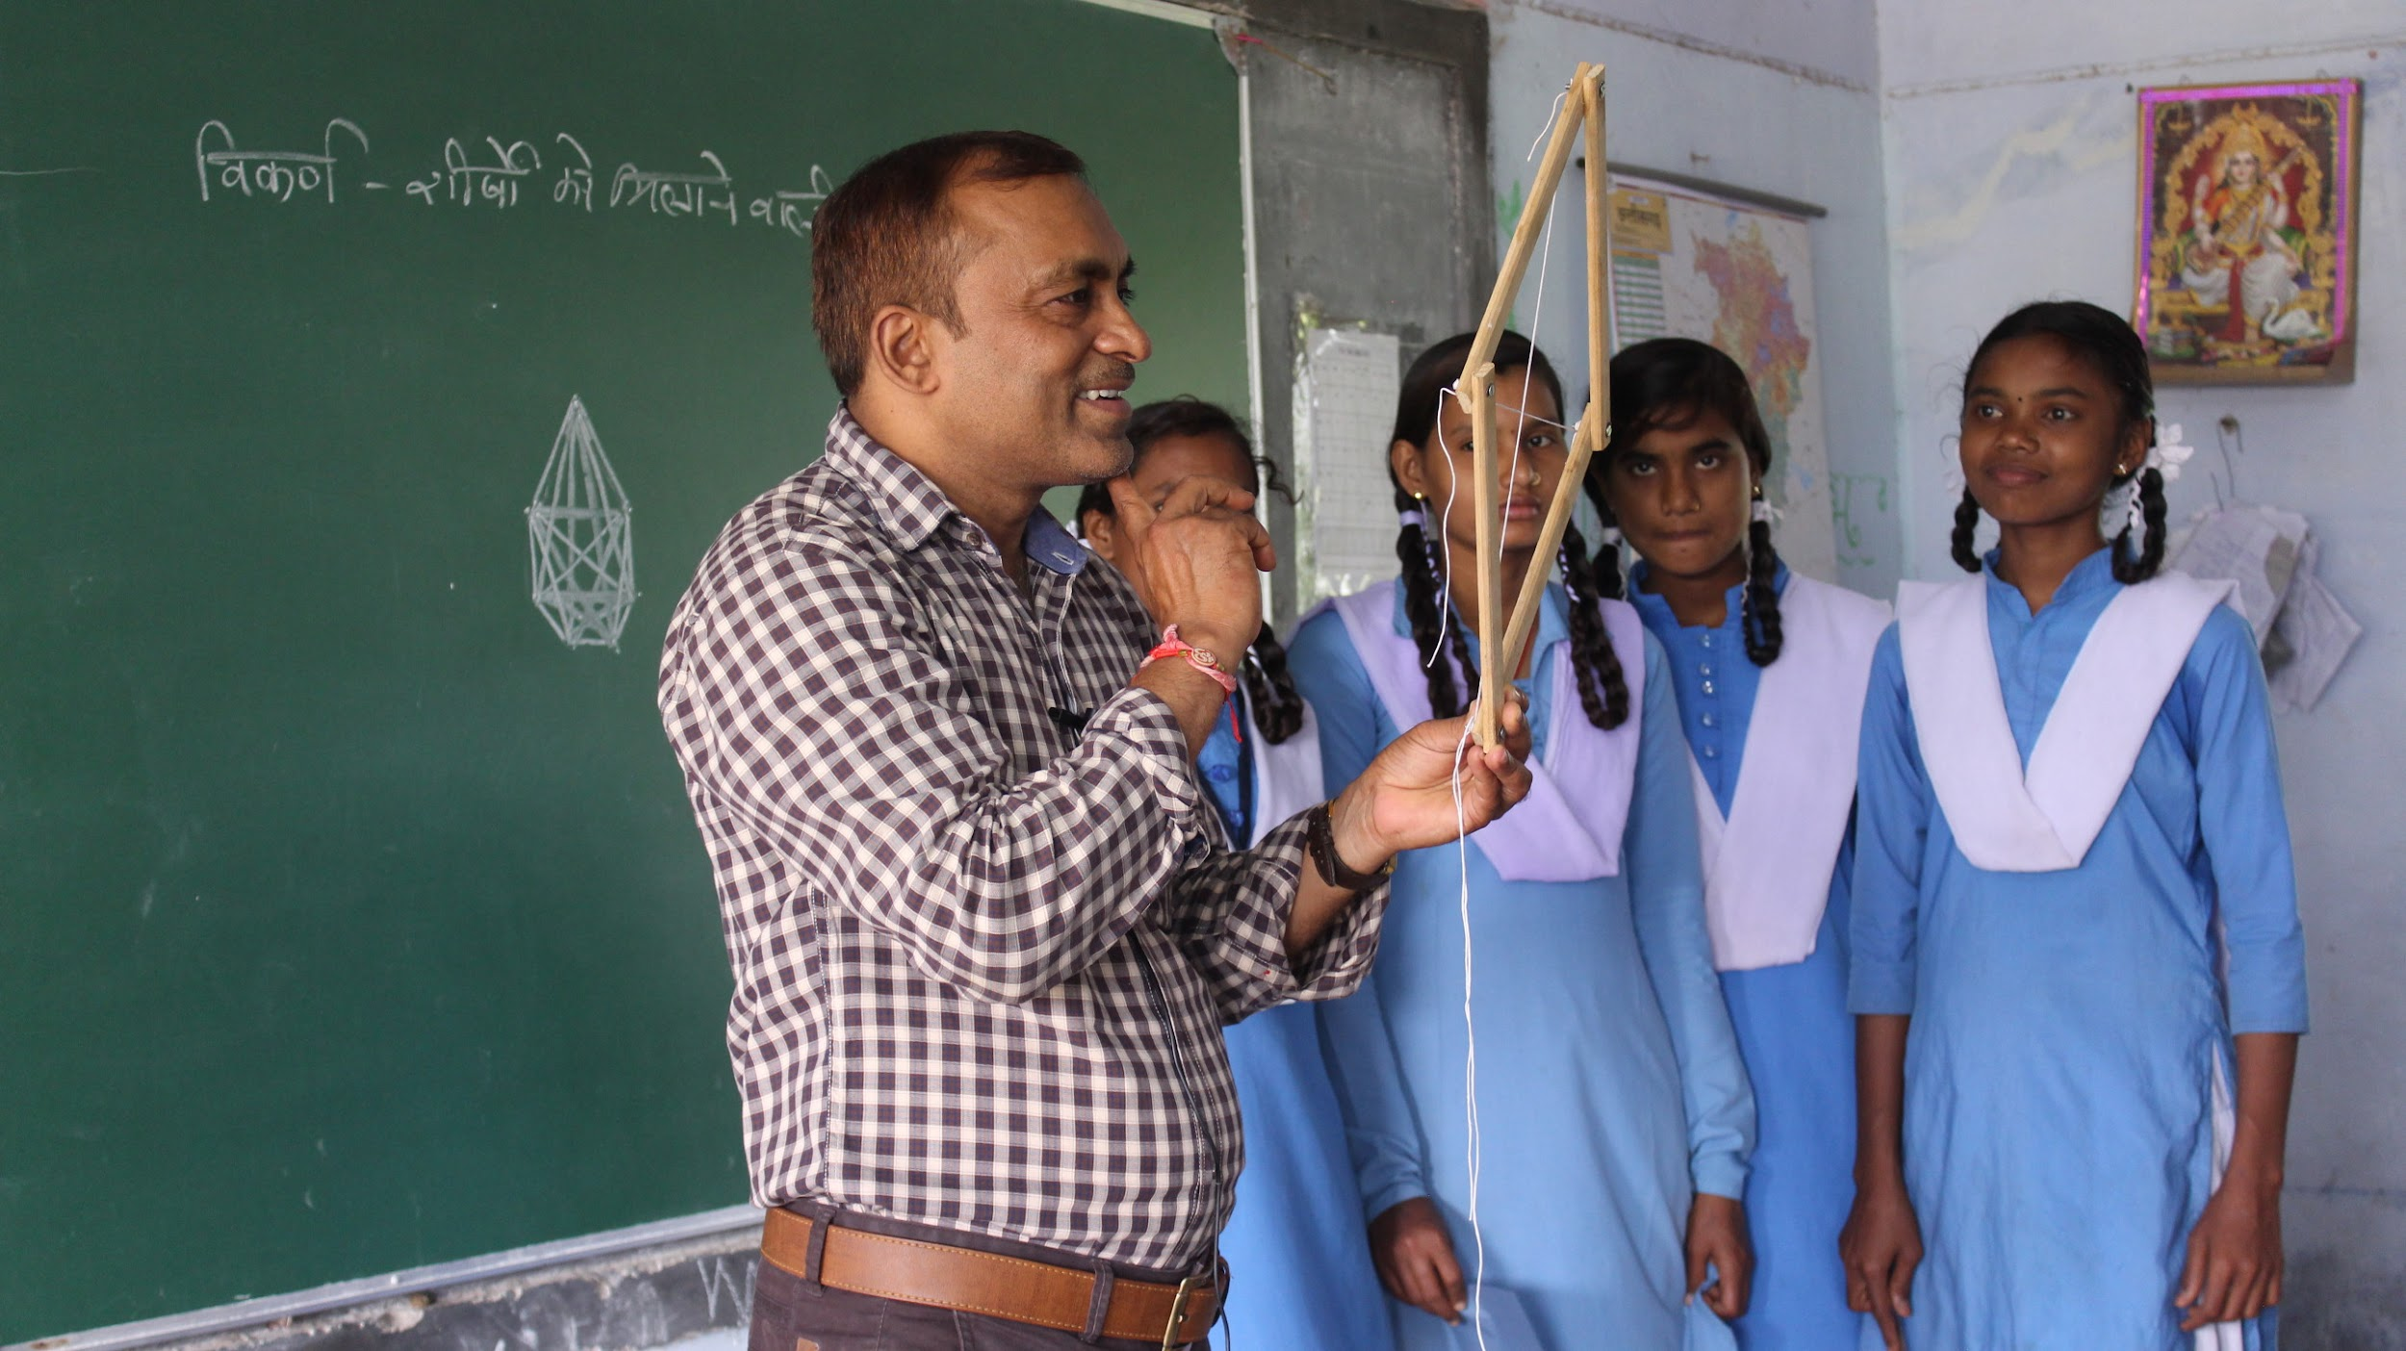
The Right Teacher for Every Child
2023
State of Teachers, Teaching and Teacher
Education Report for India

Slide 4
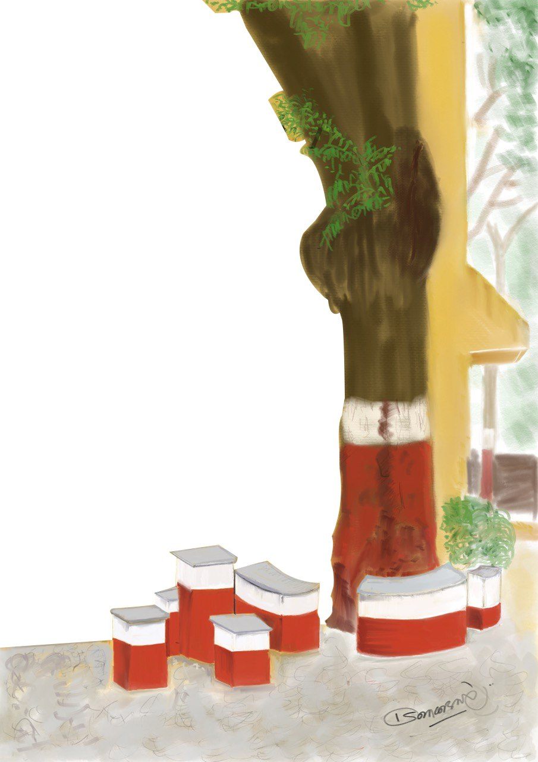
TISS and Center for Excellence in Teacher Education
The Tata Institute of Social Sciences (TISS) was established in 1936 with a vision to be an institution of excellence in higher education that continually responds to changing social realities through the development and application of knowledge.
The Centre of Excellence in Teacher Education is an Independent Centre at the Tata Institute of Social Sciences, Mumbai established with seed grants from the Pandit Madan Mohan Malaviya National Mission on Teachers and Teaching, Government of India, and the TATA TRUSTS, and with the TATA TRUSTS as founding partner.
The Centre's overarching focus and agenda is innovation and improvement in teacher education, school and higher education pedagogy and curriculum aligned to
the sustainable development goals, through research, teaching and advocacy. (https://bit.ly/cetewebsite)
Notes:
What is sottter report? What is CETE? What are the guiding questions of 2023 sotter report.

Slide 5
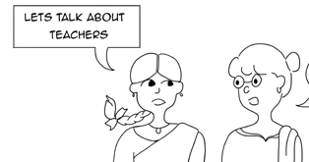
State of Teachers, Teaching and Teacher Education Report for India
The State of Teachers Teaching and Teacher Education is a Biennial State of the Sector Report produced by CETE.
Our First report in 2021 “No Teacher No Class” was the UNESCO 2021 State of the Education in India Report, landscaped the status of the profession and teacher education in India and focussed on experiences of teachers and teacher education during COVID.
This second report has a special focus on teacher availability and supply.
Notes:
What is sottter report? What is CETE? What are the guiding questions of 2023 sotter report.

Slide 6
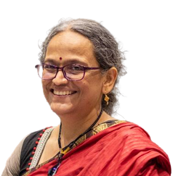
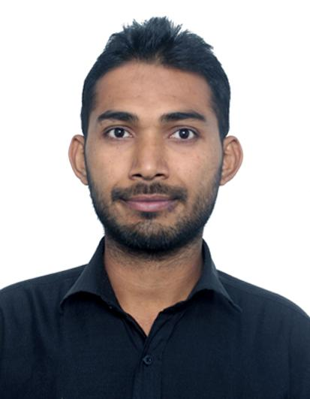
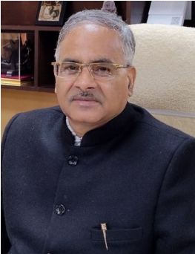
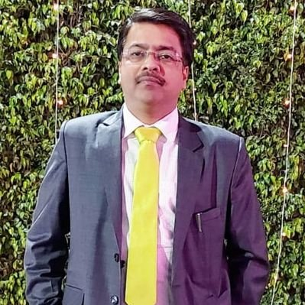
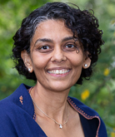
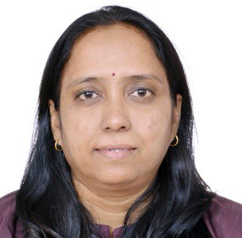
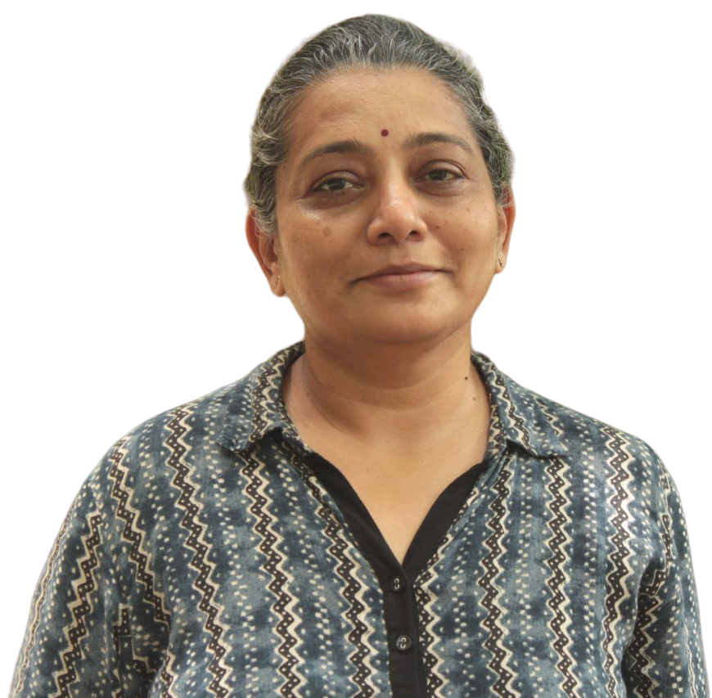
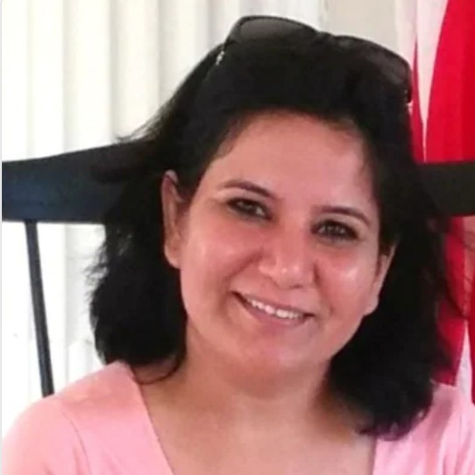
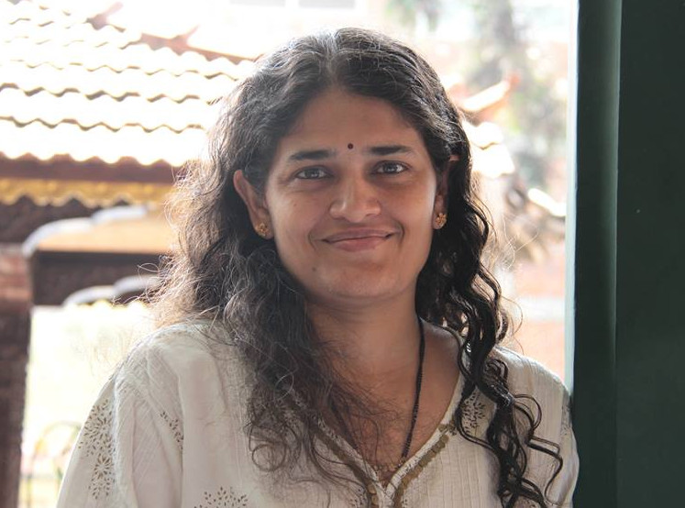
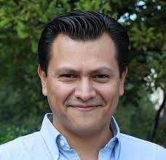
Editorial Board
Author Team
Prof. Padma Sarangapani
Dr. Kamlesh Goyal
Prof. Dinesh Saklani, Director NCERT
Mr. Harshit Mishra, Niti Aayog
Prof. Amita Chudgar, Michigan State University
Dr. Jyoti Bawane, Indian Institute of Education, Pune
Prof. Mythili Ramchand
Prof. Nidhi Gulati,
IHE, University of Delhi
Amrita Patwardhan,
TATA TRUSTS
Dr.Carlos Vargas Tames, Teacher Task Force, UNESCO HQ
With Aishwarya Rathish, Anitha Bellappa, Arpitha Jayaram K
Notes:
Authoring team

Slide 7
State of Teachers, Teaching and Teacher Education in India 2023
The Right Teacher for Every Child
The analyses examine the demographic profile of teachers in different sectors, the working conditions of teachers, the availability and supply of teachers in general, and specifically of qualified teachers, in the system. Comparisons are made between states, between urban and rural locations and between the government and private sectors
The report is divided into 8 sections:
Introduction
Teachers in India: An overview
Providing the Right Teacher in Every Class: Are there shortages? Where? What kind?
Gender balance in the teaching workforce
Working conditions of teachers with a focus on teachers in private schools
Regional concerns, rural regions and the North East
Teacher supply: what is the quality of the supply? Is it adequate?
Key observations and recommendations

Slide 8
Background Papers and Reports for SOTTTER 2023 2023
Teachers in India in 2021-22: the picture from UDISE+
Teachers in India: A snapshot from the Periodic Labour Force Survey 2021-22
Public and Private Sector Contract Teachers in India: An Analytical Research Paper
Quality of Pre-service Teacher Education and Teacher Supply in India: An analysis of TET data from one state A
Status of school teachers in Eight states: a report based on primary data
Status of Preservice Teacher Education in Eight States: A report based on primary data from teacher education faculty and student teachers.
Teacher Supply-Demand: A Review of Literature
Teaching Occupation in the News: an analysis of news coverage in Indian National English Newspapers January-December 2023.
Data sources:
UDISE+ 2021-22,
Periodic Labour Force Survey 2021-22,
The SOTTTER 23 Survey of schools and teacher education institutions carried out in Eight States,
TET Data from One State A.
Notes:
Background reports–one key aspect from each of the background reports

Slide 9
The Right Teacher for Every Child in Every Class
3 Normative Guiding Ideals:
It is desirable for the teaching workforce to have a demographic (gender and caste/social groups, linguistic ) profile similar to the student population.
This holds special significance in the case of students from socio-cultural and linguistically marginal groups and for girls.
2. Different types of professional preparation and academic qualifications are needed depending on the school stage and subject being taught, and the special needs of children.
3. Pupil-teacher ratio (PTR) norms guide the size of classrooms and overall teacher requirement, so as to ensure meaningful pedagogical transaction and attention to all students. RTE mandates against single teacher schools.
Teacher availability to meet all these requirements is a function of the overall supply–availability of pre-service institutions and choices and aspirations of students on the one hand, and timely recruitment and conducive recruitment terms and working conditions in the government and private sectors on the other.

Slide 10
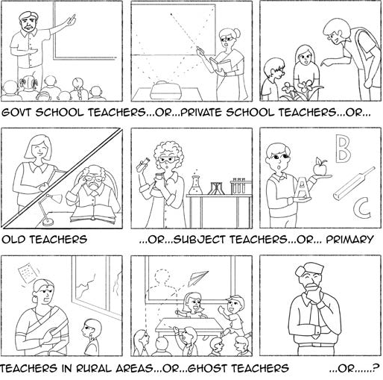
Teachers in India: An Overview
There are 9,507,123 teachers in India^{(a)}
70% are in rural areas; 49% work in Government schools, 8% in Govt. Aided schools and 37% in Private schools.
Women constitute about 51% of the total workforce^{(a)}
44% of government school teachers, 63% of private school teachers, 35% of teachers in Tribal welfare school, 85% of ECCE teachers and only 16% Physical Education teachers are women.
There are wide interstate differences: 35% in Tripura; 81% in Chandigarh
Overall low representation of women in school head positions (women contribute 71% of Private School Teacher Workforce but only 37% are school head.^{(b)}
About 2.5% teachers are Persons With Disabilities^{(a)}
The median age of the teachers is 38 years^{(c)}
Rural Private School teachers: 32 years; Urban Govt. School teachers: 44 yrs.
About 10% of workforce will need to be replaced in next 5 years and about 15% after every five years. Younger teacher workforce and the student body of B.Ed & DElEd are markedly feminized.
Notes:
2 slides: key aspects of teachers in India

Slide 11
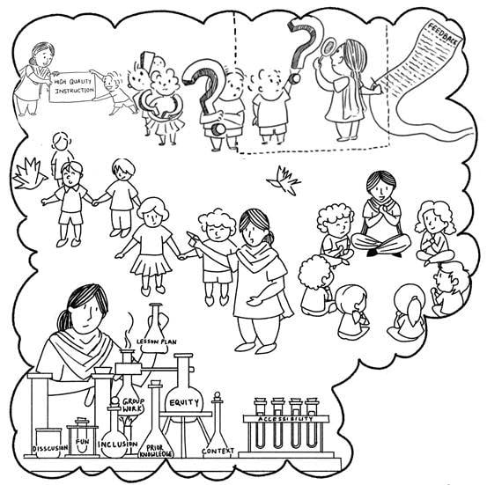
Providing the Right Teacher in Every Class
The all India PTR^{(a)} is 28:1.
Lowest: Ladakh 6:1 & Highest Bihar 53:1.
24% all schools have PTR> 35:1; 81% of these are in Rural areas.
9.5% government schools are single teacher. 91% of these are in Rural areas
90% of Teachers have some form of professional qualification.^{(a)}
Only 46% teachers in primary school have the appropriate qualification (DEd/DElEd/BElEd).
Only 57% teachers in Upper Primary have appropriate qualification (BEd). 79% teachers in
Secondary level have BEd.
70% in middle/secondary schools are teaching subject in which they have the relevant under graduate specialisation.^{(b)}
Main mismatch is Mathematics (50%) and other areas of requirement are Science and English. In government schools there are insufficient teachers for physical education, art and music and overall insufficient special educators.^{(b)}
62% Government schools and 32% Private schools report having a
teacher requirement.^{(b)}
Notes:
Key findings from are they right teachers in each class? 2 slides

Slide 12
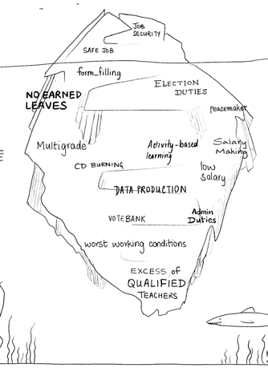
Working Conditions
Basic Amenities are Improving.
Only 58% rural schools have all classrooms in good conditions. Internet improved from 19% to
34%; 83% government schools and only 42% private schools have ramps for special needs.^{(a)}
Professional working conditions are generally better in private schools.
77% of all school have libraries^{(a)}; Private schools have more support staff but lesser support from SMC’s. Government schools have supervising officers visiting them regularly. 40% Government teachers report having higher administrative workload. 45% government teachers report problems with student attendance (30% in private) & 41% report lack of student motivation. 38% government schools have multigraded classrooms.
40% of all teachers report not having control over their curriculum. Both govt and private teaching workload is about 27-28 periods per week.^{(b)}
Employment terms for private school teachers are unfavourable.^{(c)}
50% working without any written contract. Private teachers with long contracts receive about 60% of the average Government teacher salary (overall private teachers salary is 35% of government school teacher)
57% Private school teachers are not eligible for any benefits^{(c)}
(only 12-16% receive full benefits). About 55-63% of government teachers receive all benefits. Only 27% ECCE workers receive health benefits.
(a)UDSIE 2021-22; (b)SOTTTER 23 survey; (c)PLFS 2021-22; (d)TET data from one State A
Notes:
Key findings from are they right teachers in each class? 2 slides

Slide 13
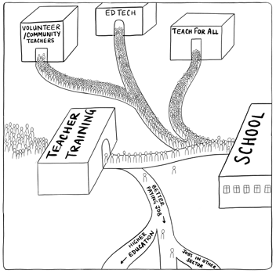
Teacher Supply
Government funded (DIETs, IASEs, Aided) institutions perform better than self financed institutions^{(d)}
Paper 1: DIETs 59% applicants qualify (mean performance: 86/150); Self financed: 31% qualify (mean performance: 77/150). More than 50% qualify in 100% DIETs; only in 7% D.El.Ed colleges, more than 50% students qualify.
Quality is a Matter of Concern^{(d)}.
Overall lower scores in TET. (only 15% score more than 60% on the test).
Low mathematics subject knowledge competence , and low proficiency in regional language in primary school teachers; Undersupply of language and social science teachers qualifying TET.
Teacher supply over different subject specialisations is uneven.
There are very few institutions offering teaching qualifications in art and music.
North East lacks sufficient institutions for special education teacher education.
Women enrolment in Physical Education programmes is low.
Insufficient men are enrolling in special education.
Increase in older aspirants shifting careers (between 15-30% in BEd programmes)
Notes:
Key findings from are they right teachers in each class? 2 slides

Slide 14

Call for Action-1
Ensure that Primary stage has appropriately qualified teachers (DEdd/DElEd/BElEd).
More investment needed to improve teacher supply in art, music and special education. Need to enhance employment opportunities and employment terms.
Improve employment terms and recruitment of physical education, art, music and special education teachers in the system.
Improve teacher availability and deployment in rural areas and North East. Attend to providing of basic amenities, improved working conditions, and incentives to work in difficult to staff areas.
Notes:
Key findings from are they right teachers in each class? 2 slides

Slide 15
Call for Action-2
Regulate to improve employment terms (contract and wages) of teachers in private schools.
Ensure provision of benefits to teachers in private schools and ECCE, and health benefits for all teachers.
Improve professional working conditions of government school teachers.
Improve quality of PSTE curriculum for overall rigour and more attention to subject knowledge competence.
Notes:
Key findings from are they right teachers in each class? 2 slides

Slide 16
Call For Action - 3
Create innovative new pathways to enter into the profession at later stages: 2-year BEd providing specialisation in primary/preparatory stage and special education, and bridge programmes to move from BEd (secondary) to Primary stage.
Increase government funding and support to teacher education overall, and to primary/preparatory teacher preparation in particular.
Innovation and scholarship support needed to enhance enrolment of women from ST communities in teacher education, and for women to join physical education teacher education. Enhance enrolment of men in Special Education.
Increase supply and monitor deployment of mathematics, science and English teachers. Analyse data from DElEd, BEd and TET to monitor trends.
Notes:
Key findings from are they right teachers in each class? 2 slides

Slide 17


CETE (2023). The Right Teacher for Every Child. State of Teachers Teaching and Teacher Education Report for India. Tata Institute of Social Sciences, Mumbai.
https://bit.ly/SoTTTER-by-CETE
Notes:
About cETE slide and our programmes admissions

Slide 18
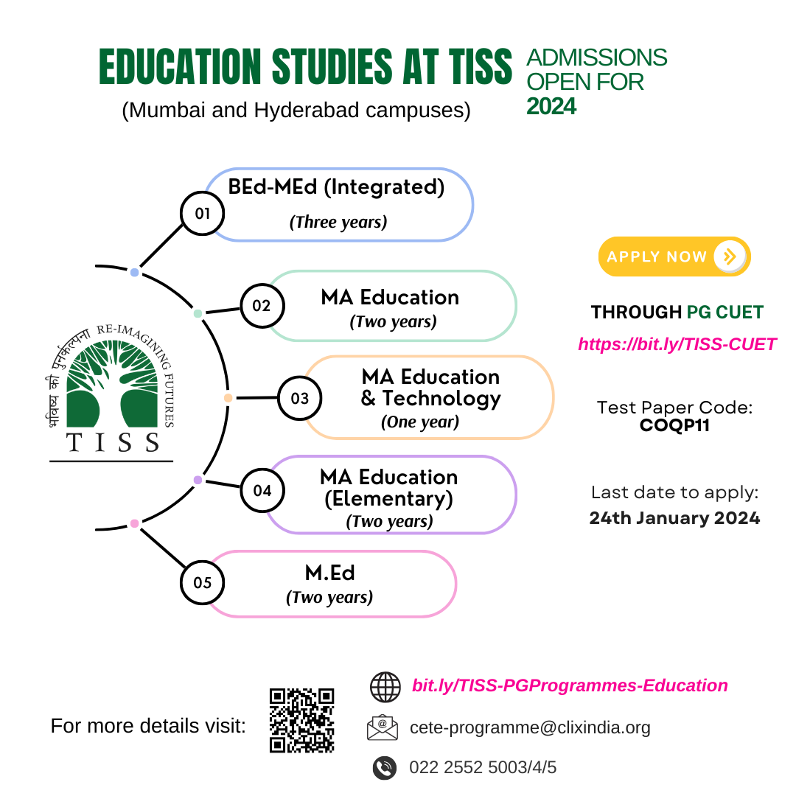


Thank You
Illustrations on Slide nos 5,8,9,10 & 11 are taken with permission from Parul and Sharma P (2024) Teachers’ lives and work in South Asia (Bhopal, Eklavya).
CETE (2023) The Right Teacher for Every Child. State of Teachers, Teaching and teacher education Report for India. Tata Institute of Social Sciences, Mumbai, INDIA.
https://bit.ly/SoTTTER-by-CETE
Follow us on all social media @cete_tiss and educational websites
www.tissx.tiss.edu
https://clixoer.tiss.edu

