Slide 1
HIMACHAL PRADESH
2017

Slide 2

Challenges of Elementary and Secondary Education in Himachal Pradesh
Low Learning Outcomes as per NAS
Annual ASER Reports suggesting that large %age of students in Higher Classes (3rd to 8th) not able to read 2nd Grade books
Students lacking in foundational skills like early reading writing and numeracy
Large scale migration from Govt. to Pvt. Schools
Text books not reaching schools in time only few books made available
System of evaluation outdated and time consuming, no competency gap mapping available

Slide 3
Systemic Reforms in Education Introduced in HP (SAMARTH)
Best Practices
Innovation in School Management

Slide 4




Systemic Reforms in Education Introduced in HP (SAMARTH) IMPACT-1
After introducing PRERNA and PRAYAS Learning Outcome enhanced by 15 to 30 % across 1st to 8th Classes
On time Textbooks delivery to 6.00 lakh students (one of the few States to achieve this feat)
The Assessment System Digitized and made available on line (Both Grade and Competencies mapped for the 1st time
HP becomes 1st State to define learning outcomes and display them class wise and subject wise in classrooms.
The Decline in enrolment from 5% in 2014-15 has come down to 1.6% in 2017-18.
91% teachers in Bijari Block Hamirpur have enrolled their children in Govt. schools. Feedback from other blocks is also positive.

Slide 5





Systemic Reforms in Education Introduced in HP (SAMARTH) IMPACT-2
5000 Schools Reviewed and Monitored with the help of Digitization. Online action tracker introduced
KHAS SHIKSHA –A system of rewarding best teacher introduced (170 best practices documented so far)
SMS based communication system introduced (7.00 lakh massages sent so far)
100 Page SDP simplified to a 3 page digitized doc (12500 schools already uploaded their SDPs in record 20 days)
1 stop portal both for students and teachers made functional for competitive exams like JEE and NEET

Slide 6
Best Practices
PRERNA
PRAYAS
KHAAS SHIKSHA
COMPETENCY CHART

Slide 7





Need and Process: PRERNA - Improving learning levels of students by imparting reading, writing and numeracy skills
Improvement in learning levels through identification of gaps in learning, addressing these gaps and constant evaluation through training and innovative teaching techniques are the core of this programme.
Objective of PRERNA
Characteristics of PRERNA
1
Baseline
2
Grouping
3
Endline
4
Use of games / ABL
To divide kids according to competency levels
Group basis competency level, not grade
Measure improvement / impact of programme
Employ interactive paedagogical techniques
School Performance Index (SPI)
The School Performance Index (SPI) categorizes schools in three levels (green, yellow or red) on the basis of cumulative baseline and endline results in basic Language and Mathematics. It provides as a basis to government’s district, block and cluster level functionaries for selecting schools which need more on-site academic support.

Slide 8
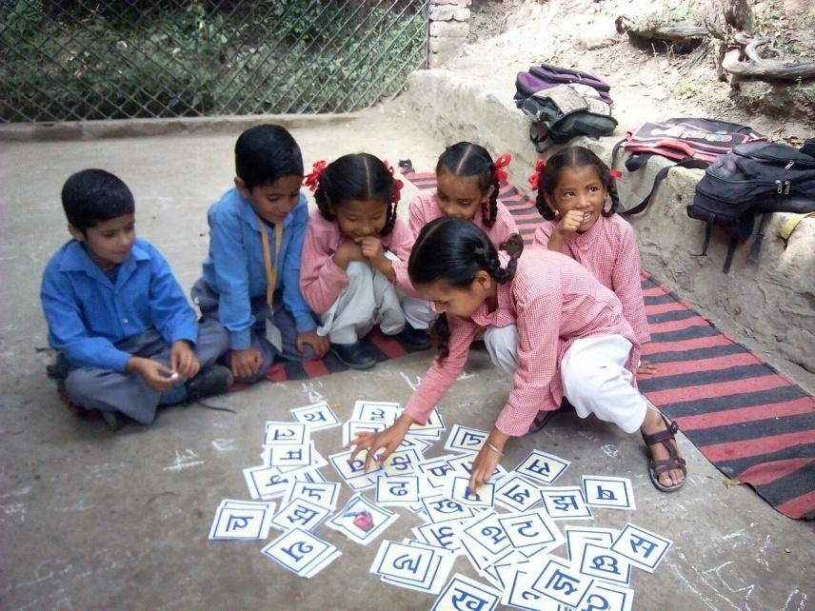
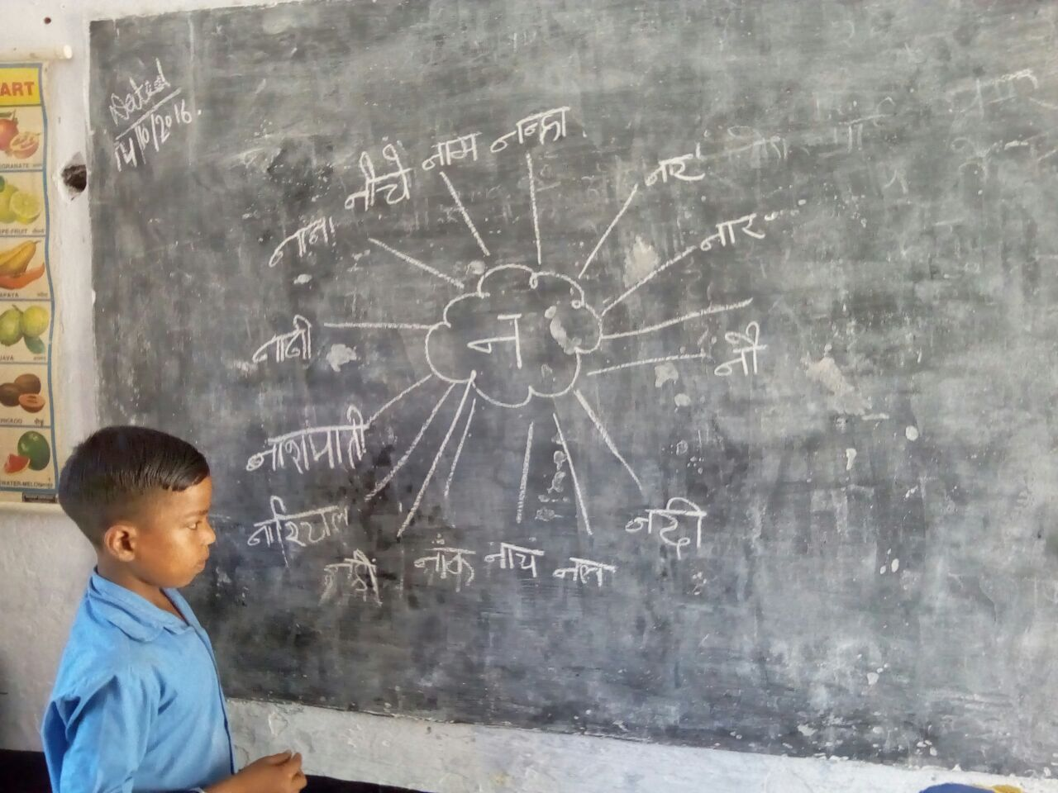
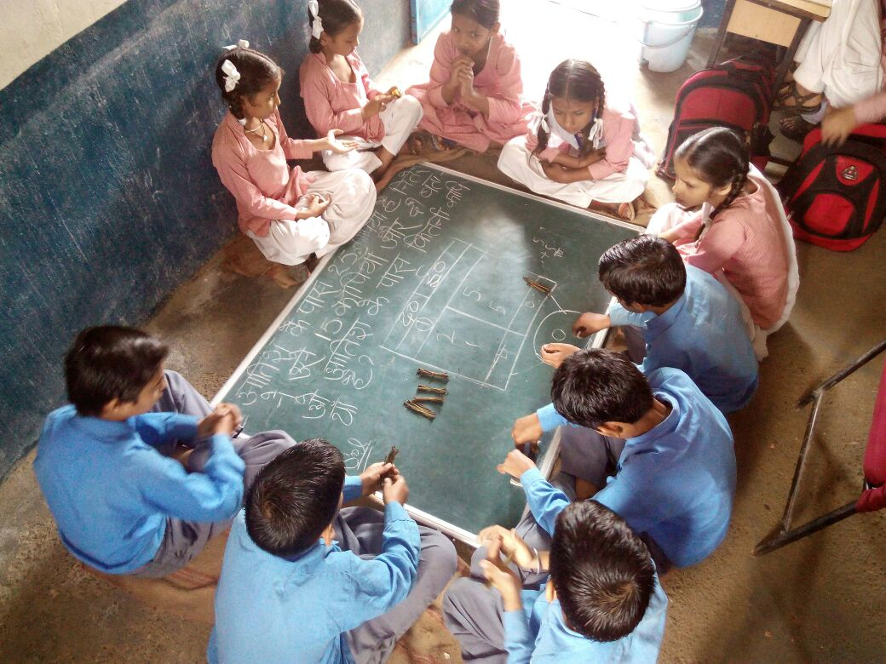
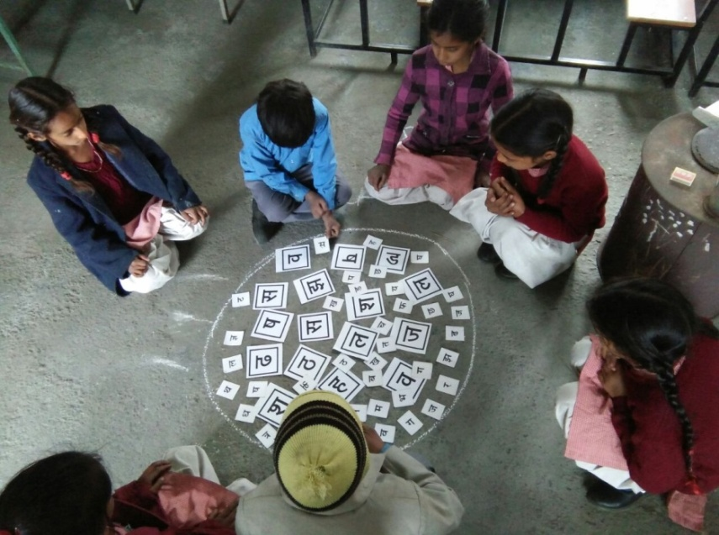
Process: PRERNA - Teaching Learning in Process (click here)

Slide 9
Impact: PRERNA - Learning Progress in 2016-17
% children who can read
Std. II level text
% children who can do
3 by 3 addition
% children who can do
2 by 1 division
1

Slide 10
Impact: The focus on foundational skills has led to an improvement in CCE results across classes
Class 3 | 2015-16 |  | 2016-17
 | % students in Grades A to C | % students in Grades D to E | % students in Grades A to C | % students in Grades D to E
Hindi | 39 | 61 | 67 | 33
Maths | 43 | 57 | 59 | 41
Class 5 | 2015-16 |  | 2016-17
 | % students in Grades A to C | % students in Grades D to E | % students in Grades A to C | % students in Grades D to E
Hindi | 64 | 36 | 75 | 25
Maths | 65 | 35 | 77 | 23

Slide 11
Impact: Percentage improvement in learning levels of the students Class- VIII
Subject | Academic year 2015-16 |  | Academic year 2016-17
 | More than 50% (A,B,C grade) | Less than 50% (D&E grade) | More than 50% (A,B,C grade) | Less than 50% (D&E grade)
Hindi | 56 | 44 | 78 | 22
English | 36 | 64 | 42 | 58
Mathematics | 27 | 73 | 43 | 57
Science | 39 | 61 | 67 | 33
Social Studies | 37 | 63 | 58 | 42

Slide 12
STATEWIDE SYSTEMIC REFORMS TO IMPROVE THE QUALITY OF EDUCATION
PRERNA
PRAYAS
KHAAS SHIKSHA
COMPETENCY CHART

Slide 13
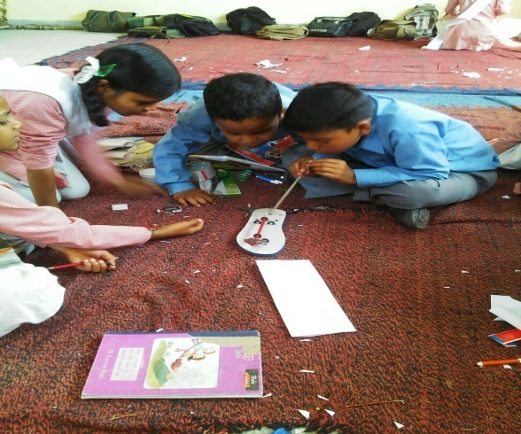
Need and Process: Prayas - An initiative to improve science and mathematics at upper primary level
To popularize Science and Math amongst students along with result enhancement in these subjects, by using and making models and other interactive learning material which are provided to teachers and students under the programme
Objective of PRAYAS
Activities under PRAYAS
Selected 40 models from 10 themes in Science, 23 models from 5 themes in Mathematics
SRG Training
Teachers’ Training at DIET level
Base Line Testing
Base Line Data Verification
Pre Fair Workshop of models
Fairs/exhibition of 1st Phase of science and maths models
Observation of Fairs
Post-fair Activities
End-line testing
Analysis of Baseline and End line was done under Prayas

Slide 14
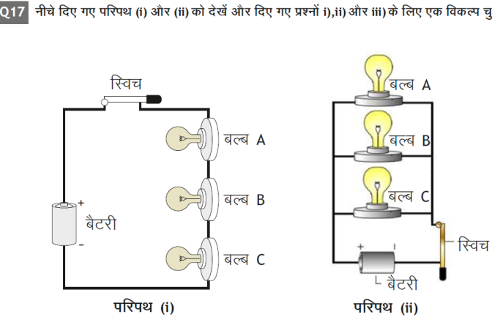
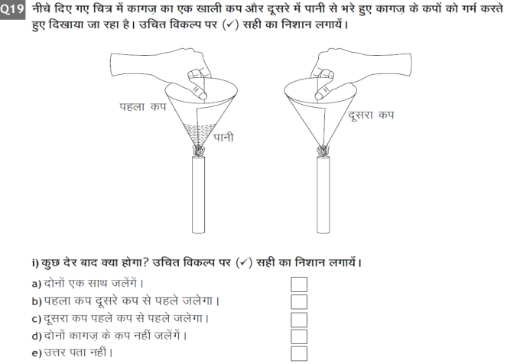
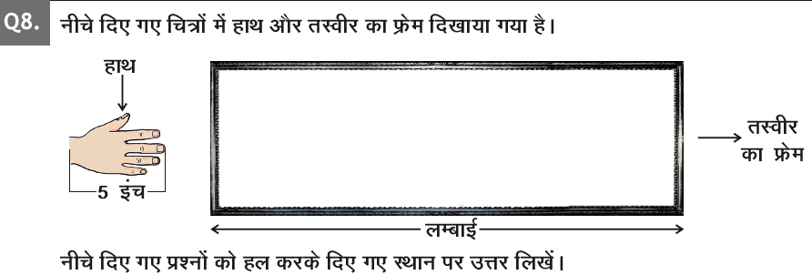
Impact: Understanding practical aspects of scientific/mathematical concepts has resulted in improved student learning outcomes
Class 8 | 2015-16 |  | 2016-17
 | % students in Grades A to C | % students in Grades D to E | % students in Grades A to C | % students in Grades D to E
Maths | 27 | 73 | 43 | 57
Science | 39 | 61 | 67 | 33
Examples illustrating how science and maths are made practical to students

Slide 15
STATEWIDE SYSTEMIC REFORMS TO IMPROVE THE QUALITY OF EDUCATION
PRERNA
PRAYAS
KHAAS SHIKSHA
COMPETENCY CHART

Slide 16

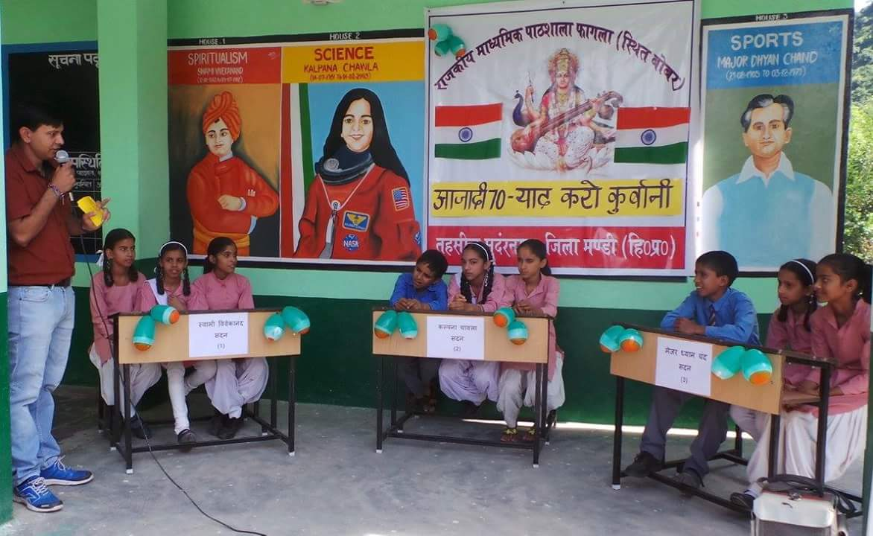
Need, process & impact: Khaas Shiksha - A unique recognition program that disseminates best practices and promotes innovation in education
Khaas Shikhsa- 170+ nominations received and >70 recognized
Simple procedure for block officials to submit nominations online
Selection committee with representatives from the SSA and Directorate (E)
Personalized Letter of Appreciations by the Director (E)
Invitation to present at Review Meetings held at state.
Best practices disseminated to stakeholders via SMS and WhatsApp, published on the Directorate (E) website



Slide 17
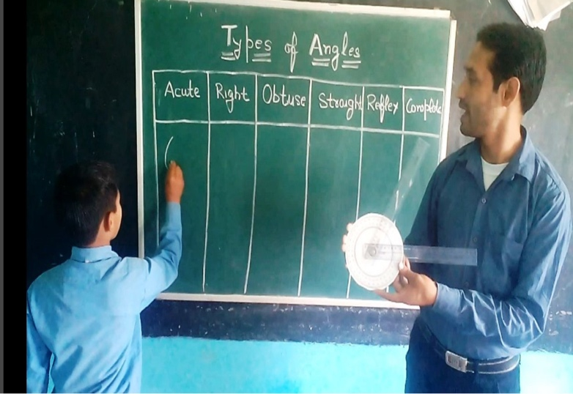
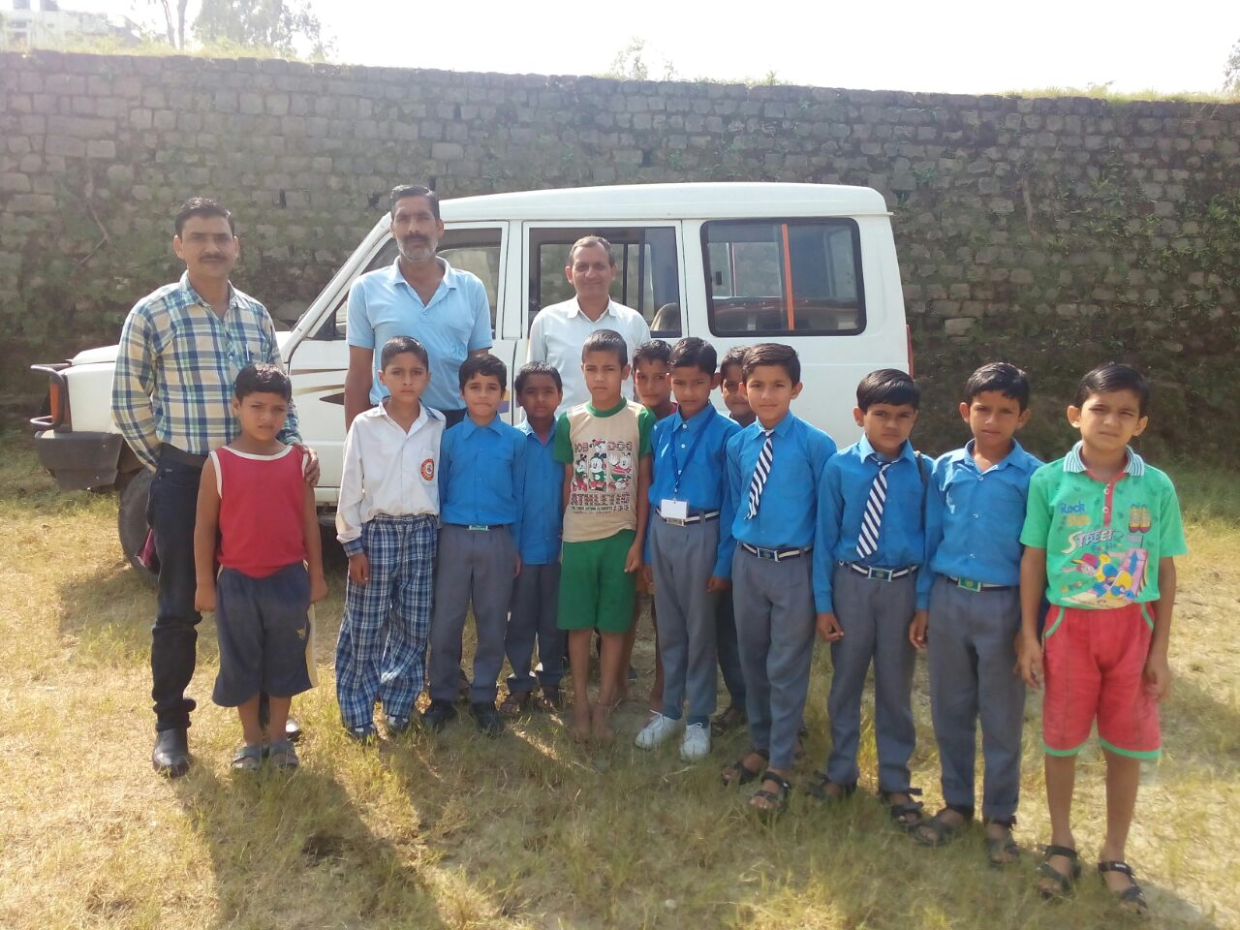
Impact: Khaas Shiksha – Locally crowd-sourced best practices in pedagogy and education management disseminated to stakeholders
Khaas Shikhsa- 170+ nominations received and >70 recognized
GSSS Paunta, Gopalpur 2 Block focuses on increasing student learning levels by ensuring TLM based teaching in classes and maintaining Student Profiles, Portfolios, School Calendar etc

GPS Dandroo, Bijhari Block bought a Tata Sumo with help from SMC and started transportation facility for students at no profit no loss formula

Slide 18
STATEWIDE SYSTEMIC REFORMS TO IMPROVE THE QUALITY OF EDUCATION
PRERNA
PRAYAS
KHAAS SHIKSHA
COMPETENCY CHART

Slide 19

Need, process & impact: The class competency/ achievement cahrt will increase focus on competency-based teaching
Class Competency Chart will map chapter-wise competency and the class’s achievement status
MHRD specified competencies for each class and subject in attractive, printable format
Provides information and allows easy tracking of classroom competency level
Immediate knowledge of class competency level allows targeted monitoring by external visitors like BRCCs and Parents
Visibility of class competency leads to more accountability of the teacher
To be displayed subjectwise for every class in schools

Slide 20
INNOVATIVE PRACTICES TO IMPROVE MANAGEMENT OF SCHOOLS
ASSESSMENT RESULT DIGITIZATION
OMR BASED REVIEW & MONITORING
TEXTBOOK DISTRIBUTION
PMIS
SMS PORTAL
DIGITIZED SCHOOL DEVELOPMENT PLAN
MID DAY MEAL
SWAYAM SIDHAM

Slide 21











Need and solution: The state used to collect outdated assessment data using a laborious and time-consuming process
Points of Improvement
Actioned Resolution
Manual labour involved - Data manually keyed in repetitively on excel sheets by cluster/block/district & state officials
No standardisation / non-compliance of data formats - Data formats not consistent causing delays and quality issues in data collection
Data granularity - Data initially captured only at class level
Time taken - 2 years to collect student-level competency-wise data
Data quality - 40-50% data not usable due to quality issues
Insufficient, bad quality and outdated data analysed after a lag of ~2.5 years
USE OF OMR SHEETS
Standardised OMR-based assessment recording sheets designed, printed and distributed to all schools and filled by teachers at the class level
enabling
Automated high-quality ‘data entry ‘ - centralised scanning of sheets in state office
Student-level competency-wise / question-wise data - Data captured questionwise at the student-level for each subject and class
Available in a digitised and analysable format in 1-2 months - Between 30-60 sheets scanned per minute
High-quality student-level data by question and subject analysable within 1-2 months after exam

Slide 22
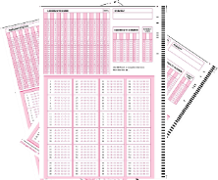





Process: Himachal has collected competency and student level data for census assessment (SA2) by following a six step process
Institutionalizing data-backed reviews of school performance at the district and state levels
OMR based assessment forms designed and distributed at each class
Forms collected and scanned through OMR reader at the state level
Digitized data converted to a usable format by a computer script
School | CCE | AW
School 1
School 2
School 3
Focus on improvement areas in this academic cycle
Assessment dissemination meetings to be conducted in districts
Dashboard created for student level and competency level insights
Himachal being a pioneer state in collecting student level and competency level data in record time

Slide 23
Impact: At the overall state level, there are 45% students in grades A&B and only ~14% in grade E across classes
Overall Analysis
Competency Analysis
Mediocre competency attainment decreases
with classes

Slide 24
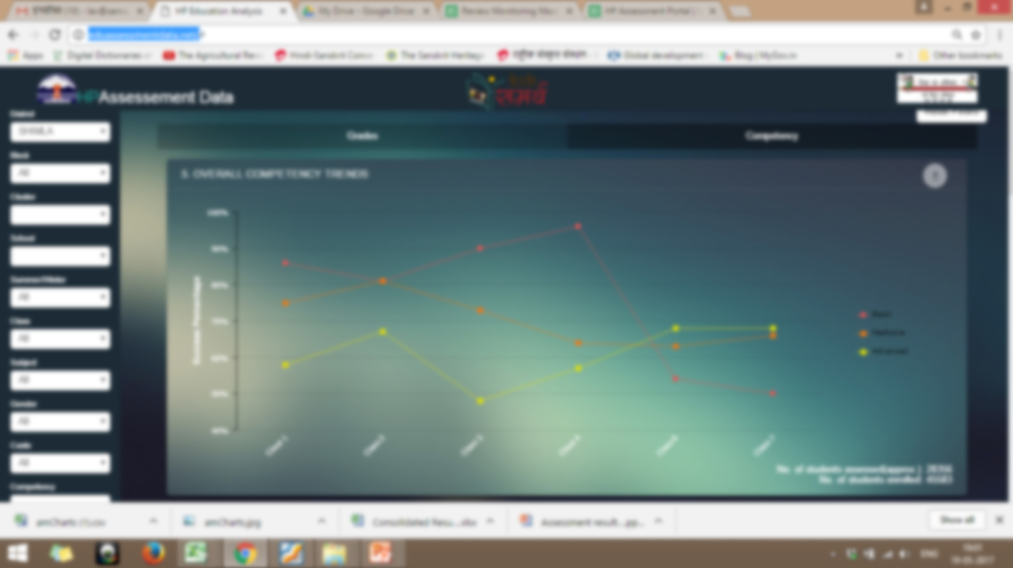
Website preview:
CLICK HERE
http://eduassessmentdata.net/

Slide 25
INNOVATIVE PRACTICES TO IMPROVE MANAGEMENT OF SCHOOLS
ASSESSMENT RESULT DIGITIZATION
OMR BASED REVIEW & MONITORING
TEXTBOOK DISTRIBUTION
PMIS
SMS PORTAL
DIGITIZED SCHOOL DEVELOPMENT PLAN
MID DAY MEAL
SWAYAM SIDHAM

Slide 26
Need & Process: Himachal has adopted a 6-step process for data-backed reviews and comprehensive monitoring of schools…
Review points captured under five categories: (i) basic school infrastructure; (ii) teaching-learning process; (iii) school management; (iv) assessment results; (v) funds utilisation
Institutionalizing data-backed reviews of school performance at the district and state levels
OMR based Quality review forms filled during school visits
Forms collected & scanned via OMR reader at the state level
Digitized data converted to a usable form by a computer script
School | CCE | AW
School 1
School 2
School 3
Monthly reviews (in groups of 4 districts) at state level
Monthly reviews using dashboard at the district level
Automatic dashboards generated for every district
5,000 schools visited | 11,000 classrooms observed | 2.97 L students covered
15 state-level meetings conducted | >35 district-level meetings held | 125 blocks involved

Slide 27
Impact … that ensures informed decision-making and corrective action at the state, district, block and school level
Leveraging data backed
reviews for decision making
USE
EXAMPLES
Policy Changes
Mandated first 15 day school readiness plan
Tablets in cluster schools
AGGREGATE TRENDS INFORM STATE POLICY
SCHOOL WISE LIST OF ISSUES FROM OMR
Program Design
Inclusion of English in Prerna & Prayas
Revision of SDP
Accountability at all levels
District officials to resolve school issues
Showcase notice to laggard officers
MONTHLY DISTRICT MEETINGS ENSURE CORRECTIVE ACTION ON GROUND
School Specific issues
Filling teacher vacancy
Civil repairs of schools
School Rating
Framework of rating ready
Rating to be revised annually

Slide 28






Next steps: There are four new focus areas which will further strengthen the review and monitoring initiative in the coming months
Move to mobile application from OMR based review and monitoring
Involving District collector for district level meetings
Involving Head Teachers and Cluster Head Teachers in the review of schools
Strengthening the issue resolution loop by putting more focus on surprise visits and better compliance of action tracker

Slide 29
INNOVATIVE PRACTICES TO IMPROVE MANAGEMENT OF SCHOOLS
ASSESSMENT RESULT DIGITIZATION
OMR BASED REVIEW & MONITORING
TEXTBOOK DISTRIBUTION
PMIS
SMS PORTAL
DIGITIZED SCHOOL DEVELOPMENT PLAN
MID DAY MEAL
SWAYAM SIDHAM

Slide 30
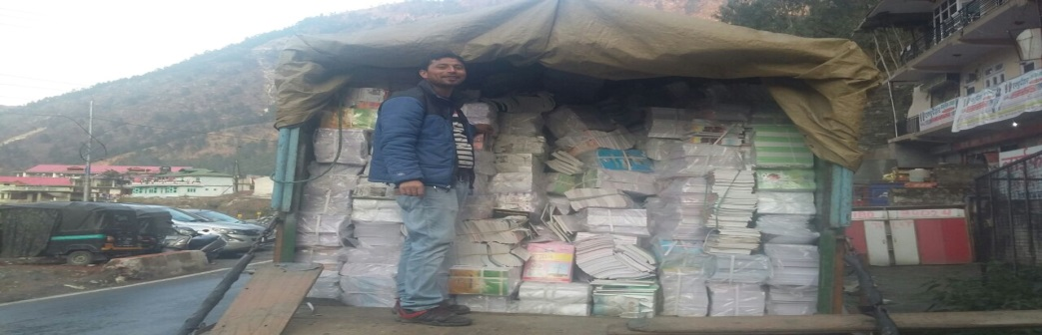
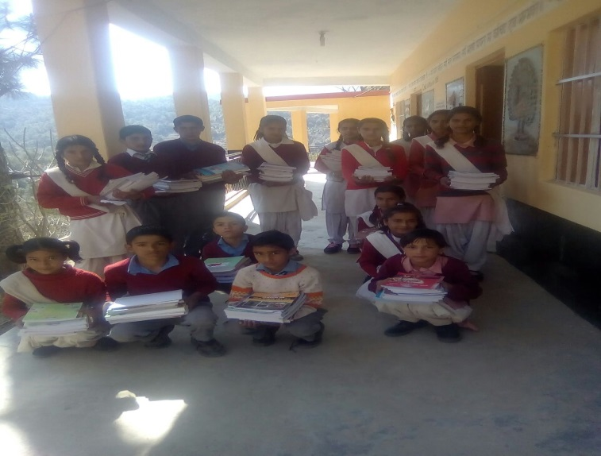
Need: Textbook delivery was a massive operational challenge beset with delays due to difficult terrain of HP
2
Academic
Cycles
ISSUES
4
Printers
Difficult terrain
24
Depots
125
Snow-bound regions blocked in winters
Blocks
2500
Clusters
15000+
Schools
2 separate academic cycles
55 lakh+
Textbooks

Slide 31




Process: The supply chain was streamlined and technology leveraged at each step
REVISED SUPPLY CHAIN
PRINTER
DEPOT
BLOCK
Primary clusters
Primary schools (Class 1-5)
Higher Clusters
GHS/GSSS (Class 6-10)
Tech-based support across the supply chain
Demand collected online and indents are uploaded on the website
hptextbook@gmail.com to receive emails related to textbooks
Special textbook helpline to instantly solve textbook queries and problems
Online schedule for 125 blocks to collect books from 24 depots
Whatsapp leveraged to send and receive real-time information

Slide 32
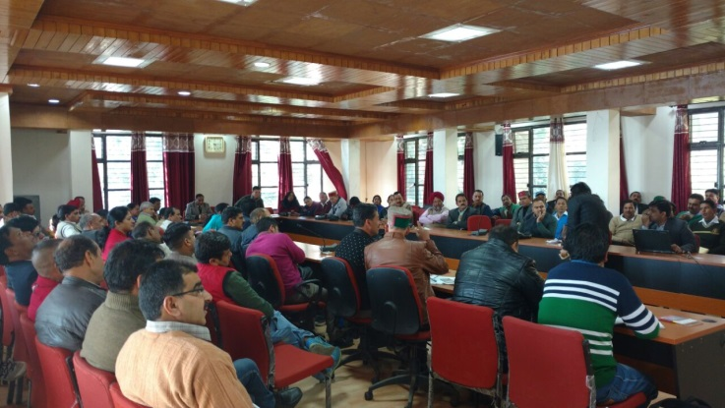
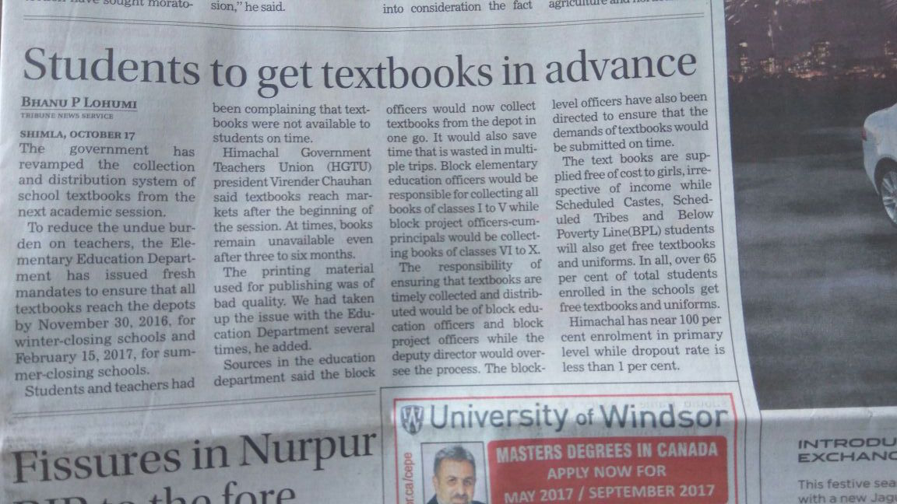
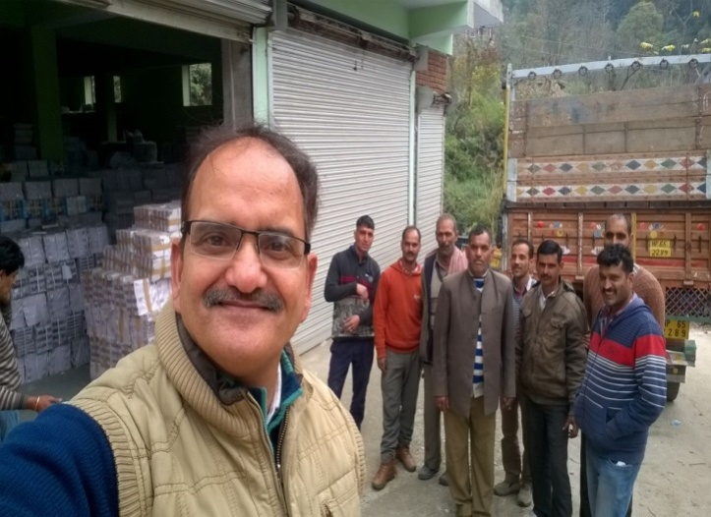
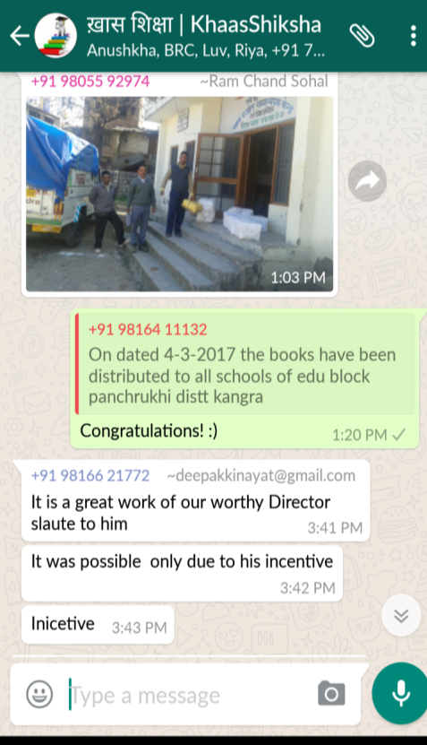
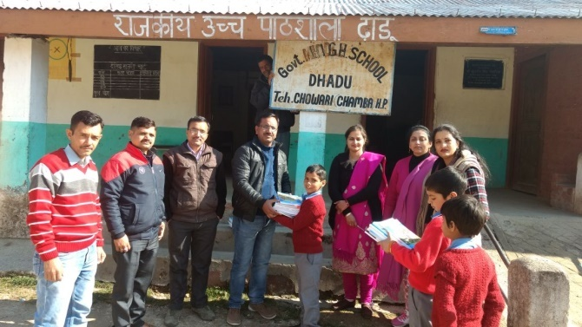
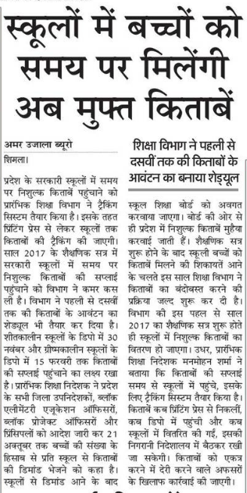

Impact: Snapshots from the successful on-time textbook distribution campaign in Himachal
The Tribune
Book collection at depot
Textbook Distribution Workshop
Book distribution ceremony
Amar Ujala
Whatsapp
One of the 1st states in India to deliver textbooks on/ before time to all students
–
Whatsapp

Slide 33
Next steps: Next year, the state plans to create a technology tool to automatically track progress of textbook delivery at all levels
Features of Technology tool
End to end tracking of textbook from printer to school level
lk
Auto SMS to any stakeholder who delays the textbook delivery to next level
Access of insight portal to entire leadership of HPBOSE, Directorates and SSA
Provide continuous tips to refresh the training content for effective on-ground execution
Sample Tech tool
Printer
Depot
BRC
School

Slide 34
INNOVATIVE PRACTICES TO IMPROVE MANAGEMENT OF SCHOOLS
ASSESSMENT RESULT DIGITIZATION
OMR BASED REVIEW & MONITORING
TEXTBOOK DISTRIBUTION
PMIS
SMS PORTAL
DIGITIZED SCHOOL DEVELOPMENT PLAN
MID DAY MEAL
SWAYAM SIDHAM

Slide 35
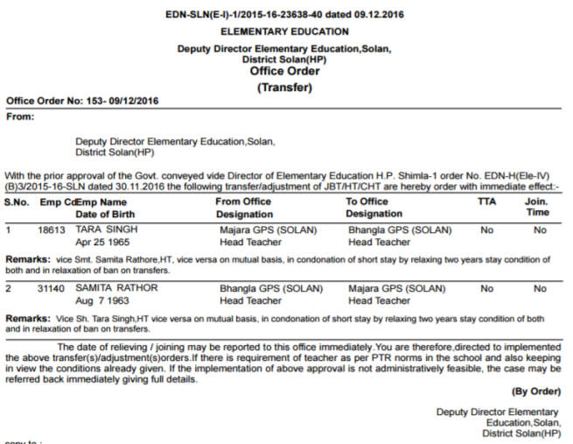
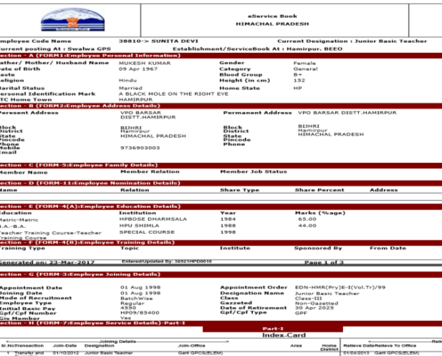
Process & Impact: The revamped, updated PMIS is enabling paperless administration through servicebook digitization and online transfers
Online Transfers
eServicebook Updation
Nodal officers assigned in every block and district
900+ transfer orders published online
10/12 districts are conducting all transfers online
Online Transfer Order
Timely follow-ups and tracking
More than 99% teachers (JBT, HT, CHT) have up to date eServicebooks
E-Servicebook

Slide 36
INNOVATIVE PRACTICES TO IMPROVE MANAGEMENT OF SCHOOLS
ASSESSMENT RESULT DIGITIZATION
OMR BASED REVIEW & MONITORING
TEXTBOOK DISTRIBUTION
PMIS
SMS PORTAL
DIGITIZED SCHOOL DEVELOPMENT PLAN
MID DAY MEAL
SWAYAM SIDHAM

Slide 37
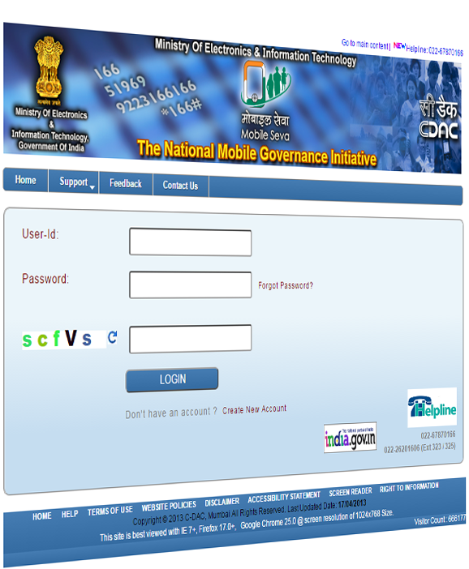
Need and process: A customised SMS portal has been created for instant and targeted communication across the education system
Progress so far
Instant and targeted messages to eliminate top-down communication gaps in the system
1
Coordinated with Department of IT to build a special portal for Department of Education
2
Phone numbers of all stakeholders till the cluster level updated in the portal
3
More than 4,20,000 messages sent by the state through the portal so far
>4,00,000 SMSes sent
4
Logins to be created for district and block level officials to be able to send SMSes
5

Slide 38
Intervention details: Different types of SMSes have been sent to govt. officials across levels & teachers, resulting in various benefits
Recipient
Benefits of SMS portal
Examples of messages sent
District Officers
Communication lag between state/district level removed
All Dy. Directors and DPOs to ensure textbook demand form is filled by all blocks by 6 pm today (Class 1-5 by BEEO and 6-10 by DPOs). BRCCs may assist.
Instant action from district officials to meet tight deadlines
Block Officers
Meeting with block officials held at short notice
Reminder | PMIS training tmr, 27 Aug at 11 am in DIET Dharamshala. Official who will work on PMIS to attend from each block. Bring pendrives and PMIS of BEEO.
Higher compliance in bringing necessary collateral along
Teachers
Recognition and motivation for teachers
Thank you, teachers! The ASER 2016 report has ranked Himachal first among all states in reading and mathematics. Keep up the good work and make Himachal proud.
Dissemination of classroom best practices to teachers

Slide 39
INNOVATIVE PRACTICES TO IMPROVE MANAGEMENT OF SCHOOLS
ASSESSMENT RESULT DIGITIZATION
OMR BASED REVIEW & MONITORING
TEXTBOOK DISTRIBUTION
PMIS
SMS PORTAL
DIGITIZED SCHOOL DEVELOPMENT PLAN
MID DAY MEAL
SWAYAM SIDHAM

Slide 40
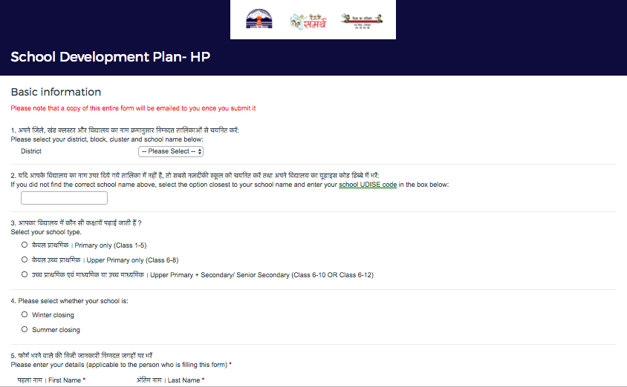
Need and process: Streamlined and digitized 1 year targets of School Development Plan to allow regular tracking and mentoring
Progress so far
1
Simple 3 page form that allows self-assessment & 1 year target selection
Pre-filled and flexible targets across learning level improvement, increasing community participation, infrastructure enhancement etc.
2
3
PDF of SDP automatically emailed to all block officials & integrated with OMR based Review & Monitoring forms for targeted inspections
Digitization at school or block level
4
Automatic SMS and email reminders to school leaders as deadline for target approaches

Slide 41
INNOVATIVE PRACTICES TO IMPROVE MANAGEMENT OF SCHOOLS
ASSESSMENT RESULT DIGITIZATION
OMR BASED REVIEW & MONITORING
TEXTBOOK DISTRIBUTION
PMIS
SMS PORTAL
DIGITIZED SCHOOL DEVELOPMENT PLAN
MID DAY MEAL
SWAYAM SIDHAM

Slide 42

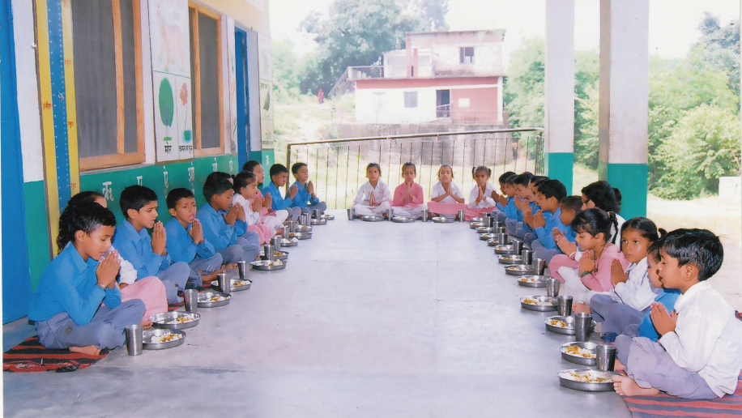
Coverage : Enrollment Vs Achievement
Students Praying before Mid Day Meal
Institutions | Enrolment | Achievement
PRIMARY | 3,17,448 | 2,95,069 (93%)
UPPER PRIMARY | 2,38,800 | 2,21,735 (93%)
Total | 5,56,248 | 5,16,804 (93%)
© Dept. of Elementary Education, Himachal Pradesh

Slide 43
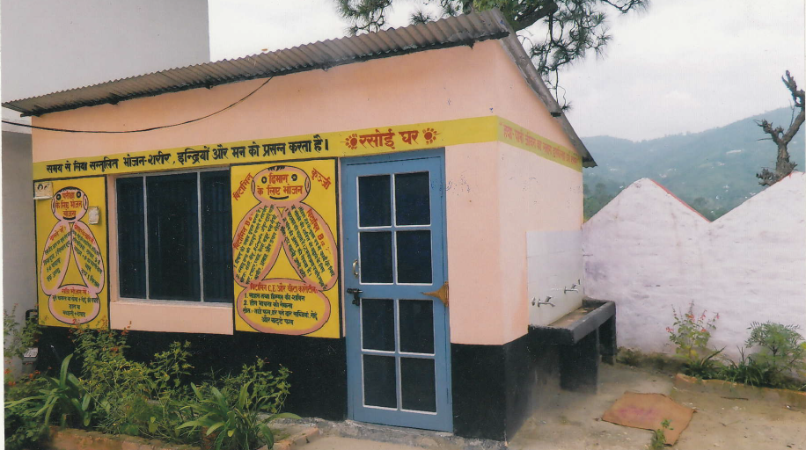
Status of Kitchen-shed (As on 31-03-2017 )
Year | Sanctioned | Completed | In-progress | Not started
2016-17 | 14,959 | 14,500 (96%) | 195(2%) | 264(2%)
GPS Nand,
Jhandutta,
Bilaspur H.P.

Slide 44
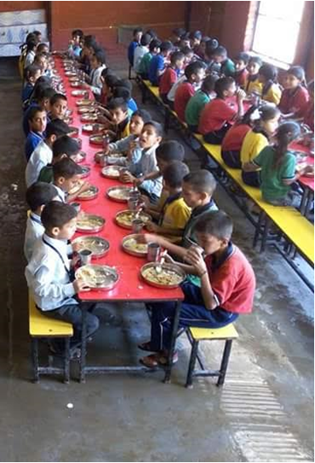
Students Enjoying the Mid Day Meal

Slide 45
Grievance Redressal Mechanism (GRM)
Toll Free number :-
Toll free number 1800-180-8007 has been established in the Directorate on 5.6.12. The complaints/ grievance are being attended on every working day between 10.30 am to 3.00 pm.
Provision of on- line registration of grievances :-
e_samadhan http://admis.hp.nic.in/esamadhan, on the web portal of HP Government . Public can register their grievance online. The grievances received through e_samadhan are monitored regularly by the department as well as by the Government.
Scheme is being regularly monitored by SMC, HT, CHT, BEEOs and Deputy Directors.
© Dept. of Elementary Education, Himachal Pradesh

Slide 46



Implementation Automated Reporting Monitoring System (ARMS)
The state has registered the mobile numbers of 30,000 respondent teachers from 15000+ schools MDM web portal designed and developed by NIC HP for SMS based mobile app for Automated Reporting and Management System (ARMS) of MDMS in all school working days.
At present, 90% schools are reporting through this mobile app and the same are being pushed on National Portal every day.
SMS
15544
MDM Mobile App
© Dept. of Elementary Education, Himachal Pradesh

Slide 47
Best practices followed in the State
The School Management Committees (SMC) have been constituted for every school and the SMC are responsible for the over all implementation of the programme at school level, therefore teachers are least involved.
22441 Cook-cum-helpers have been engaged out of which 83% are female and maximum of them are mothers of the students.
The state has enhanced the honorarium for Cook-cum- Helpers @ Rs. 200/- per month from state resources. Now the honorarium will be paid @ Rs. 1200/- per month to the CCH (900+100+200)
Health screening / checkup of cook-cum-helper is made mandatory twice in a year.
© Dept. of Elementary Education, Himachal Pradesh

Slide 48
Best practices followed in the State
Funds are being transferred to the implementing agencies through e-transfer. All the CCH are being paid through e-banking.
57cook-cum-helpers have been imparted training in the Hotel Management Institute Kufri ,Shimla till date as master trainer.
Funds amounting to Rs. 23.11 lakhs have been provided to 4622 schools @ Rs. 500/- per schools through e-transfer for hand washing facilities.
The cook cum helpers cover their head with cloth ( Dhatu) as it is already a tradition in the state of Himachal Pradesh.
89% of the schools are using LPG as a fuel.
© Dept. of Elementary Education, Himachal Pradesh

Slide 49
INNOVATIVE PRACTICES TO IMPROVE MANAGEMENT OF SCHOOLS
ASSESSMENT RESULT DIGITIZATION
OMR BASED REVIEW & MONITORING
TEXTBOOK DISTRIBUTION
PMIS
SMS PORTAL
DIGITIZED SCHOOL DEVELOPMENT PLAN
MID DAY MEAL
SWAYAM SIDHAM

Slide 50
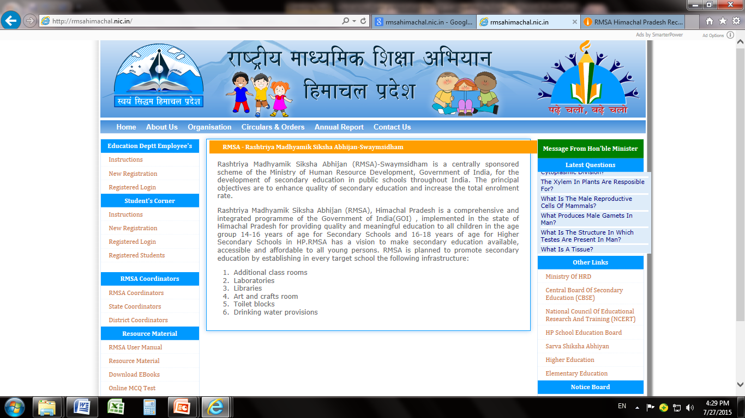
A Forum for Sharing Ideas and thoughts
The Portal (http://rmsahimachal.nic.in) designed for the purpose provides the interactive support to the teachers and the taught by providing the forum for sharing ideas classroom processes and prescribing defined learning Indicators and on line study material to prepare students for competitive examinations etc.

Slide 51

The 5 level question bank has bben developed in the form of 5 stage game
Root
stage
Root level or zero level questions
Only one question paper to qualify this stage
Take –off
stage
Level -I questions
If failed lock this level & send to basic Level notes
Smart
stage
Level -II questions
Intelligence
stage
Level -III questions
Genius
stage
Level -III + advance level questions
2 question papers each of 15 questions
On securing 50 % marks Smart Level will be unlocked
2 question papers each of 15 questions
On securing 50 % marks Intelligence stage will be unlocked & he/she will be entitled Smart
If failed lock this level and send back to take- off stage
3 question papers each of 15 questions
On securing 60 % marks Genius stage will be unlocked & he/she will be entitled Intelligent
If failed lock this level & send back to smart stage or send to advance level notes
On securing 70 % marks he/she will be entitled Genius
If failed lock this level & send to advance level notes or send to Intelligence stage
2 question papers each of 15 questions

