Slide 1

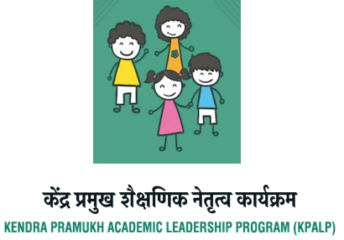


Findings of the
KPALP IMPACT STUDY

Slide 2
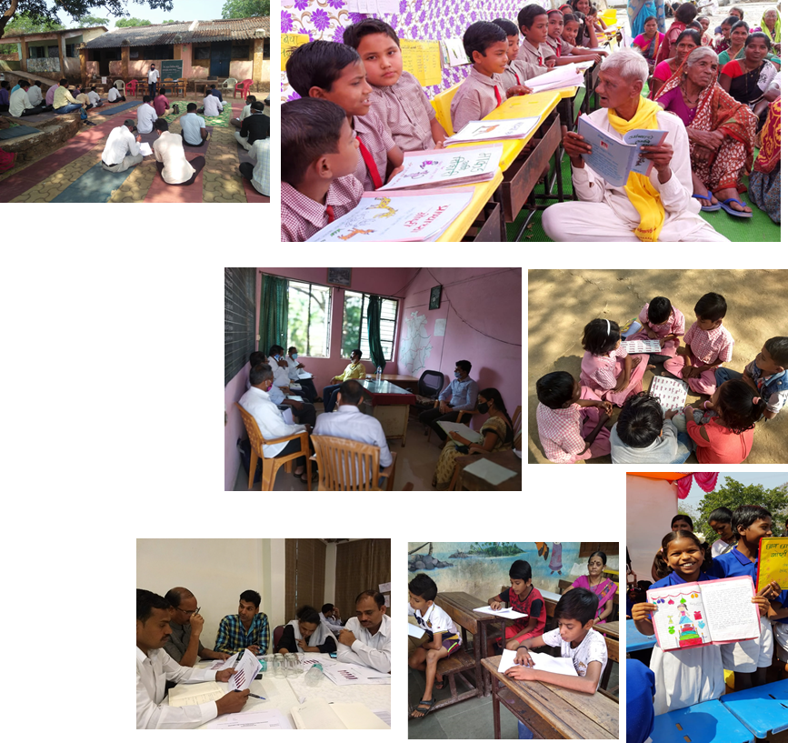
About KPALP
Professional development of mid level functionaries or Kendra Pramukhs
Enhance mentoring and teacher support skills
Data Analysis
Classroom Observation
Feedback
Action Planning
Self Assessment and Evaluation
KP Skill Matrix

Slide 3
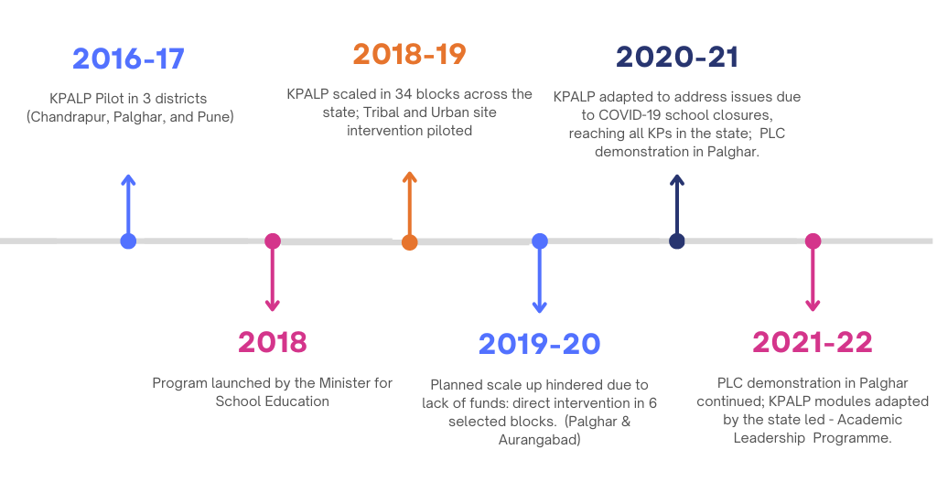
KPALP Timeline 2016-2022

Slide 4
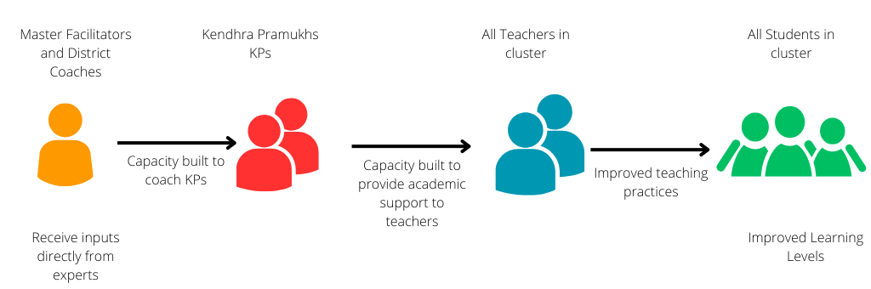
KPALP Capacity Building Approach

Slide 5
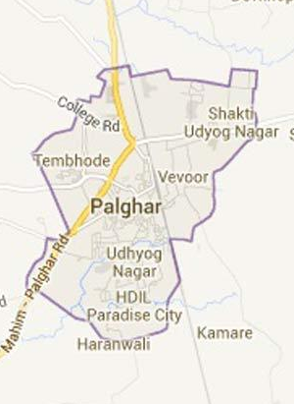
Introduction to the Study
Objectives: To analyse the programme design and implementation of the KPALP model in one district - Palghar
Study Methodology: In-depth interviews with programme stakeholders ( 10 KPs, 2 MFs, 6 teachers, Head Teachers and BRPs, representatives from UNICEF & CEQUE, and (government)
Research questions:
How has the KPALP programme been adopted on the ground?
What is the impact of the programme wrt changes in the attitudes/ skills and practices at the level of KPs and teachers?

Slide 6
Literature Review
Teacher Support
Pedagogic Decentralisation Teachers have the autonomy to contextualise their practice
Teacher Resource Centres & PLCs Creating a social learning environment to learn, share practice and develop a professional identity
Practice-based Professional Development Professional development opportunities are hybrid and practice-based focusing on teacher's classroom contexts
School-Based Support Academic support must be continuous, contextualised and school-based

Slide 7
Data Analysis- Round 1
Predetermined themes drawn from the interview schedule
Perceptions about Programme
Capacity Building
Teacher Support Processes
Teacher Practice
Scaling & Sustainability
Stakeholders perceptions about the programme goals, objectives and learnings.
Stakeholder’s understanding of the capacity building modules and their implementation in practice.
Stakeholder’s knowledge, attitudes and practices regarding teachers’ support processes.
Stakeholder’s knowledge, understanding and practices related to teacher school and classroom practices.
Stakeholders opinions about programme scalability and sustainability.

Slide 8
Data Analysis - Round 2
Themes inductively drawn from the data
Perceptions about KPALP
Capacity Building
Mentoring and Support
Change in Practice
Scaling & Sustainability
Design Team
Master Facilitators and Kendhra Pramukhs
Data Analysis & Classroom Observation
Feedback and Comment Technique & Action Planning
School Visits
Professional Learning Communities (PLC)
Attitudinal Changes
Cluster Level Meetings
Leadership during the pandemic Period
Teacher Support in Tribal Areas
Progress Tracking
Programme Sustainability

Slide 9
Findings
Changes in KPs knowledge/skills, attitudes and practices
“
“
KPs' classroom observation, data analysis, feedback provision, and collaborative action planning skills improved substantially as a result of KPALP's capacity building.
KPs modified their mentoring and support practices, providing more positive feedback and following up with teachers to encourage them to take risks and innovate in the classroom.
Observable shifts in attitudes towards teachers and work;
More focus on student learning data in order to identify learning gaps and hold teachers accountable.
The development of action plans to enhance teacher practise.
We did not feel any kind of fear about KP because KPALP had changed the role from inspector to mentor or guide and that change made us more supportive in resolving the problems. Students also do not feel uncomfortable about her visit. She used to sit with the students and students also confidently answered her questions. Students ask KP when she will visit our school next time.
Teacher 5, GPS, Palghar
Earlier we just used to observe the classroom, but through Five D [model], now we know how to observe the class, how to see students' performance and learning outcomes, so now we focus on minor issues.
KP2

Slide 10
Findings
Changes in school processes
“
“
KPs offered more academic assistance and were viewed as mentors as opposed to inspectors.
KPs developed beneficial relationships with teachers, principals, and even students.
KPs believed that more decision-making authority at the cluster level would facilitate more effective implementation of action plans.
When I was sitting with students and asking any questions related to the syllabus, students raised their hands and said, ‘Sir me…. Sir me … sir me’ that is the indication of the progress in their understanding.
KP7
I worked under several KPs and I found that the feedback from the KPs has changed from the aspects of attendance of the teachers and administrative work to the performance of the students.
Head Teacher, GPS, Palghar

Slide 11
Findings
Change in adopting active pedagogies
“
Teachers introduced novel approaches to expressive talk and writing in classrooms.
KPs were able to provide innovative pedagogical ideas primarily in areas where experts had offered assistance and provided scaffolds in the form of models and templates.
KPs inspired teachers by sharing and recognising their innovations during cluster meetings.
KPs possessed a more nuanced comprehension of learning issues pertaining to tribal children.
There is a lack of pedagogical knowledge among KP. There is scant evidence of pedagogical change regarding numeracy.
Whenever I find any kind of negativity among the teachers about the performance of the tribal students, then I tell the teachers very respectfully and politely, that these are our students, so you should respect them, and our responsibility is to teach them to make their performance better. If you have any issues or need any kind of help then please get back to me, I am here to support you to resolve the issues.
KP1

Slide 12
Findings
Change in adopting active pedagogies
“
KPs demonstrated leadership by digitising the processes of capacity building and mentoring.
When it came to the lack of resources and devices among students, KPs were powerless, and they expressed genuine concern for the learning loss they observed when schools reopened.
In Covid period, physical teaching was stopped at school and we were communicating with students or their parents on mobile. Whenever possible we were going to the local area to observe whether students are studying or not. We were checking their homework to ensure that students are in process of learning. We also gave some responsibility to the local youth who could track the progress of the students.
Teacher 6, GPS, Palghar

Slide 13
Findings
Operation of the PLCs established for KPs
“
PLCs provided a useful forum for peer-to-peer sharing and learning.
KPs were provided with pedagogical inputs by experts via PLC.
Through PLCs, KPs were able to better understand their academic role.
KPs were able to translate PLC practices in teacher meetings at the cluster level. PLCs provided a platform for KPs to develop their professional identities.
We are exchanging ideas in our PLC that whatever good things or innovation appears in the block in teaching, we demonstrate it in PLC or make other KPs understand it and make effort to include that activity in their schools.
KP9

Slide 14
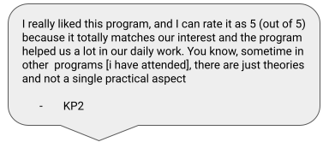
Impact
KPALP (pilot) was successful based on the data analysis and findings presented.
KPs have developed the skills and knowledge of mentoring based on the professional development they have received and have altered their attitudes towards mentoring in order to build positive relationships with teachers, resource persons, block leaders, and even students.
Stakeholders were able to identify specific improvements in KPs' skills, attitudes, and practices at all levels of the system, from the school to the block level.
In the five blocks we visited in the Palghar district, the programme appears to have diffused into the system and permeated.

Slide 15
Impact
“
KPALP (pilot) was successful based on the data analysis and findings presented.
KPs have developed the skills and knowledge of mentoring based on the professional development they have received and have altered their attitudes towards mentoring in order to build positive relationships with teachers, resource persons, block leaders, and even students.
Stakeholders were able to identify specific improvements in KPs' skills, attitudes, and practices at all levels of the system, from the school to the block level.
In the five blocks we visited in the Palghar district, the programme appears to have diffused into the system and permeated.
We are exchanging ideas in our PLC that whatever good things or innovation appears in the block in teaching, we demonstrate it in PLC or make other KPs understand it and make effort to include that activity in their schools.
KP9

Slide 16
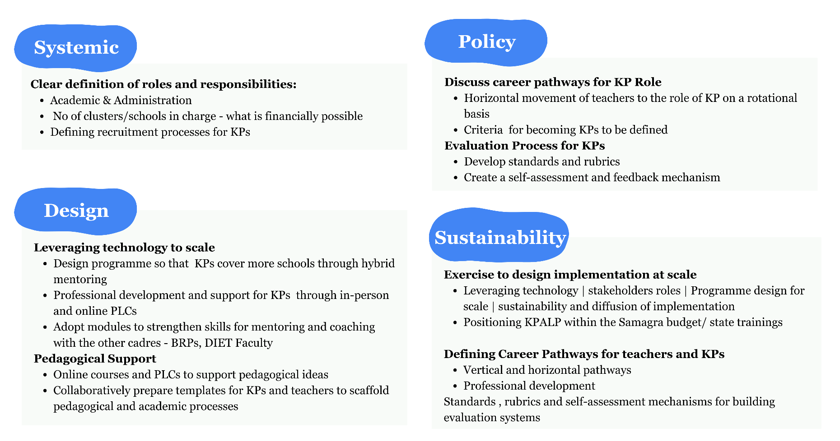
Recommendations

Slide 17
Thank You
Authoring and Research (CETE, TISS, Mumbai)
Bindu Thirumalai, Assistant Professor
Surendra Bhalerao, Research Assistant
Ravi Chalwadi, Research Assistant
Muhammad Suhaib, MA Education Student
Translations
Surendra Bhalerao, Research Assistant
Ravi Chalwadi, Research Assistant

Slide 18
References
Cohen, D. K., & Ball, D. L. (2000). Instructional innovation: Reconsidering the story. In Annual Meeting of the American Educational Research Association, New Orleans.
Daly, A.J. (2015). Social Network Theory and educational change. Harvard Education Press, Cambridge, Massachusetts, USA.
Darling-Hammond, L., Hyler, M. E., Gardner, M. (2017). Effective teacher professional development. Palo Alto, CA: Learning Policy Institute. Retrieved December 12, 2019 from https://learningpolicyinstitute.org/sites/default/files/productfiles/Effective_Teacher_Professional_Development_REPORT.pdf
Giordano, E. (2008). School clusters and teacher resource centres: Fundamentals of educational planning. UNESCO: International Institute for Educational Planning, Paris 2008.
Government of India [GoI]. (2011). Approaches to School Support and Improvement. New Delhi. MHRD.
GoI (2012). Ministry of Human Resource and Development [MHRD]. Vision of Teacher Education in India. Quality and Regulatory Perspective. Report of the High-Powered Commission on Teacher Education Constituted by the Hon’ble Supreme Court of India. Volume 1.
GoI(2020). National Education Policy 2020. New Delhi. MHRD
Hoppers, W. H. M. L. (1998). Teachers’ resource centres in Southern Africa; an investigation into local autonomy and educational change. International Journal of Educational Development, 18(3), 229–246.
Lim, C.P., Juliana & Liang, M.(2020). An activity theory approach toward teacher professional development at scale (TPD@Scale): A case study of a teacher learning center in Indonesia. Asia Pacific Educ. Rev. 21, 525–538.. https://doi.org/10.1007/s12564-020-09654-w

Slide 19
Marrongelle, K., Sztajn, P., & Smith, M. (2013). Scaling up professional development in an era of common state standards. Journal of teacher education, 64(3), 202-211.
OECD (2019), “Raising the attractiveness of a career in schools”, in Working and Learning Together: Rethinking Human Resource Policies for Schools, OECD Publishing, Paris.
Olsen, B., Rodríguez, M., & Elliott, M. (2022). Deepening Education Impact: Emerging Lessons from 14 Teams Scaling Innovations in Low-and Middle-Income Countries. Ongoing Analysis from the ROSIE Project. Center for Universal Education at The Brookings Institution.
Patton, M. Q. (1990). Qualitative evaluation and research methods (2nd ed.).Thousand Oaks, CA, US: Sage Publications, Inc.
Rogers, Everett M. (1995), Diffusion of Innovations, Fourth edition, New York, Free Press.
Sancar, R., Atal, D., & Deryakulu, D. (2021). A new framework for teachers’ professional development. Teaching and Teacher Education, 101, 103305.
Sarangapani P.M. (2021) A Cultural View of Teachers, Pedagogy, and Teacher Education. In: Sarangapani P.M., Pappu R. (eds) Handbook of Education Systems in South Asia. Global Education Systems. Springer, Singapore.
Sarangapani, P., Nawani, D. (2013). Collaborative Action Research On the Influence and the Impact of Teacher Resource centres - Report. TISS Mumbai. Sayed, Y. (2002) Democratising Education in a Decentralised System: South African policy and practice, Compare: A Journal of Comparative and International Education, 32:1, 35-46
Sayed, Y. (2010) Globalisation, educational governance and decentralisation: promoting equity, increasing participation, and enhancing quality? 40:1, 59-62.
Sayed Y., Sarangapani P.M. (2020) Understanding Teachers and Teaching in South Asia. In: Sarangapani P., Pappu R. (eds) Handbook of Education Systems in South Asia. Global Education Systems. Springer, Singapore.
Singh A.K., Rind I.A., Sabur Z. (2020) Continuous Professional Development of School Teachers. In: Sarangapani P.M., Pappu R. (eds) Handbook of Education Systems in South Asia. Global Education Systems. Springer, Singapore.
Thirumalai, B, Ramanathan, A, Charania, A, Stump, G (2019). Designing for Technology Enabled Reflective Practice: Teachers’ Voices on Participating in a Connected Learning Practice. In Teaching and Teacher Education. South Asian Perspective. Setty, R., Iyengar, R., Witenstein, M., Byker, E.J., Kidwai, H. (Eds.), Palgrave Macmillan.

Slide 20
Thirumalai, B. (2022). A Study of Teachers’ Community of Practice in the Indian Context. Unpublished doctoral dissertation submitted to the Tata Institute of Social Sciences, Mumbai.
Thirumalai, B & Sarangapani, P.M. (2018). Building Teacher Professional Communities in India: an examination of the APPEP experience of Teacher Centres. Presented in 2018 at CESI, Vadodara, India.
UNESCO (2021) No Teacher, No Class. State of the Education Report for India, UNESCO, India.
UNICEF(2019). Scaling innovation for every child. Strategies, models and critical success factors that emerged from 1,600+ days of scaling innovations for children across 90 countries, UNICEF.
Wolfenden, F. (2022). TPD@Scale: Designing teacher professional development with ICTs to support system-wide improvement in teaching. Foundation for Information Technology Education and Development.

